Slide 1
What Do They Know?
Reed College Library (2010)
The ILL Usability Project at Reed College
Eric Alwine
Resource Sharing Specialist
alwinee@reed.edu
Annie Downey
Associate College Librarian & Director of Research Services
adowney@reed.edu
Joe Marquez
Web Services Librarian
jmarquez@reed.edu

Slide 2
The ILL Usability Project at Reed College
Our goal: to initiate ongoing assessment and improvement of Reed’s Interlibrary Loan service.

Slide 3
ILL is mysterious.

Slide 4
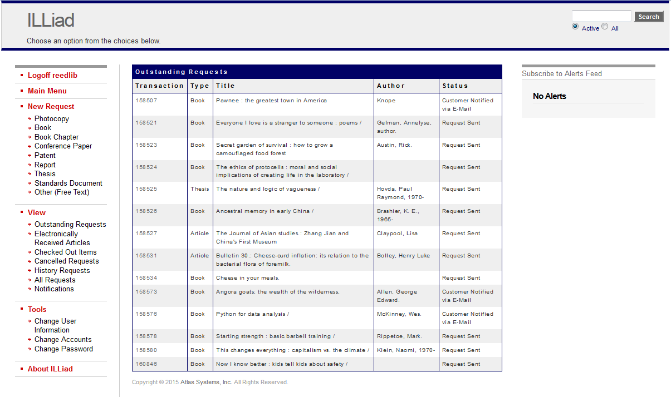

Slide 5
LUX
LUX = Library User Experience Group
Our Mission: To better understand how the library and its resources are used.

Slide 6
Service Design
“Service design is a holistic, co-creative, and user-centered approach to
understanding customer behavior for the creation or refining of services.”
More than just a process. It is a mindset.

Slide 7
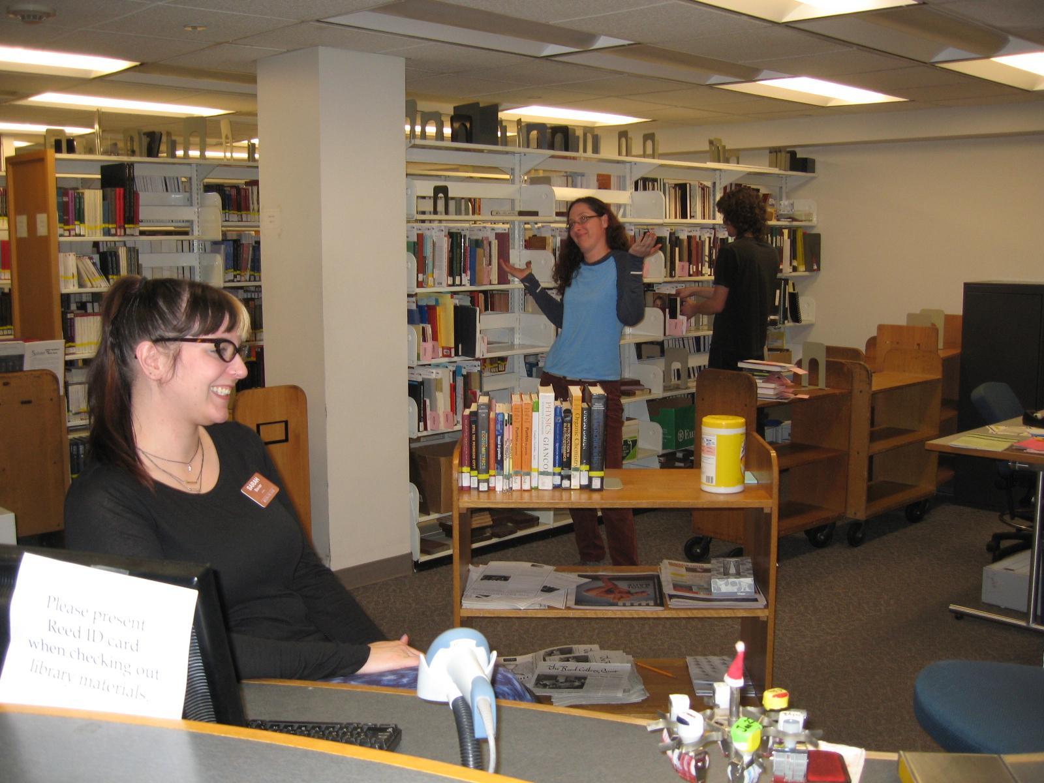
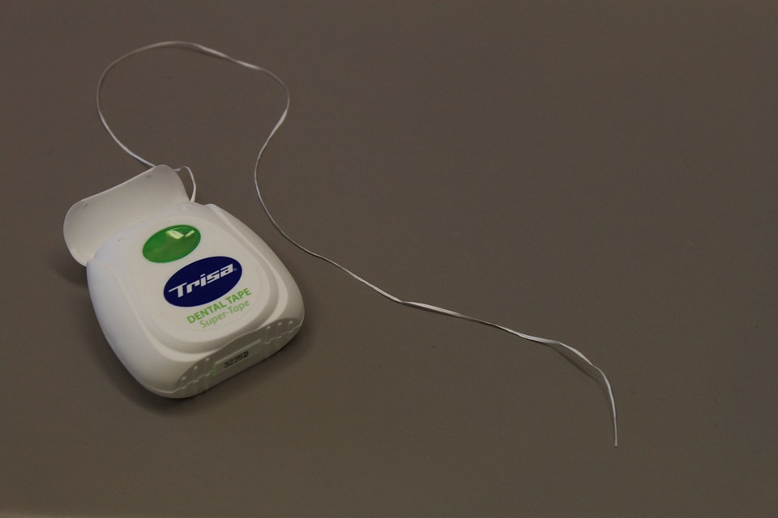
Objectives:
Improve ILL service for users
Optimizing and demystifying ILL workflows for staff
UX
Start a usability testing “habit”
Reed College Library (2010)

Slide 8
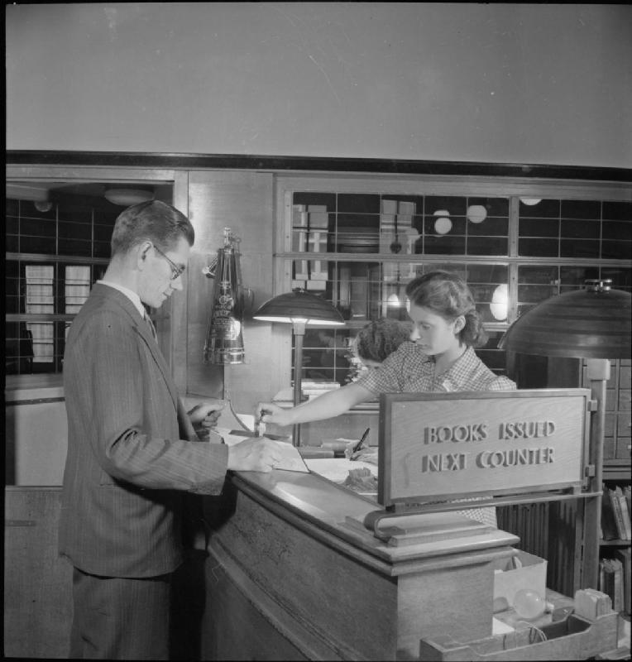
The Plan
Staff Experience
Workflow Chart
Student Worker Perspective
Interdepartmental Outreach
User Experience
ILL Survey
Usability Studies

Slide 9
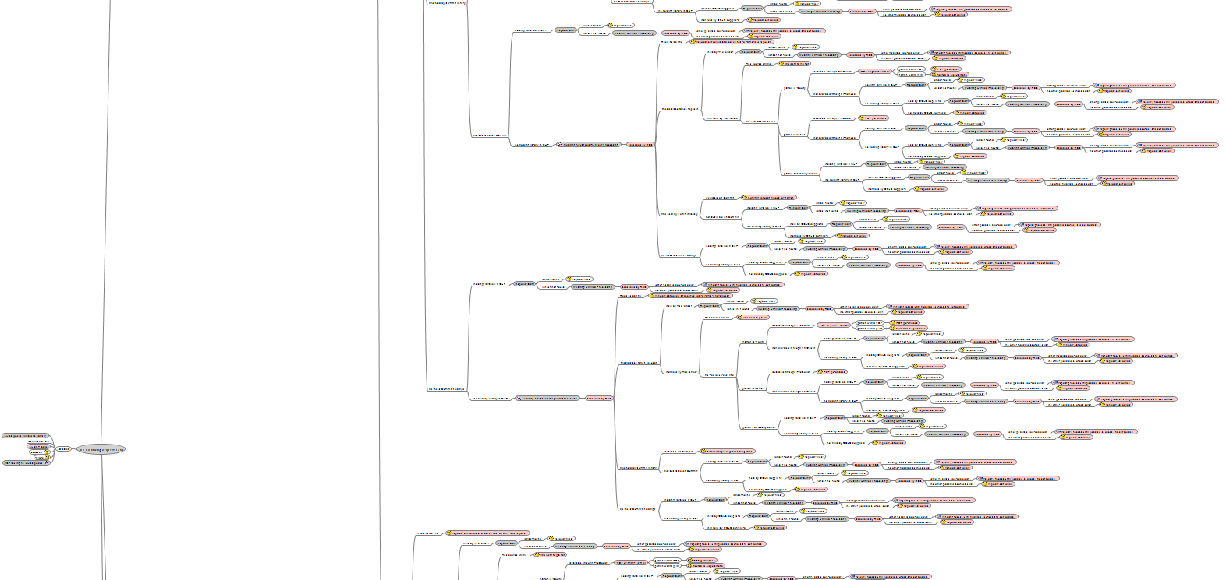
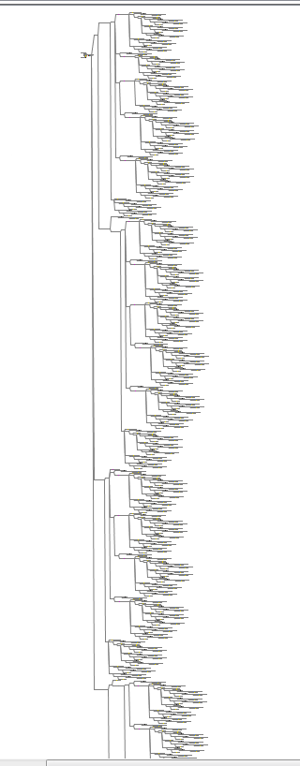
Workflow Visualization
Nope.

Slide 10
Student Worker Perspective
Activities
“A week in the job” notes
“Focus Group”
Tips
Focus on process
Connect end user experience with staff experience
Identify problem points and time spent on tasks

Slide 11
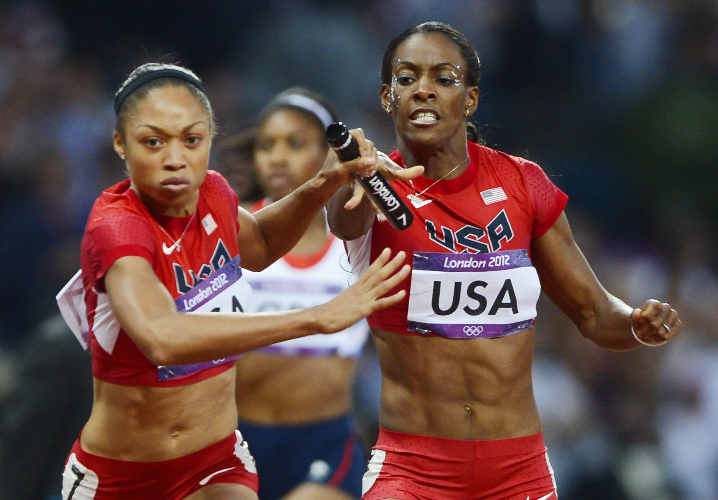
Interdepartmental Outreach
Notes:
Librarians meeting; Dummy ILL account (with routing rules for safety)

Slide 12
User Experience

Slide 13
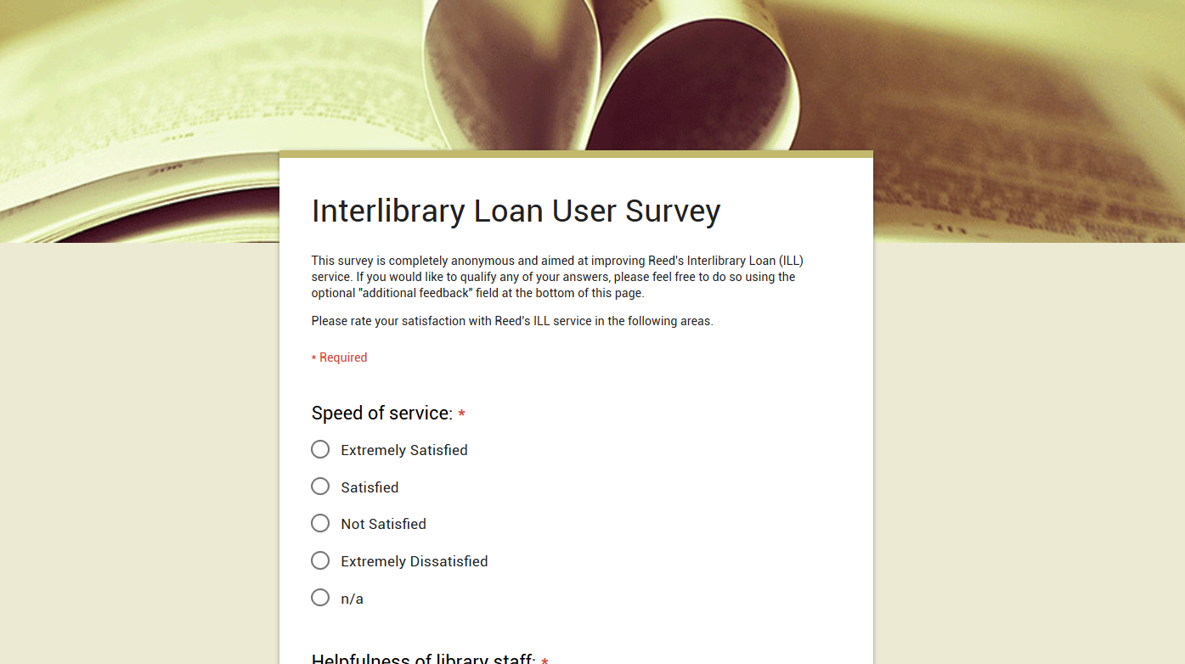
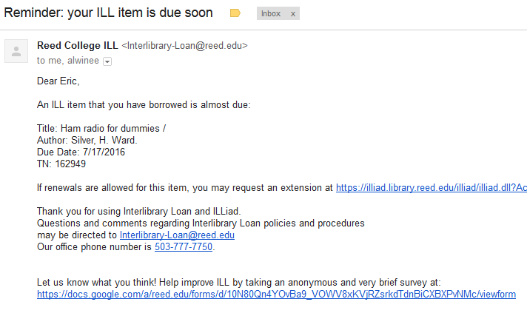
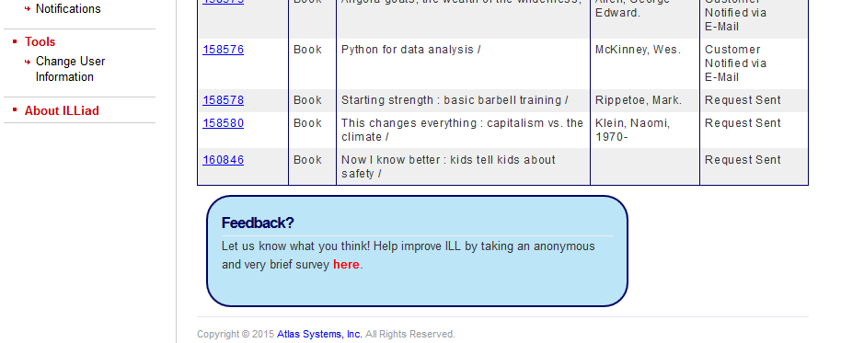

Slide 14
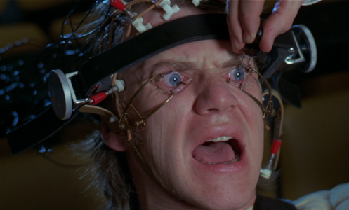
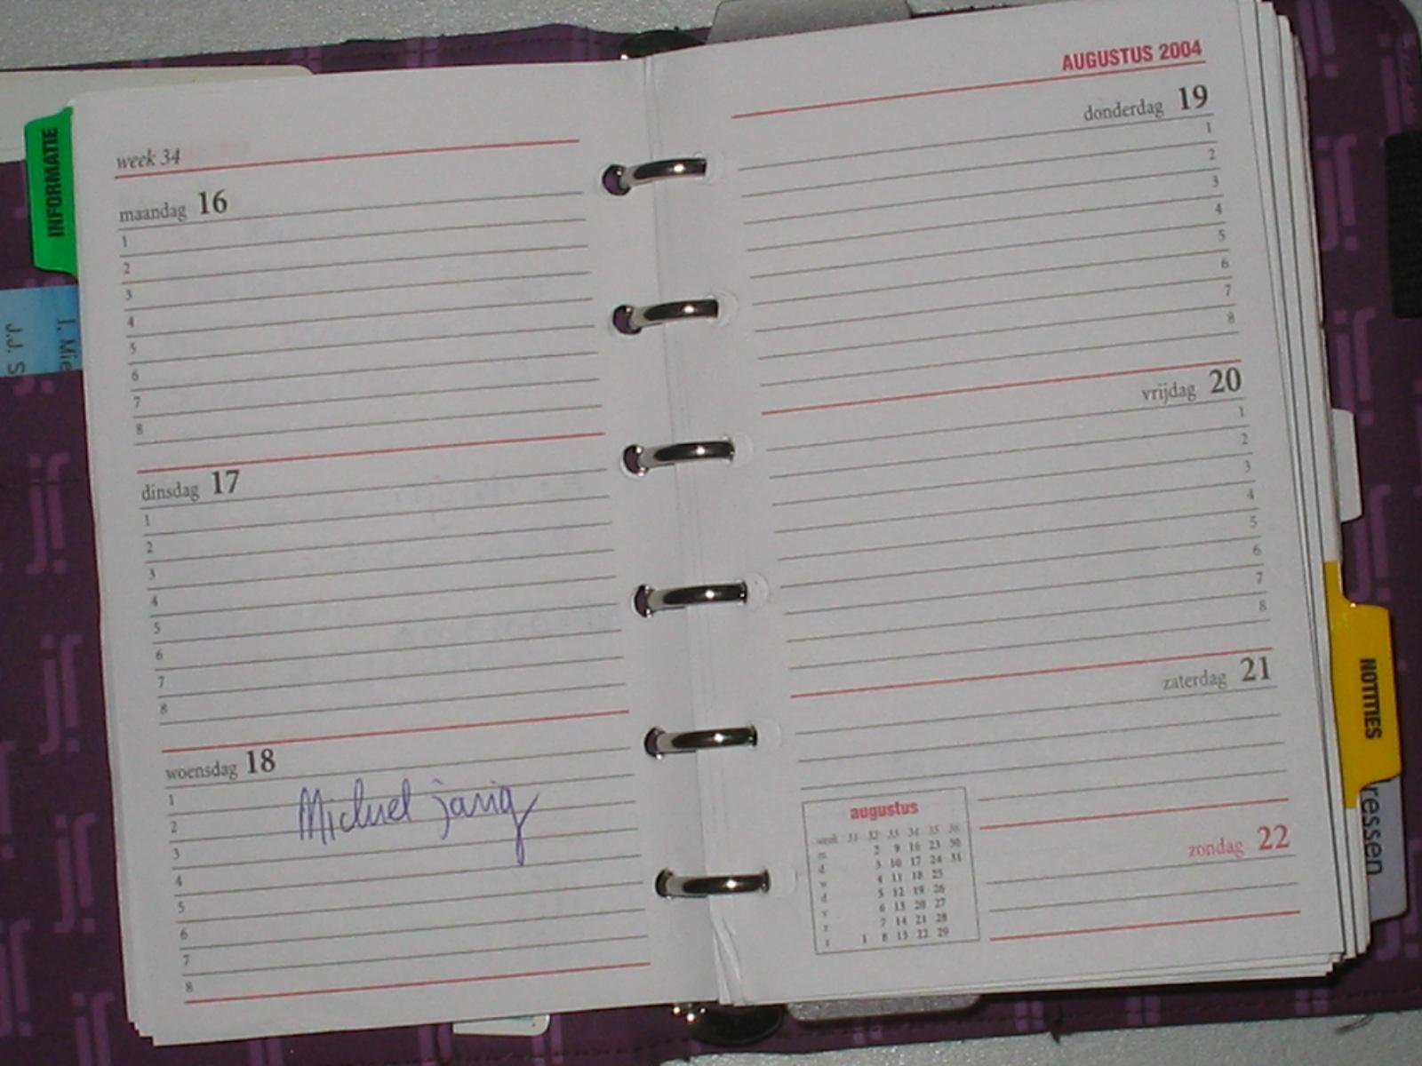
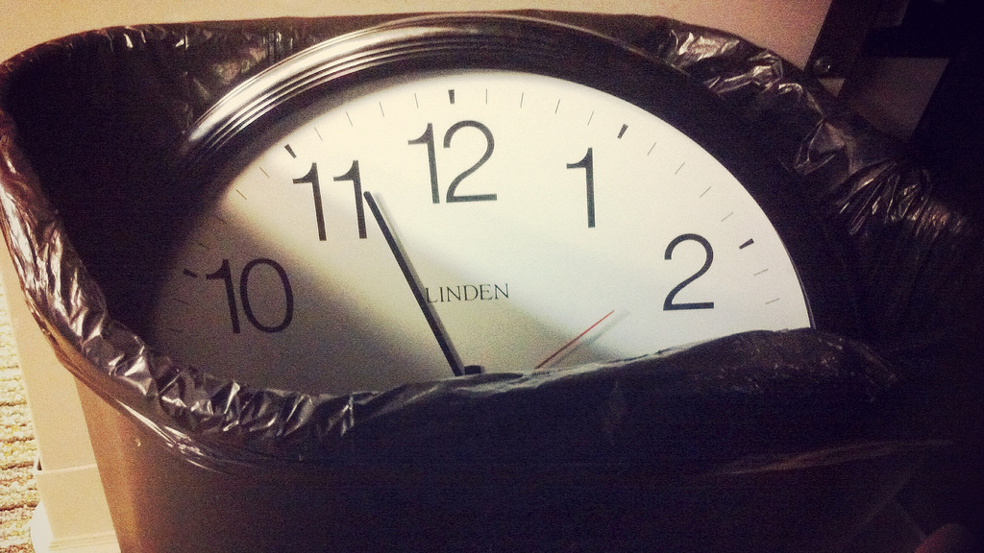
Usability Testing
“If you want to know whether your [service or product]... is easy enough to use, watch some people while they try to use it and note where they run into trouble. Then fix it, and test it again.”
-Steve Krug, Don’t Make Me Think!: A Common Sense Approach to Web Usability
Costs:
expensive software
equipment
appointments
time commitment
incentives
https://www.coredevx.com/site/wp-content/uploads/2016/05/usability-test.jpg

Slide 15
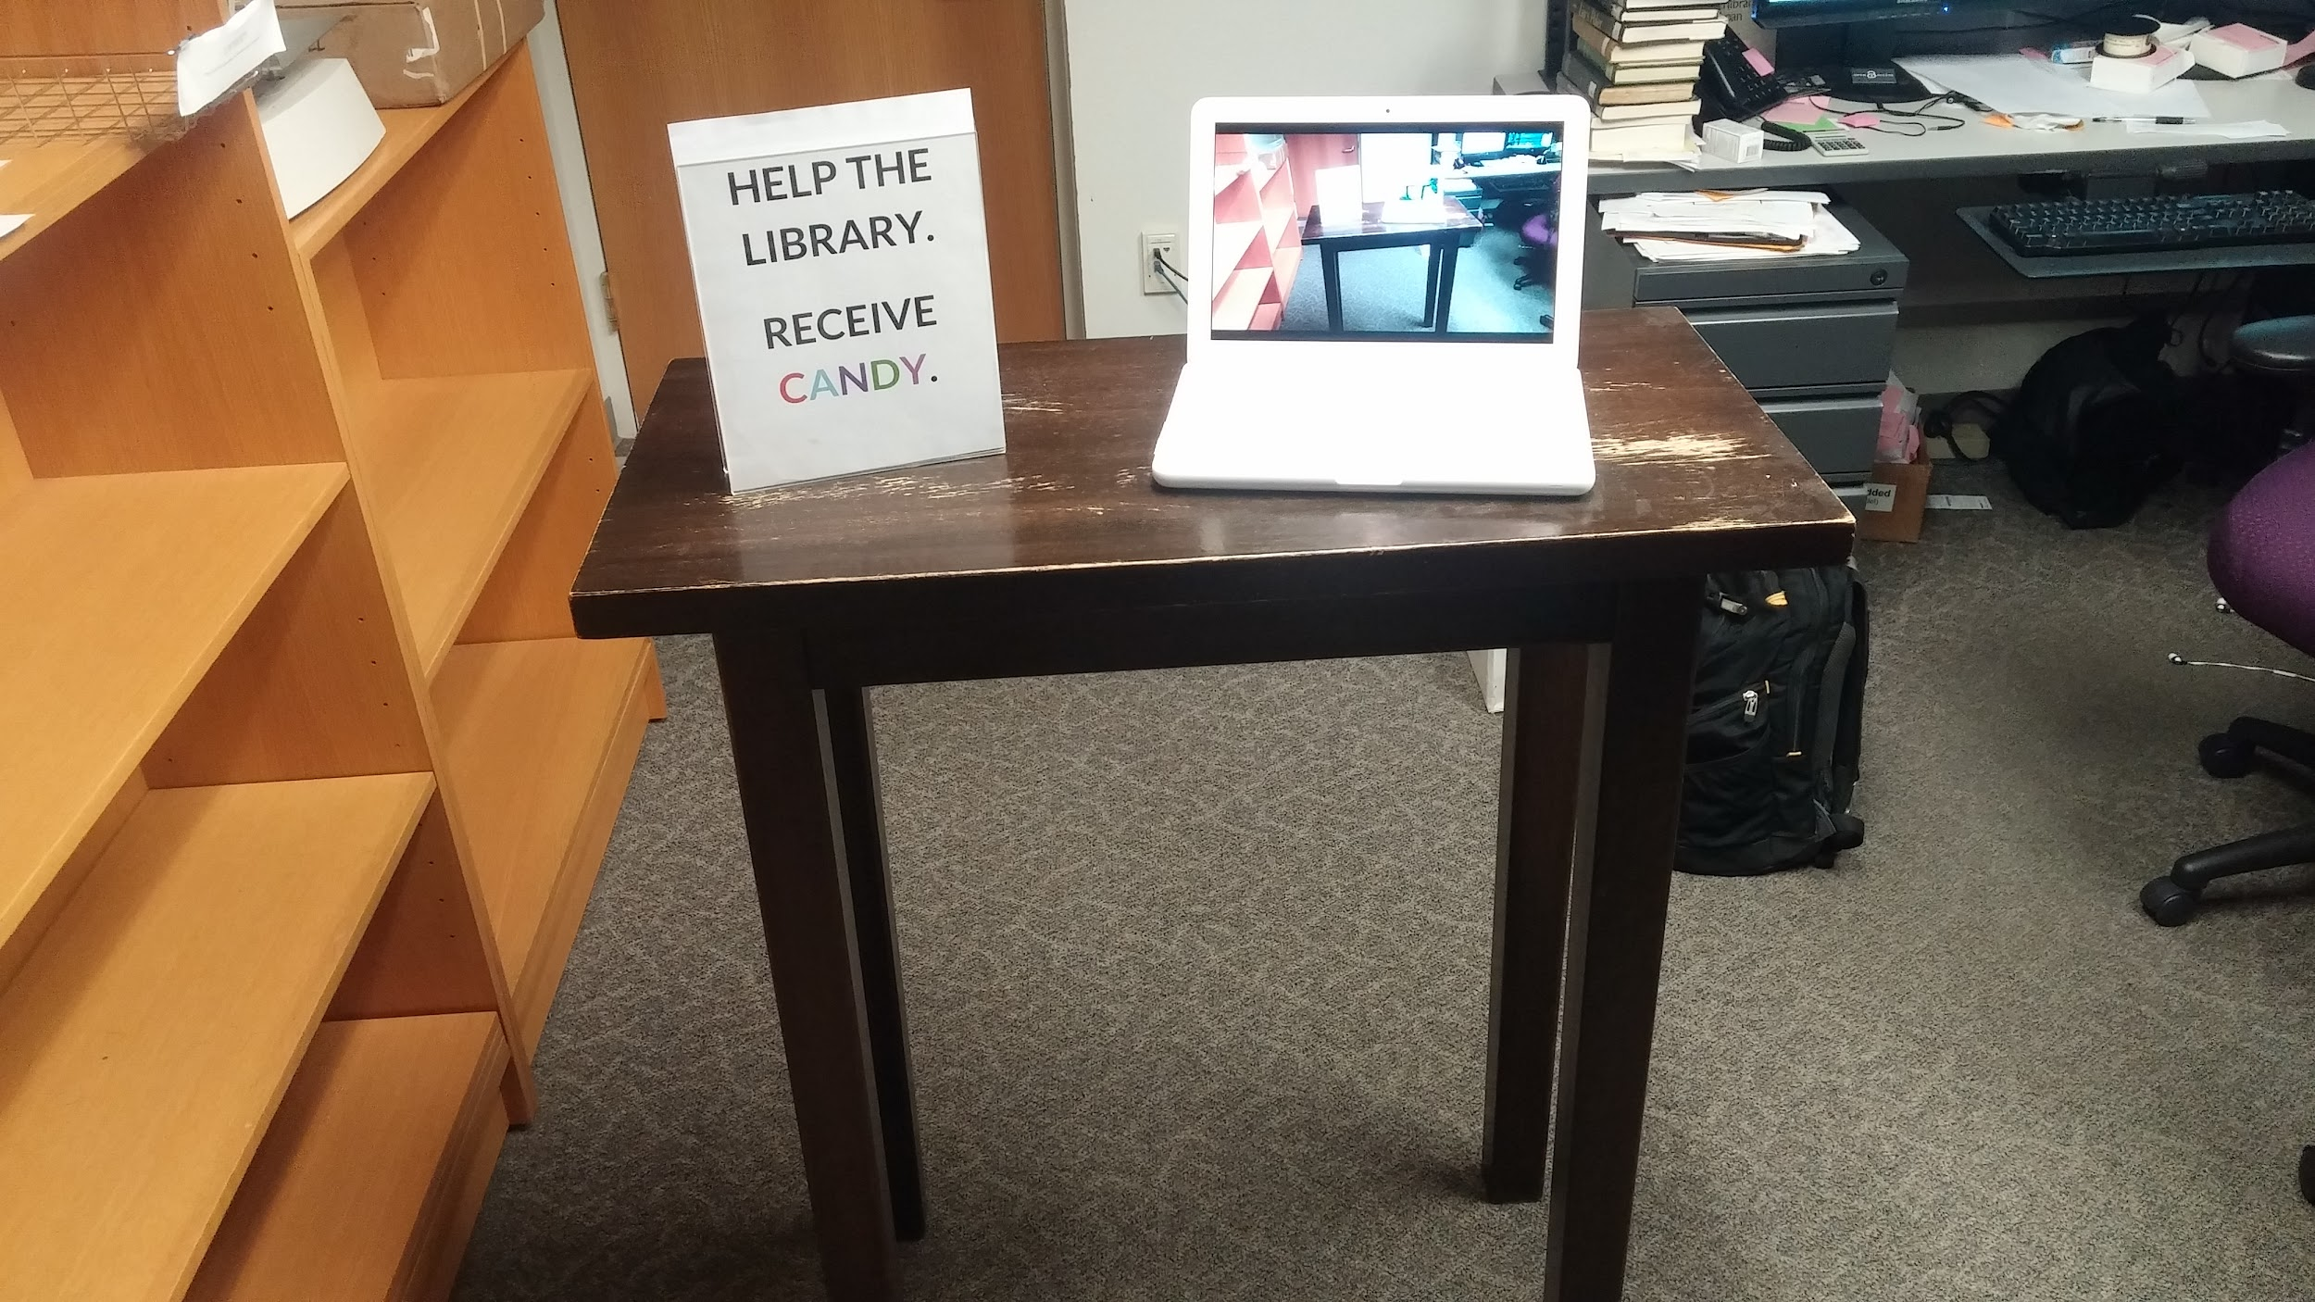
Usability Testing

Slide 16
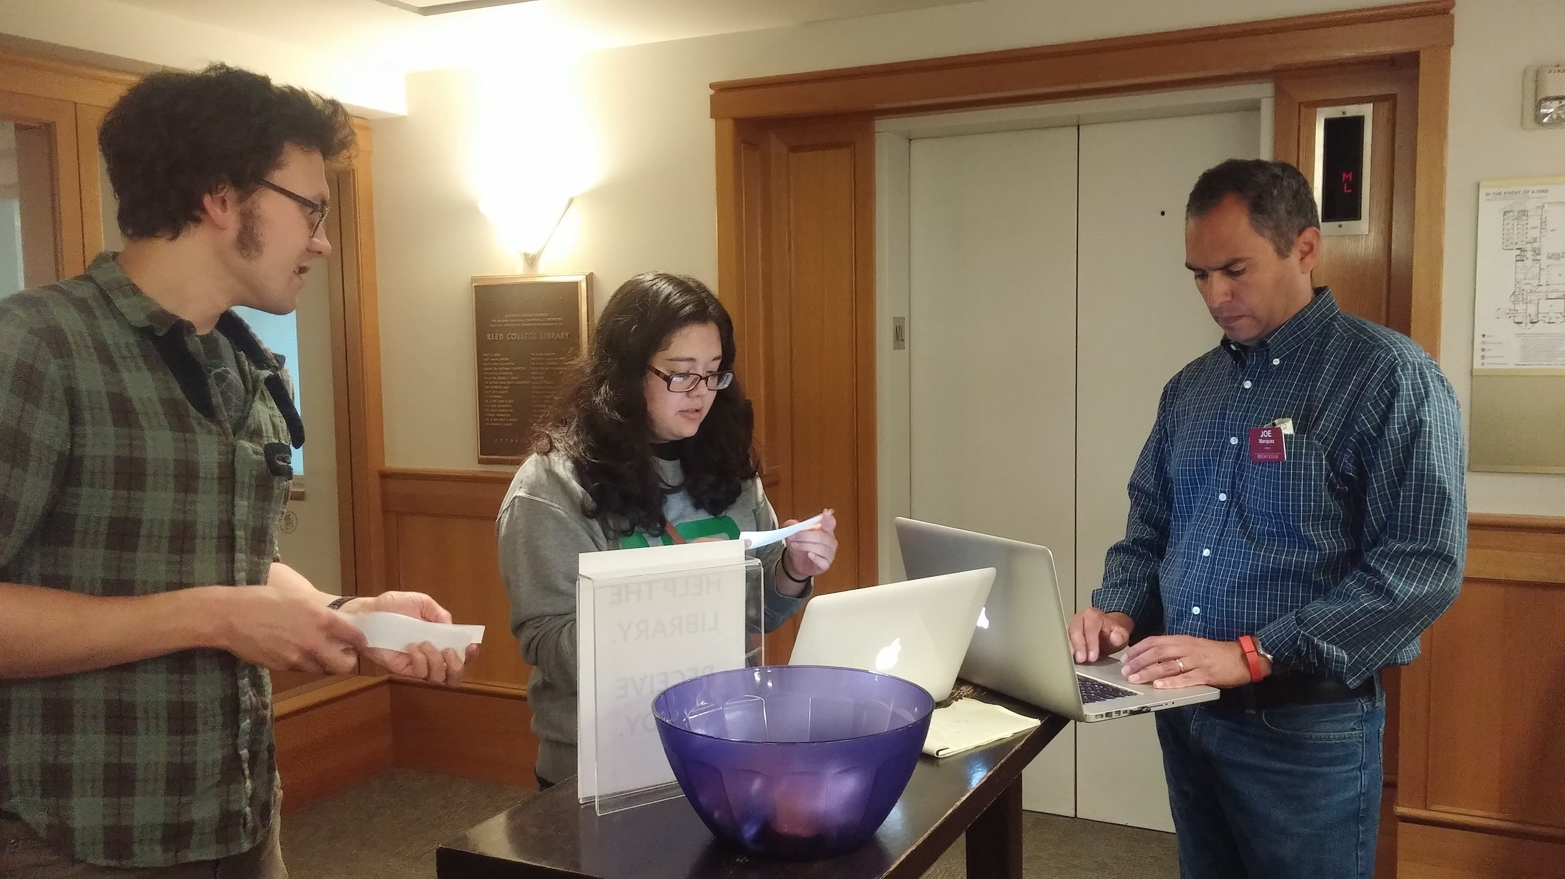

Slide 17
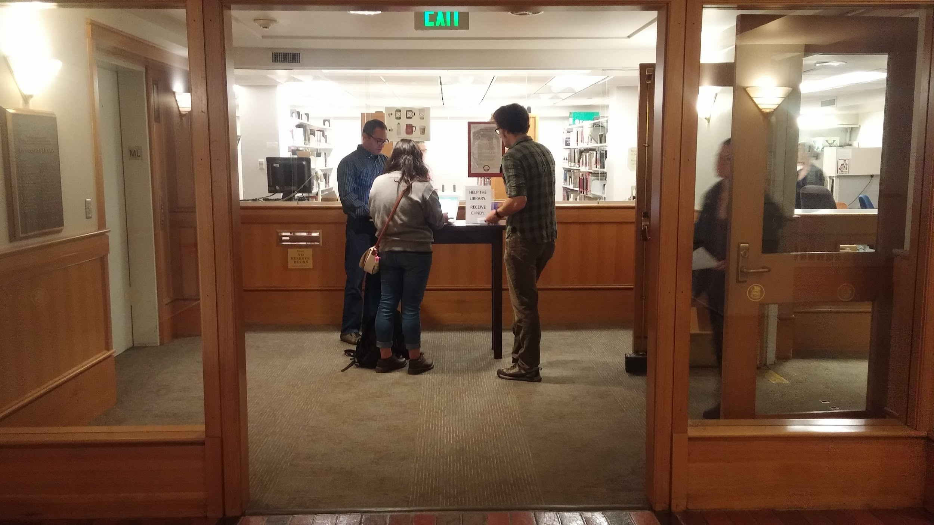

Slide 18
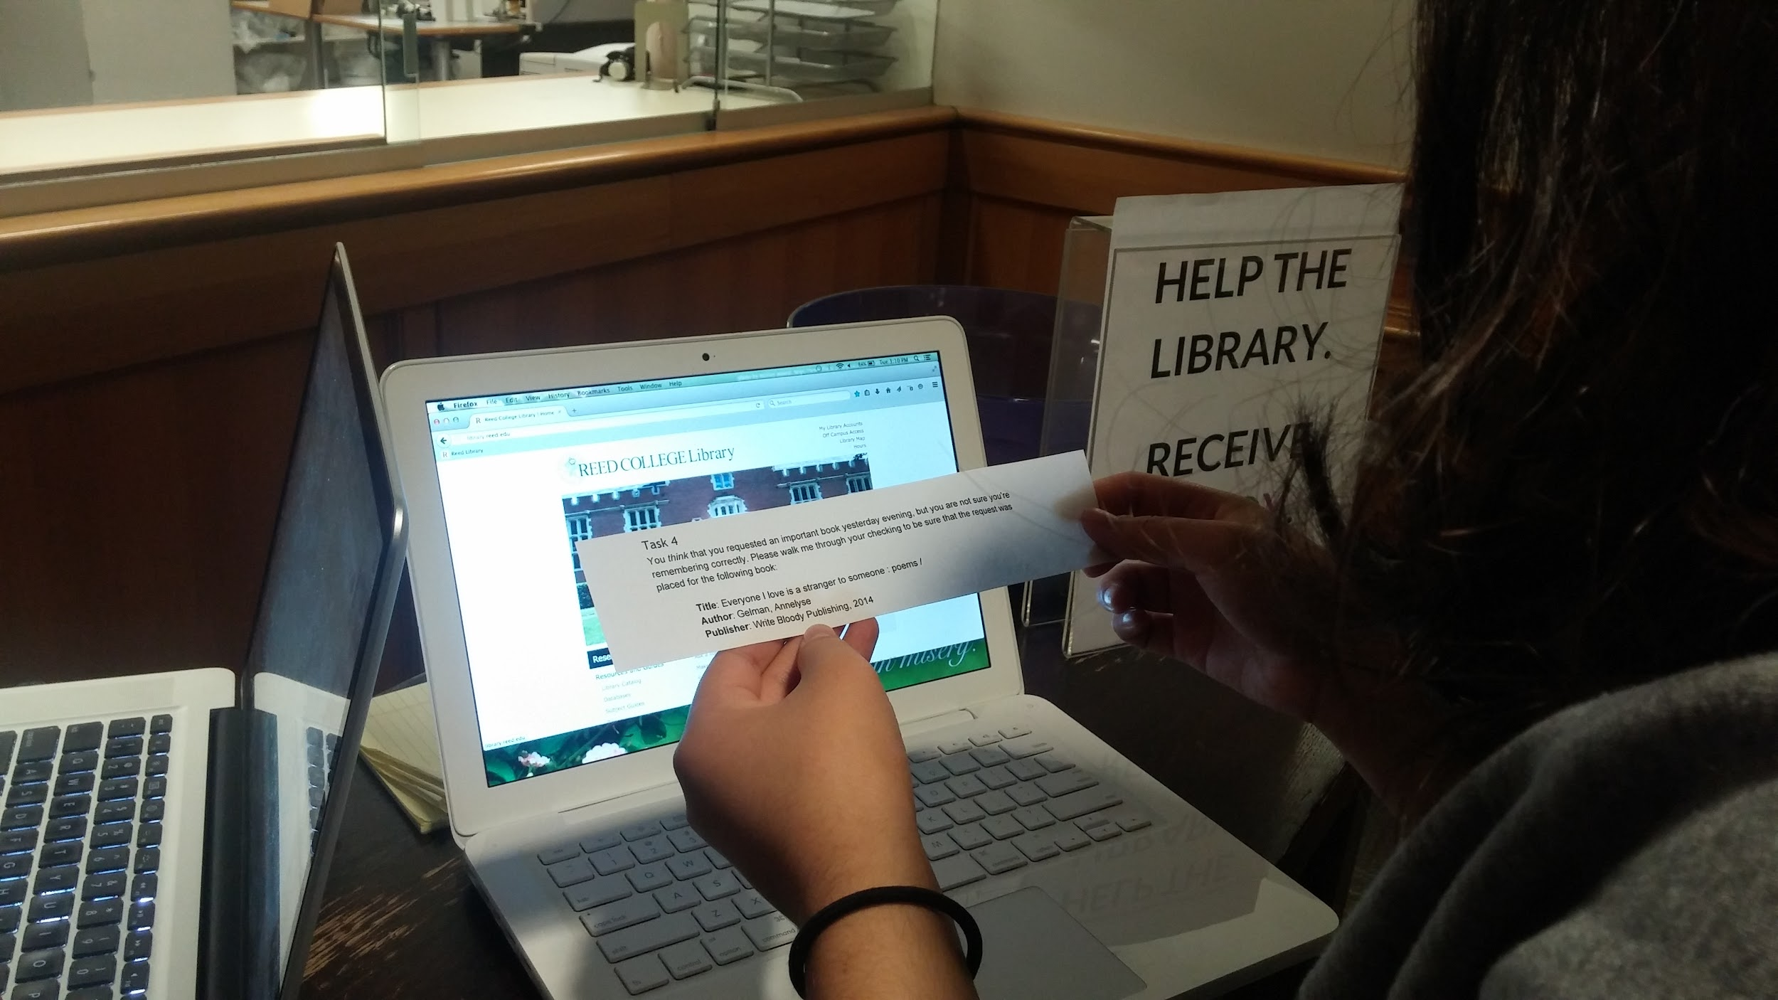

Slide 20
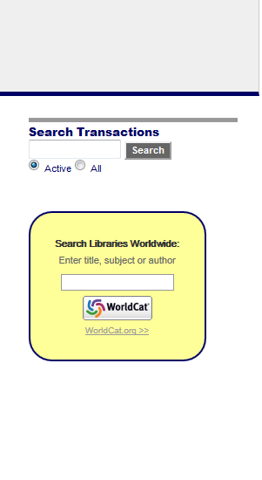
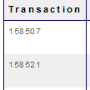
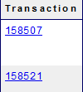
→
→
→
→

Slide 21
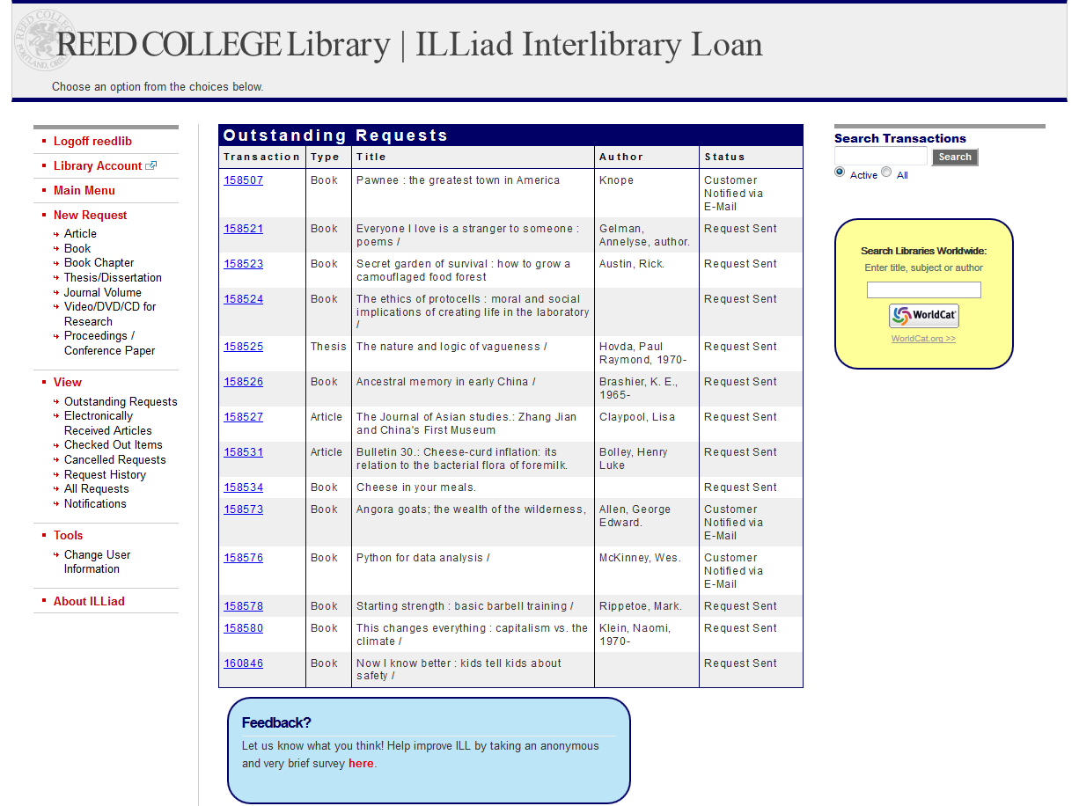

Slide 22
Lessons Learned
Student workers are an excellent resource
A little qualitative data can go a long way
Regular usability testing can be cheap and easy

Slide 23
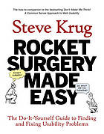
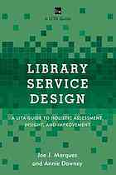
Literature
Rocket surgery made easy : the do-it-yourself guide to finding and fixing usability problems
by Steve Krug
Library service design : a LITA guide to holistic assessment, insight, and improvement
by Joe Marquez and Annie Downey

