Slide 1
Professional Development for Student Employees: Creating and Supporting a Learning Culture
Kate Ball Jones
Resource Sharing Operations Specialist
University of Oregon Libraries

Slide 2
Learning Outcomes
Explore the definition of learning culture.
See the benefits of creating a learning culture for your student employees, yourselves, your libraries, and your academic institutions.
Come away with inspiration and resources to customize ideas for your own workplace.

Slide 3
What is a “learning culture”?
A learning culture is a set of organizational values, conventions, processes, and practices that encourage individuals—and the organization as a whole—to increase knowledge, competence, and performance.
-Oracle Human Capital Management
A learning culture consists of a community of workers instilled with a “growth mindset.” People not only want to learn and apply what they’ve learned to help their organization, they also feel compelled to share their knowledge with others.
-Society for Human Resource Management
Training culture will often be seen in place of a learning culture because it’s easier to classify things this way.
-Nick Leffler, Instructional Design Consultant #lrntoday

Slide 4
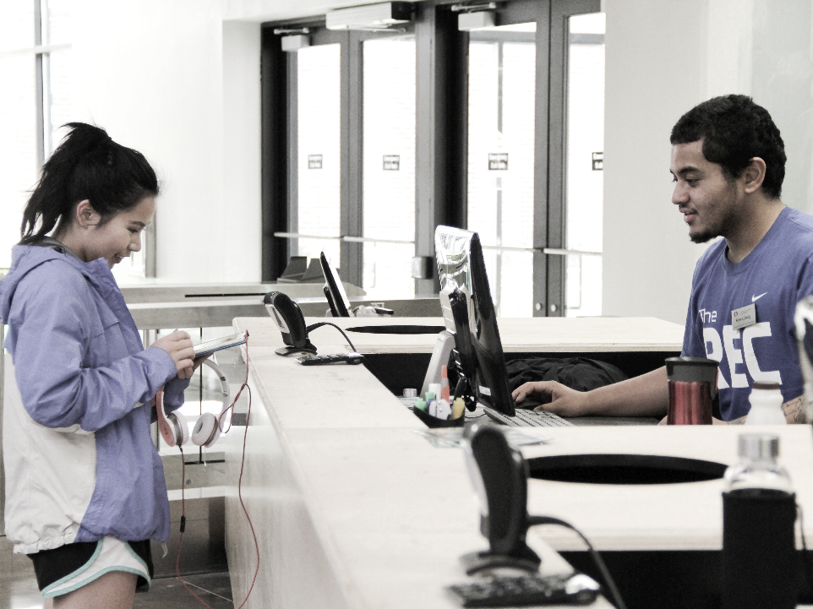
Why is campus employment important for students?
On-campus employment is a vital part of the college experience that will make students competitive and successful in their careers after graduation.
50%
Employers
Difficulty finding qualified college graduates to hire
(American Council of Trustees & Alumni, 2013)
56%
Employers
Satisfied with the workplace preparation of college graduates
(Association of American Colleges & Universities, 2013)
83%
Employers
Will not hire college graduates without meaningful professional experience
(CERI, 2012)

Slide 5
Student employment
in libraries has the power and possibility to cultivate these competencies.
Creating professional development and a culture of learning will benefit students in any fields they pursue after graduation.

Slide 6
Make your student library jobs “real” with interviews, professional development opportunities, and performance evaluations to prepare students for life after graduation.
Creating a learning culture in the workplace teaches what it means to have a career and illuminates transferable skills that are an asset to any position in the future.

Slide 7
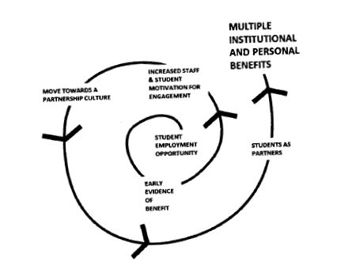
“Great, but what’s in it for me?” As we model values and behaviors that prioritize learning, we reap the benefits for ourselves & our libraries.
You get to learn too!
Creating development opportunities and putting the energy into fostering a learning culture helps us learn alongside our students to develop skills that can make us happier and more successful.
Better Efficiency!
More informed and engaged student employees make fewer mistakes, learn from the mistakes they do make, and help with training newer students.

Slide 8
How does a workplace learning culture support your academic institution?
“My third objective is to enhance the experience of our students while they are with us. Increasing the richness and intensity of our academic program is part of the story… But part of the education a great residential university provides to its students takes place outside of the classroom. Whether on the athletic fields, in the dining halls, or in co-curricular activities, our students learn important lessons about leadership and what it means to be citizens in an increasingly diverse global environment. We must work hard to make sure both our academic and our non-academic programs are excellent and work in tandem to produce the next generation of leaders for the state, nation, and world.”
https://around.uoregon.edu/content/president-schill-outlines-his-top-priorities-message-faculty-and-staff President Michael Schill
September 24, 2015
UO Advantage gamifies the college experience. Students’ supervisors can customize professional development and milestones as “experiences”
Students earn experience badges that better allow them to articulate the value of their work on campus

Slide 9
A Brief History of Student Employment Enhancement at the UO Libraries…
UO Libraries is largest academic employer of students on-campus.
https://around.uoregon.edu/content/uo-libraries-student-jobs-are-not-just-shelf
Student Supervisors Group started at UO Libraries in 2010 to develop “strategies and programs that enrich the academic experience of library student assistants and prepare them to be successful after graduation.”
Steering Committee
Student Training Working Group
Student Development Fund Group – started in 2014-2015 Academic Year.
Student Appreciation Planning Group
Campus-wide Student Employment Enhancement Committee formed in 2014.
“Through active engagement of on-campus employer partners and mutually beneficial collaboration across campus, SEE is developing a suite of professional development tools, resources, and support for student workers, their supervisors, and departments to collectively enhance the professional readiness of our college graduates.”
“Supervisors develop valuable professional skills in supervision, establish a network of support among student supervisors on campus, and are able to identify how their students grow, develop, and leave ready for their profession.”

Slide 10
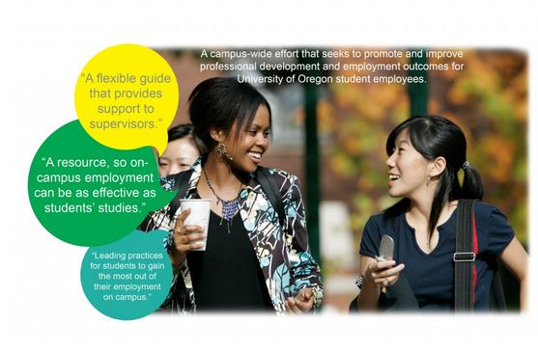
SEE Resource Guide: Employment Essentials & Enhancements http://uosee.uoregon.edu/2015/08/11/see-resource-guide/
Core Strategies
Learning-Focused
Inclusive
Mentoring
Checklist Areas of Focus
Recruitment and Hiring
Orientation and Training
Performance Management and Review
SEE Opportunity Worksheets: http://uosee.uoregon.edu/2015/08/28/see-opportunity-worksheets/

Slide 11
Recruitment and Hiring
Revise position descriptions to include learning outcomes that demonstrate what transferrable skills can be acquired on the job.
Remove gendered language, acronyms, and unnecessary physical requirements.
Reach out to promote available jobs through on-campus partners that reach a diverse population of students.
Post open positions through online resources that promote accessibility.
Conduct interviews with a set list of questions – give candidates a few minutes with printed set of questions to accommodate different learning and processing styles.
Follow up with candidates who were not selected and offer to provide feedback, if requested.

Slide 12
Orientation and Training
Create a concrete orientation and training plan – put it in writing & make it consistent.
Take time to explain the big picture of your library’s processes, mission statement, and core values.
Model tasks, behaviors, and attitudes that reflect a learning culture – Questions are awesome!
Train experienced students to mentor new students.
Provide access to professional development beyond task-based training.
Fall Orientation for all Library Student Assistants.
Returning students volunteer to facilitate table discussions for leadership experience.
Student-created orientation video highlighting transferrable skills.

Slide 13
UO Libraries Fall Orientation Video: created for students by students
https://www.youtube.com/watch?v=p62O8H4VRKs

Slide 14
Performance Management & Review
Create a performance evaluation template – share with students as part of orientation so they understand expectations from the beginning.
Create a review timeline and make raises and promotions tied to reviews. Make this process transparent & consistent for all employees.
Use the performance review as an opportunity to start constructive conversations about goals and areas for improvement.
Take advantage of any communication training that your institution offers, to be able to improve your confidence in providing constructive feedback.
Author Douglas Stone - Difficult Conversations & Thanks for the Feedback

Slide 15
Student Employment Enhancement in Action at UO Libraries: 2014-2016
21 professional development trainings (36 sessions total)
3 collaborations with campus partners and 1 community collaboration in training
3 student-led trainings
7 long-term projects, across 3 library locations
15 #myuolibjob videos
Redesigned fall orientation with more student-produced content
Library-wide student performance evaluation template & merit-based raises
Annual student appreciation lunch and students included in High Jump Award

Slide 16
Resources and Bibliography
Kate Ball Jones
kdball@uoregon.edu
#myuolibjob YouTube Channel
https://www.youtube.com/results?search_query=%23myuolibjob
University of Oregon Student Employment Enhancement Committee (SEE)
http://uosee.uoregon.edu/
uosee@uoregon.edu
Center for Educational Research and Innovation (CERI)
http://www.oecd.org/edu/ceri/researchprojects/
National Association of Colleges and Employers – Knowledge Center (NACE)
http://www.naceweb.org/knowledge/coaching-counseling.aspx
Burns, Liam, and Craig Mahoney. Student engagement: Identity, motivation and community. Eds. Claus Nygaard, et al. 2013.
Coplin, William D. 10 things employers want you to learn in college: The know-how you need to succeed. Springer Science & Business, 2003.
Frock, David. "Identifying mentors for student employees on campus." European Journal of Training and Development 39.1 (2015): 43-58.
Hinchliffe, Lisa Janicke, and Melissa Autumn Wong. Environments for Student Growth and Development: Libraries and Student Affairs in Collaboration. Assoc of Cllge & Rsrch Libr, 2012.
Perozzi, Brett, ed. Enhancing student learning through college employment. Dog Ear Publishing, 2009.
Stone, Douglas, Bruce Patton, and Sheila Heen. Difficult conversations: How to discuss what matters most. Penguin, 2010.
Stone, Douglas, and Sheila Heen. Thanks for the feedback: The science and art of receiving feedback well. Penguin, 2015.

Slide 17
Image Credits
Learning Outcomes:
https://www.mohe.gov.sa/en/Ministry/Dqi/ListofQualityEnhancementInitiatives/Pages/The-National-Project-for-Assessment-of-Higher-Education-Learning-Outcomes.aspx
Learning Culture:
https://www.lynda.com/articles/6-steps-to-learning-culture
Engagement Escalation Spiral:
Burns, Liam, and Craig Mahoney. Student engagement: Identity, motivation and community. Eds. Claus Nygaard, et al. 2013.
pg. 113
All other images & video courtesy of the University of Oregon

