Slide 1
Dude, Where Is My Book?
Real-time Shipment Tracking with OBILLSK
Ryan Litsey & Kenny Ketner

Slide 2
Real-Time Shipment Tracking
OBILLSK now offers real-time shipment tracking system for all ILL couriers (FedEx, USPS, DHL, UPS, Courier Services, and Other Services)
Input (scan or type) a box’s shipping label and the ILL or Transaction Number for each item (request) in the box
Scanning is done using a barcode scanner, but a keyboard can be used if no scanner is available
There is confirmation of scans and total number of items in the box

Slide 3
Track It and Unpack It
Track It: connects to all major shippers and provides real-time locations, if available from the shipping vendor
Unpack It: can help when shipments are lost
It can use any of the data – Shipping Label, TN # or ILL #
The system can then tell you what else was in the box
This can help libraries save thousands of dollars and hundreds of hours spent tracking lost shipments and broken boxes

Slide 4
Full Suite of Reporting Capabilities
Total items scanned
Total packages
Items per package
Most items in a box
Number of unique receivers
Top receiver
Scans per weekday bar graph
Scans per month line chart
Courier usage pie chart
Map of shipping destinations
Top 10 receivers list
Total items by OCLC symbol

Slide 5
Let’s See It Live
https://shipping.lib.ttu.edu
We will use actual lost boxes between
Texas Tech and University of Denver
Texas Tech and Washington University St. Louis

Slide 6
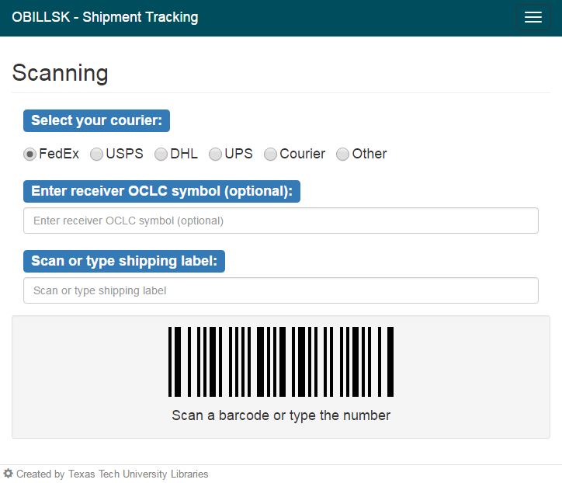

Slide 7
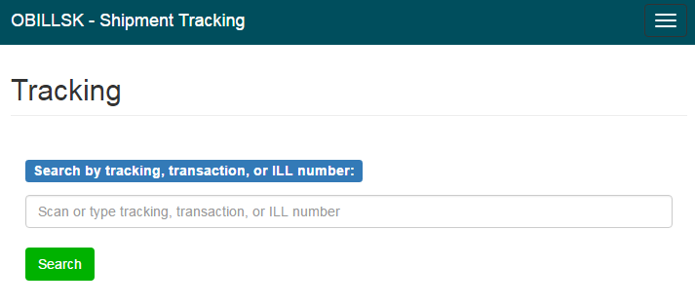

Slide 8
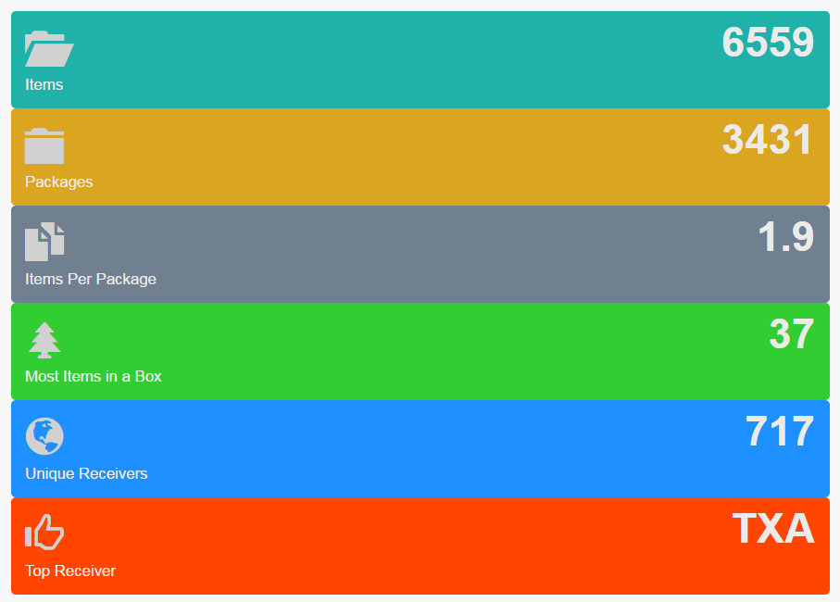

Slide 9
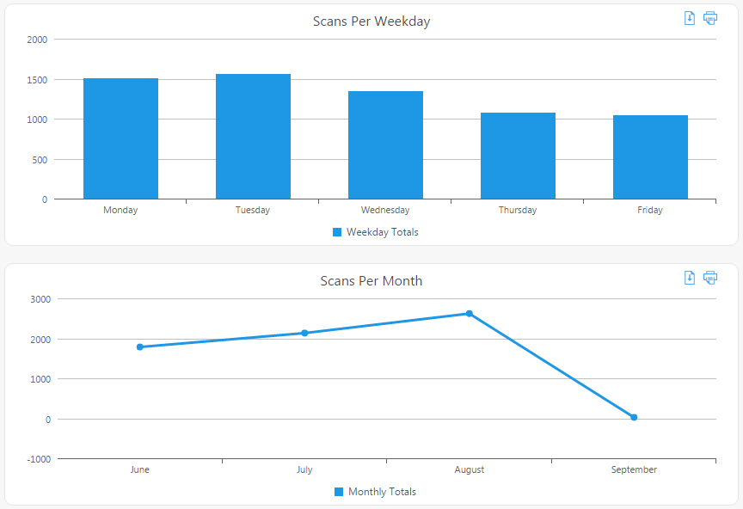

Slide 11
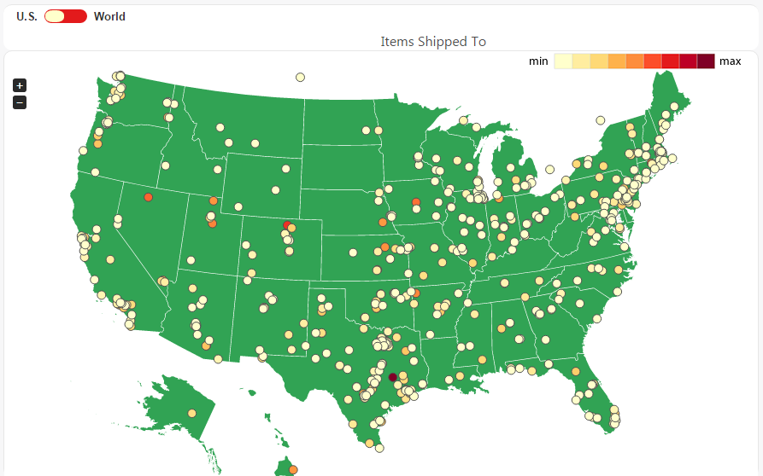

Slide 12
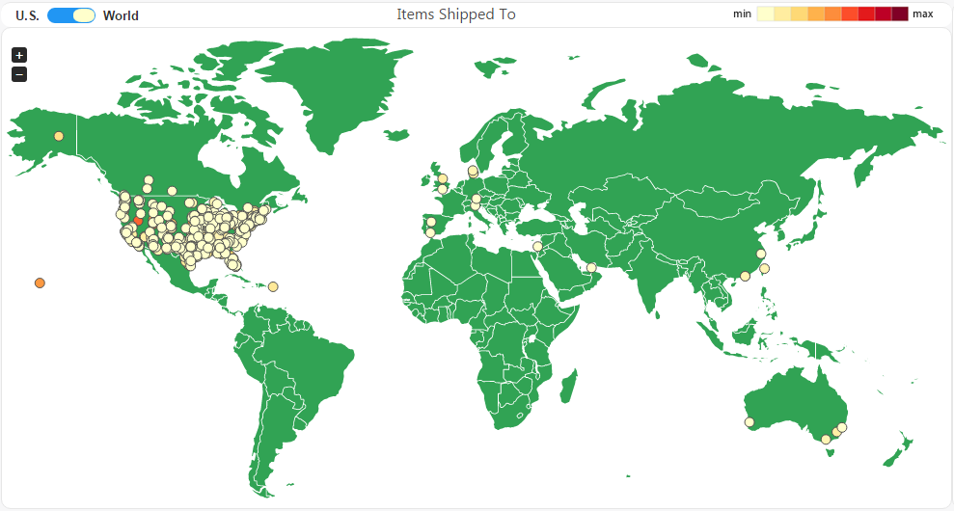

Slide 13
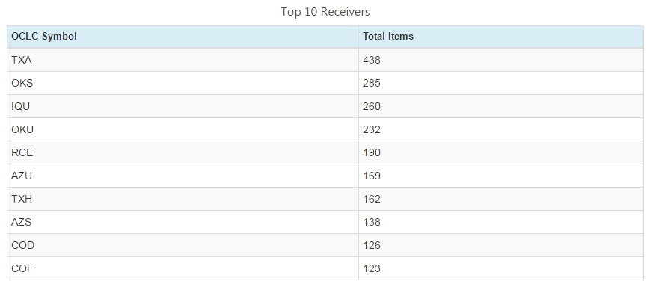

Slide 14
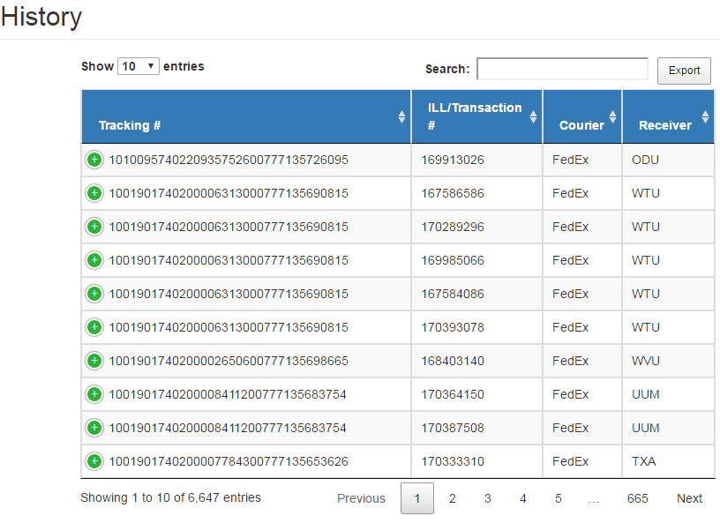

Slide 15
Thank You
Ryan Litsey
Ryan.Litsey@ttu.edu
Kenny Ketner
Kenny.Ketner@ttu.edu

