Slide 1
We Know What You Want Predicting ILL Requests With ALIEN
Using Real-time Data, Statistics, and Predictive Analytics
to Inform ILL and Collection Development Strategies

Slide 2
ALIEN knows…
ALIEN – the Automated Library Information Exchange Network
The beginnings of the first library machine learning decision network
A learning computer that examines a variety of library data sources to construct probabilistic and statistical decisions
Using predictive analytics with ILL, Reserves and Circulation data to recommend library behavior

Slide 3
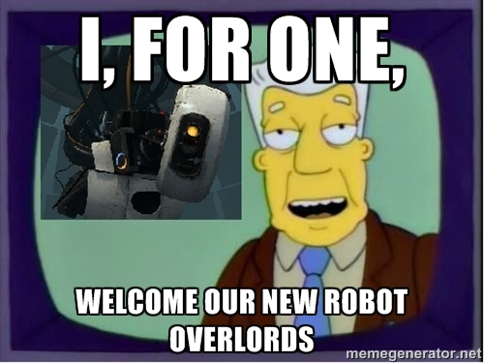

Slide 4
How Predictive ILL Works
Using data gathered from the ILL servers, we create generations of ILL requests
The system establishes a probabilistic curve for each semester (generation) for the ILL requests received for a certain OCLC number
Each successive generation, the system refines the curve and the confidence interval it gives for a prediction
Eventually the curve will narrow to match reality

Slide 5
What Does It Look Like

Slide 6
Moving Beyond ILL
Using the ILL, Reserves and Circulation data and their OCLC numbers, we can match with WorldCat data to do our next level of analysis
Collection analysis is carried out with advanced statistical techniques including k-means clustering

Slide 7
Tensorflow – An open source software library for machine intelligence
https://www.tensorflow.org/versions/r0.10/tutorials/mnist/beginners/index.html

Slide 8
k-Means
k-means clustering is a mathematical approach for large scale data analysis
It partitions n observations into k clusters in which each observation belongs to the cluster with the nearest mean
So we take n observations; ILL requests, circulation stats, in house use stats, course reserves
Each n observation for a specific data set (ILL, Reserves, Circ stats) is stored separately
We search OCLC using the OCLC number to determine the k cluster using WorldCat subject descriptors

Slide 9
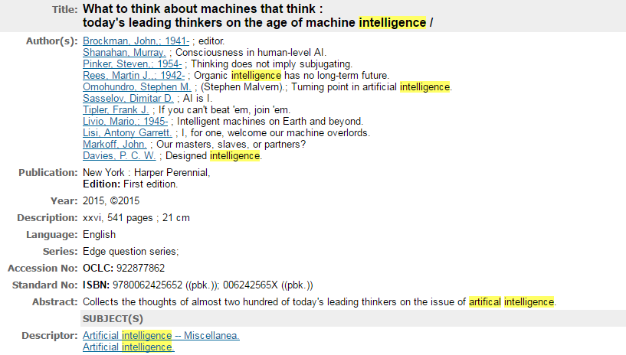
An Example
We use a combination of data sources to gather data on a libraries collection
We analyze each book for it’s recognized OCLC subjects
We sort each book into a subject category
We analyze where the libraries collection has the most convergence – this represents your library’s focus

Slide 10
What Does It Mean?
We are effectively using a variety of data sources to make large scale comparisons
We take one book and compare it to others using ILL requests, reserves, in-house use, circulation data, and place them in an overarching subject

Slide 11
Eventually a complete picture of the library emerges

Slide 12
Next Steps
For ALIEN we are looking to further develop:
Accessing course reserves data
Build recommendation functionality
Can we access facilities data for maintenance issues
Add a natural language UI

Slide 13
Thank You
Ryan Litsey
ryan.Litsey@ttu.edu
Kenny Ketner
Kenny.Ketner@ttu.edu

