Slide 1
How Link Resolvers work and their impact on interlibrary loan
Doris Munson, Eastern Washington University
NWILL
September 8, 2016

Slide 2
What is a link resolver?
Software that takes a scholarly citation formatted as an OpenURL and gives the user various options, such as
Retrieve the full-text of an article
Look a physical item up in the online catalog
Request an Interlibrary Loan
It’s also possible to set up links to non-citation resources, such as Ask A Librarian.

Slide 3
Terminology
Origin/source: Where the user finds the citation
Resource/target: The full-text of the citation
Knowledge base: a database in the link resolver that contains information about e-journals with full-text
This includes dates of coverage
The link resolver does not search databases to find the full text of articles

Slide 4
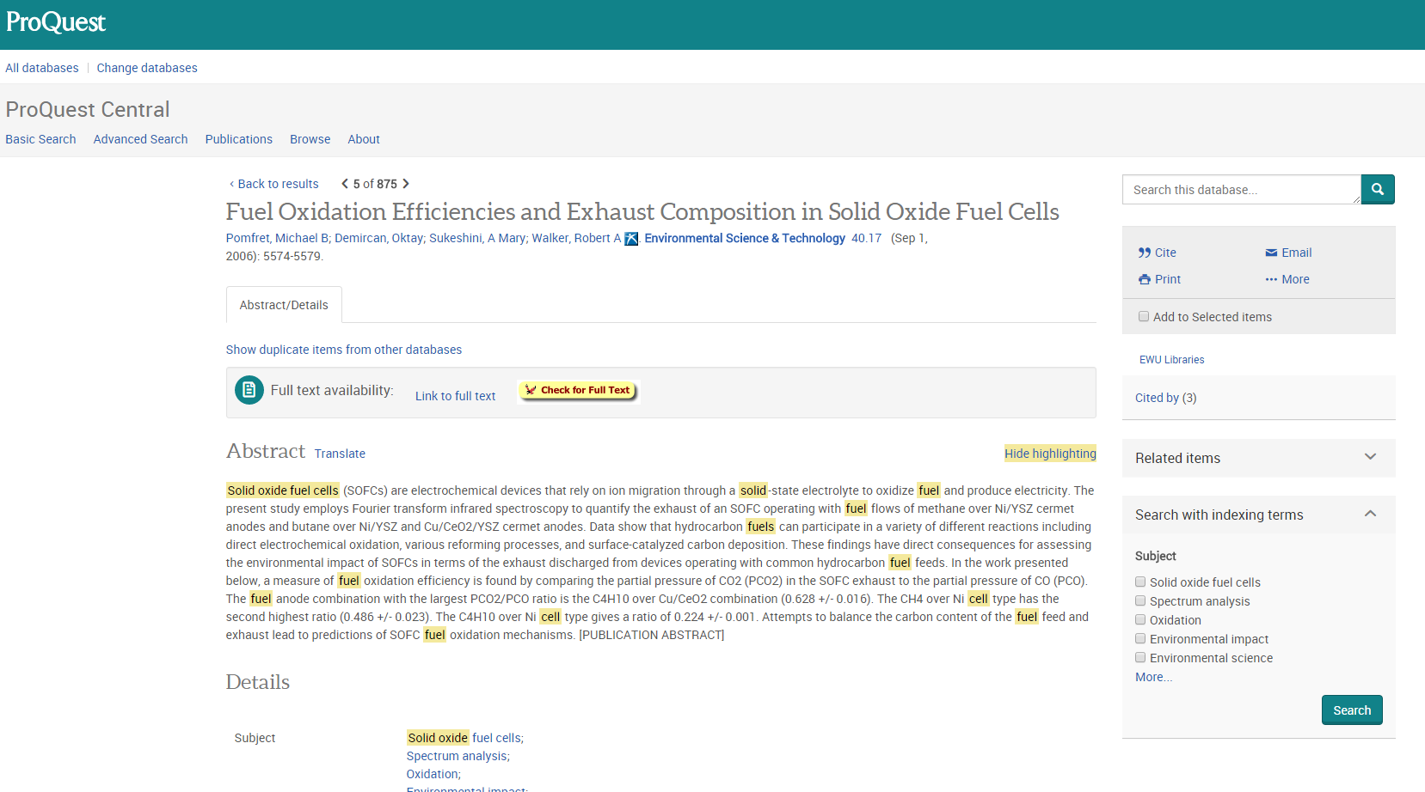
Example of the link resolver in action – Origin Starting from a library licensed database, searching for articles
Origin – EBSCO “check for full text” screenshot

Slide 5
What can be an origin?
Any database with bibliographic citations that supports openURLs
Origin has to be configured in the admin site of where the bibliographic citation comes from
Examples: EBSCOhost, ProQuest, Web of Science, Google Scholar, PubMed
AE

Slide 6
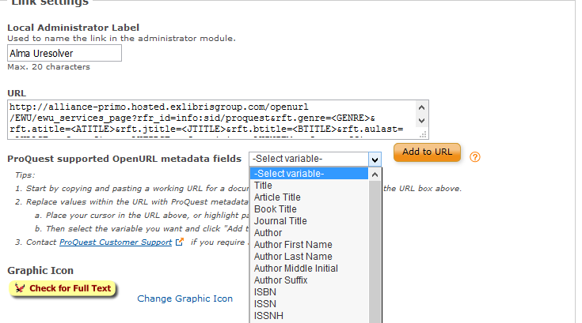
ProQuest Admin Module: library has some control over what variables are passed to the link resolver

Slide 7
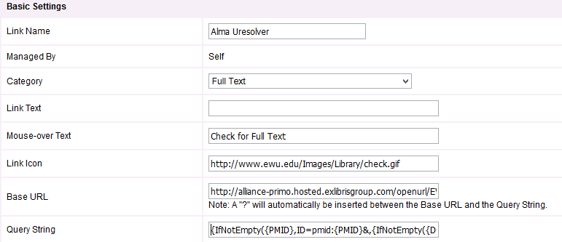
EBSCO Admin: the library has some control but you have to know how to use the variables

Slide 8
The Link Resolver Results page

Slide 9
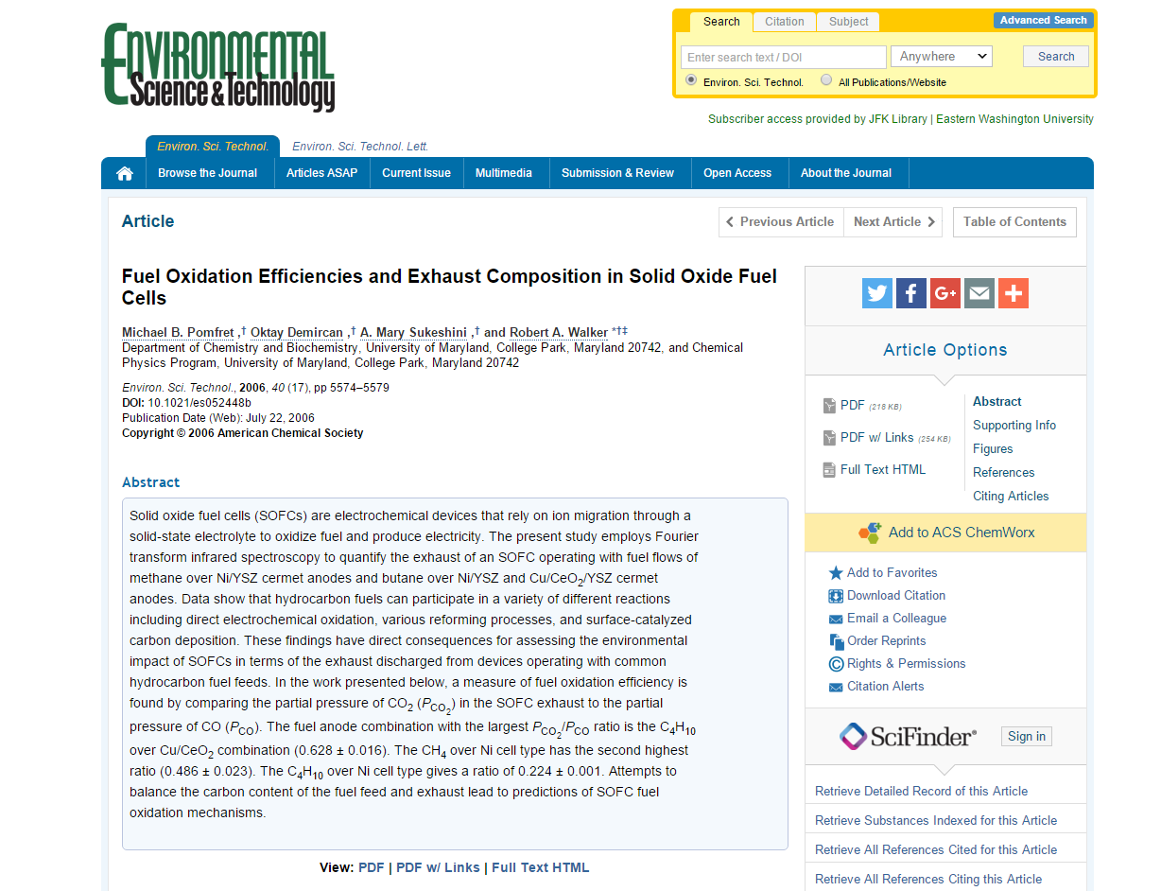
From the Results page, to the Resource (full text of the article)

Slide 10
What can be a Resource?
Any vendor site that has full text and supports openURL
A vendor site can be both an origin (no full text for a citation) and a resource (full text for an article)

Slide 11
Resource Examples:
EBSCOhost
ProQuest
Sage journals
JSTOR
Open access systems such as DOAJ

Slide 12
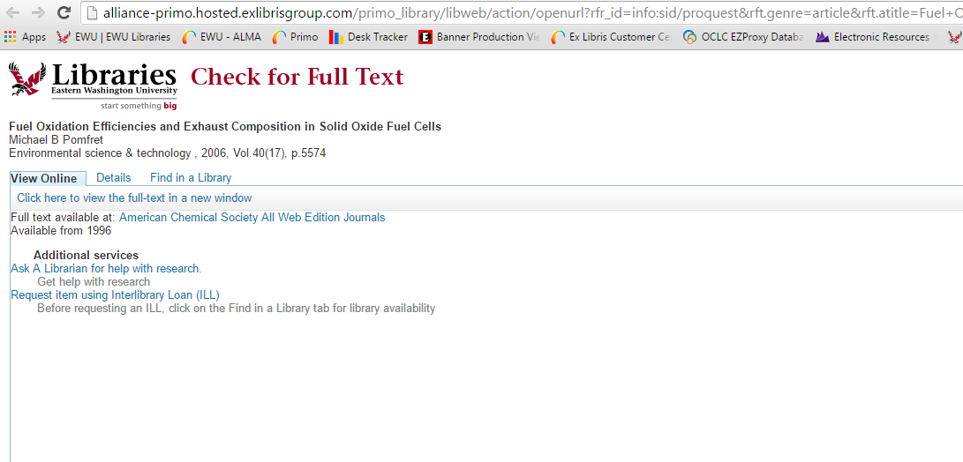
OpenURL standard used to convey data
http://alliance-primo.hosted.exlibrisgroup.com/primo_library/libweb/action/openurl?rfr_id=info:sid/proquest&rft.genre=article&rft.atitle=Fuel+Oxidation+Efficiencies+and+Exhaust+Composition+in+Solid+Oxide+Fuel+Cells&rft.jtitle=Environmental+Science+%26+Technology&rft.btitle=&rft.aulast=Pomfret&rft.aufirst=Michael&rft.auinitm=B&rft.ausuffix=&rft.au=Pomfret%2C+Michael+B%3BDemircan%2C+Oktay%3BSukeshini%2C+A+Mary%3BWalker%2C+Robert+A&rft.date=2006-09-01&rft.volume=40&rft.issue=17&rft.part=&rft.spage=5574&rft.issn=0013936X&rft.eissn=&rft.isbn=&rft.object_id=230134307&vid=ewu_services_page&institution=EWU&url_ctx_val=&url_ctx_fmt=null&isSerivcesPage=true

Slide 13
Open URL select metadata from example
atitle=Fuel+Oxidation+Efficiencies+and+Exhaust+Composition+in+Solid+Oxide+Fuel+Cell (article title)
jtitle=Environmental+Science+%26+Technology (journal title)
aulast=Pomfret (Author Last name)
aufirst=Michael (Author First name)
date=2006-09-01
volume=40
issue=17
spage=5574 (starting page)
issn=0013936X

Slide 14
How a link resolver works
Receives the openURL from the Origin
Uses the data in the openURL to search the Knowledge base for a match
Usually match on ISSN and date
Knowledge Base is a database of available journals that contains the journal title, ISSN, eISSN, start date, end date, and URL
The Knowledge Base is managed by the library either manually, uploading a file from a subscription service (i.e., Serials Solutions), or through an ILS that has it integrated (i.e., Alma)
At EWU, the results page is displayed in Primo
The link resolver then constructs links to any available full-text resources, the library catalog for books, and/or Interlibrary Loan

Slide 15
Why the link resolver will fail
There is an error in the Knowledge Base
Coverage dates are incorrect
Journal is not included (should display)
No longer receive journal (shouldn’t display)
The knowledge base is created by data supplied by the vendor. The vendor has to update the data before it can be corrected in the KB
RK
Notes:
So why will the link resolver fail? Probably the most common issue is related to incorrect data, such as incorrect coverage dates, journals that the library no longer provides access to are still listed in the knowledgebase and new journals are not yet listed in the knowledge base. It is important to remember that the library does not control much of this data; it is supplied by the vendor and must be corrected by the vendor.

Slide 16
Why the link resolver will fail (cont.)
The openURL from the Origin does not match data in the Resource
The date, volume, issue, or pages are incorrect or do not match
The origin indexes one edition and the resource indexes a different edition of the journal, magazine, or newspaper
Example: New York Times Eastern edition and the New York Times National edition
Example: Economist U.S. edition and U.K. edition
One uses the ISSN and the uses the eISSN
Data entry errors introduced when it is entered into the vendor database
RK
Notes:
Another data-related reason for link resolver failure occurs when data in the origin does not match data in the resource. There could be several reasons for this: incorrect or mis-matching dates, volumes, issues or pages, the origin and resource index different editions, such as the New York Times eastern edition versus national edition, as well as differences in which ISSN is used, and other data errors.

Slide 17
Impact on ILL
Users can easily place an ILL request through ILL software such as ILLiad or Relais
Forms self-populate, users are not required to manually enter citation information
ILL staff know where the citation originated
Can be a source of incorrect data if the openURL is formatted incorrectly

Slide 18
Example of a link for Interlibrary Loan (ILLiad)

Slide 19
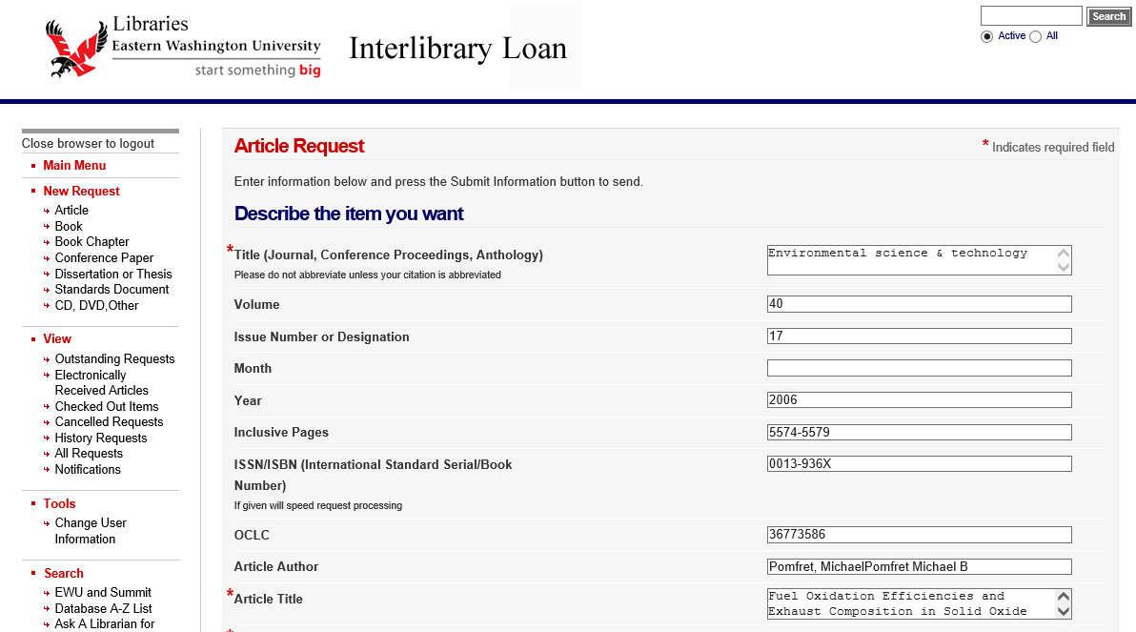
Screenshot of ILL result

Slide 20
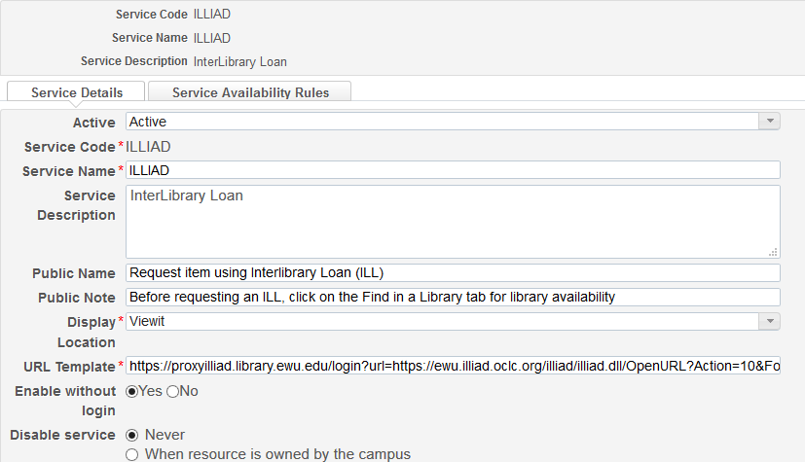
ILL links are configured in the link resolver

Slide 21
Base article URL that the Alma Link Resolver uses for ILLiad
EWU uses Ezproxy to authenticate users into ILLiad
Base ILLiad URL
https://proxyilliad.library.ewu.edu/login?url=https://ewu.illiad.oclc.org/illiad/illiad.dll/OpenURL?Action=10&Form=30&rft.genre={rft.genre}&rft.title={rft.title}&rft.stitle={rft.stitle}&rft.atitle={rft.atitle}&rft.jtitle={rft.jtitle}&rft.au={rft.au}&rft.date={rft.year}&rft.month={rft.month}&rft.volume={rft.volume}&rft.issue={rft.issue}&rft.number={rft.number}&rft.spage={rft.spage}&rft.epage={rft.epage}&rft.edition={rft.edition}&rft.issn={rft.issn}&rft.eissn={rft.eissn}&rft.aulast={rft.aulast}&rft.aufirst={rft.aufirst}&rft.auinit={rft.auinit}&rft.pub={rft.pub}&rft.pubdate={rft.pubdate}&rft.pubyear={rft.pubyear}&rft.publisher={rft.publisher}&rft.place={rft.place}&rft.doi={rft.doi}&&rfe_dat={rft.oclcnum}&rfr_id={rfr_id}
Information about the ILL request

Slide 22
The ILL software has to recognize the fields in blue
The link resolver takes data from the origin openURL to populate the fields in green
rft.genre={rft.genre}&rft.title={rft.title}&rft.stitle={rft.stitle}&rft.atitle={rft.atitle}&rft.jtitle={rft.jtitle}&rft.date={rft.year}&rft.month={rft.month}&rft.volume={rft.volume}&rft.issue={rft.issue}&rft.number={rft.number}&rft.spage={rft.spage}&rft.issn={rft.issn}&rft.eissn={rft.eissn}&rft.au={rft.au}&rft.aulast={rft.aulast}&rft.aufirst={rft.aufirst}&rft.auinit={rft.auinit}&rft.doi={rft.doi}&rfe_dat={rft.oclcnum}&rfr_id={rfr_id}
Note for ILLiad users: The blue fields need to appear in the ILLiad Customization OpenURL Mapping Table or they won’t populate the ILLiad form correctly. If you are using other ILL software, check for a similar openURL mapping table

Slide 23
Remember our example?
atitle=Fuel+Oxidation+Efficiencies+and+Exhaust+Composition+in+Solid+Oxide+Fuel+Cell (article title)
jtitle=Environmental+Science+%26+Technology (journal title)
aulast=Pomfret (Author Last name)
aufirst=Michael (Author First name)
date=2006-09-01
volume=40
issue=17
spage=5574 (starting page)
issn=0013936X
AE

Slide 24
Example of a problem: -Requests were going to the wrong ILL form. -Cause: the genre was “unknown” -Solution: map the “unknown” genre to the book loan form

Slide 25
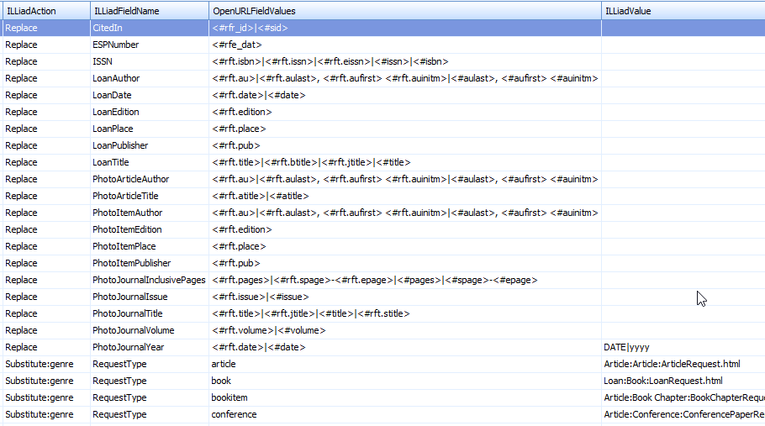
ILLiad Customization Manager OpenURL Mapping Table

Slide 26
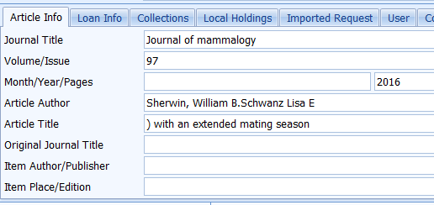
Problem: Did the problem start in ILLiad, the link resolver, or in the origin?

Slide 27
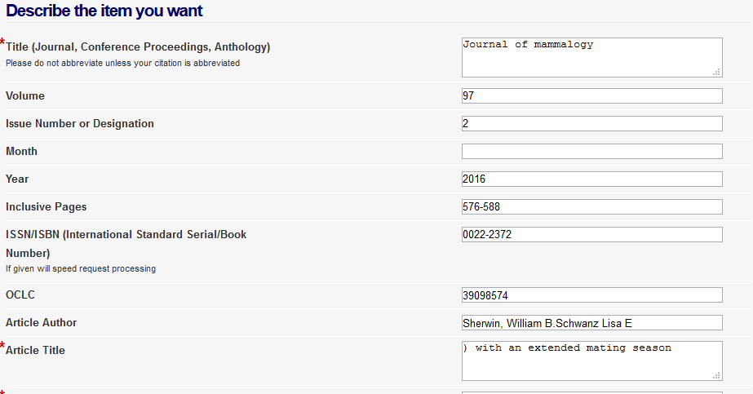
ILLiad article request form

Slide 28
URL sent to ILLiad: What’s in the atitle field?
https://proxyilliad.library.ewu.edu/login?url=https://ewu.illiad.oclc.org/illiad/illiad.dll/OpenURL?Action=10&Form=30&rft.genre=article&rft.title=Journal+of+mammalogy&rft.stitle=J+MAMMAL&rft.atitle=%29+with+an+extended+mating+season&rft.jtitle=Journal+of+mammalogy&rft.au=Sherwin%2C+William+B.Schwanz%20Lisa+E%20&rft.date=2016&rft.month=03&rft.volume=97&rft.issue=2&rft.number=&rft.spage=576&rft.epage=588&rft.edition=&rft.issn=0022-2372&rft.eissn=1545-1542&rft.aulast=Schwanz&rft.aufirst=Lisa+E&rft.auinit=&rft.pub=American+Society+of+Mammalogists&rft.pubdate=1919-&rft.pubyear=&rft.publisher=American+Society+of+Mammalogists&rft.place=Provo%2C+UT+%3A&rft.doi=10.1093%2Fjmammal%2Fgyv204&&rfe_dat=39098574&rfr_id=info%3Asid%2Fwww.isinet.com%3AWoK%3AWOS

Slide 29
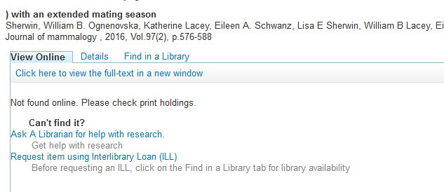
Link resolver results page

Slide 30
URL for the link resolver results page: what is in the atitle field?
http://alliance-primo.hosted.exlibrisgroup.com/primo_library/libweb/action/openurl?rft.epage=588&rft_val_fmt=info%3Aofi%2Ffmt%3Akev%3Amtx%3Ajournal&rft.stitle=J+MAMMAL&rft.volume=97&isSerivcesPage=true&rft.jtitle=JOURNAL+OF+MAMMALOGY&rft.aufirst=Lisa+E.&rft.genre=article&dscnt=3&rft.pages=576-588&url_ctx_fmt=info%3Aofi%2Ffmt%3Akev%3Amtx%3Actx&vid=ewu_services_page&institution=EWU&rft.spage=576&fromLogin=true&rft.issn=0022-2372&dstmp=1472588514313&rft_id=info%3Adoi%2F10.1093%2Fjmammal%2Fgyv204&rfr_id=info%3Asid%2Fwww.isinet.com%3AWoK%3AWOS&rft.issue=2&rft.aulast=Schwanz&url_ver=Z39.88-2004&rft.date=2016&rft.au=Sherwin%2C+William+B.&rft.au=Ognenovska%2C+Katherine&rft.au=Lacey%2C+Eileen+A.&rft.atitle=Paternity+and+male+mating+strategies+of+a+ground+squirrel+%28Ictidomys+parvidens%29+with+an+extended+mating+season&rft.eissn=1545-1542&fromLogin=true

Slide 31
Root of the problem?
The origin passed the full article title to the link resolver
The link resolver dropped the first part of the article title for some reason
(EWU is working with the vendor to see if we can resolve the problem)

Slide 32
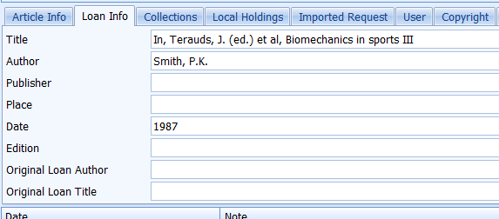
Problem: Did the problem start in ILLiad, the link resolver, or in the origin?

Slide 33
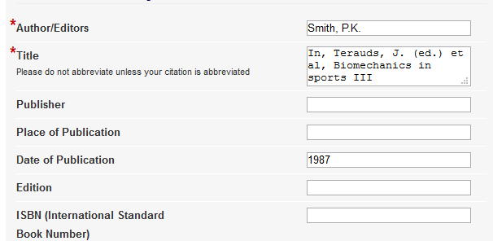
ILLiad book request form: Why isn’t the ISBN listed? Why is the author incorrect?

Slide 34
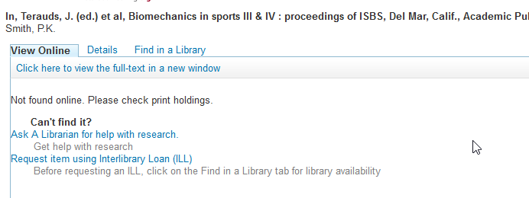
Link resolver results page: Why isn’t there a link to search the online catalog?

Slide 35
URL sent by origin to link resolver: This is an edited book. No ISBN was passed.
http://alliance-primo.hosted.exlibrisgroup.com/primo_library/libweb/action/openurl?genre=book&atitle=&title=In%2C%20Terauds%2C%20J.%20%28ed.%29%20et%20al%2C%20Biomechanics%20in%20sports%20III%20%26%20IV%20%3A%20proceedings%20of%20ISBS%2C%20Del%20Mar%2C%20Calif.%2C%20Academic%20Publishers%2C%201987&issn=&isbn=&volume=&issue=&date=19870101&aulast=Smith%2C%20P.K.&spage=&pages=&sid=EBSCO:SPORTDiscus%20with%20Full%20Text:SPH358431&vid=ewu_services_page&institution=EWU&url_ctx_val=&url_ctx_fmt=null&isSerivcesPage=true

Slide 36
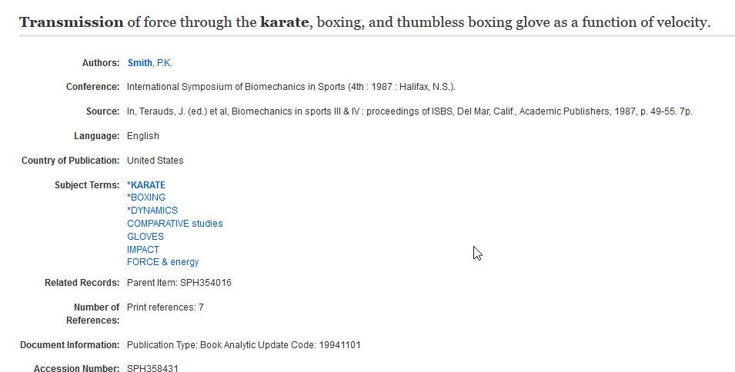
Original record in SportDiscus. The author is the chapter author. No ISBN or ISSN is included.

Slide 37
The problem started in the database
Chapter in an edited book. It can be problematic to pass chapter information correctly because databases index them differently
The citation was identified as a book rather than a book chapter
The book editor and the book title were put into the book title field
The database did not include an ISBN that would have allowed the link resolver to create a link to the online catalog

Slide 38
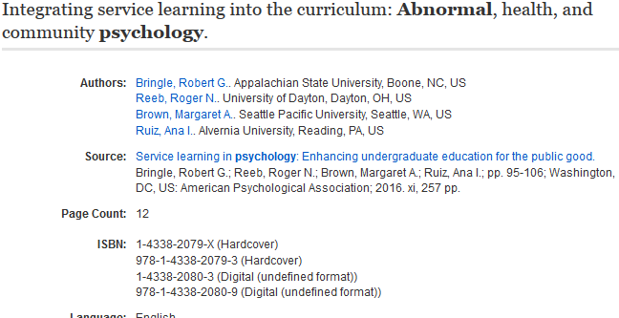
Better indexing of a book chapters can be found in PsycINFO

Slide 39
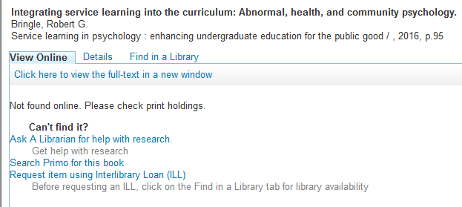
Link resolver results page gives correct citation information and includes a link to the online catalog
This link is only given if an ISBN is passed to the link resolver

Slide 40
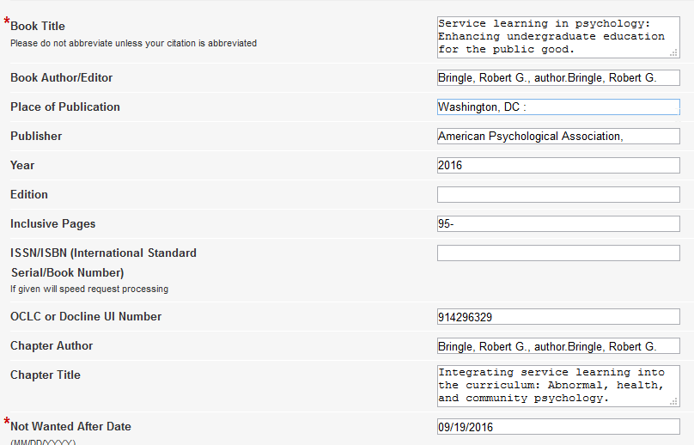
ILLiad request for Book Chapter

Slide 41
Questions?
Thank you for coming
Doris Munson
Access Services Librarian
Eastern Washington University
dmunson@ewu.edu

