Slide 1
Patron-Driven Acquisitions at the University of Oklahoma
Problems, Solutions, Possibilities
Molly Murphy
University of Oklahoma

Slide 2
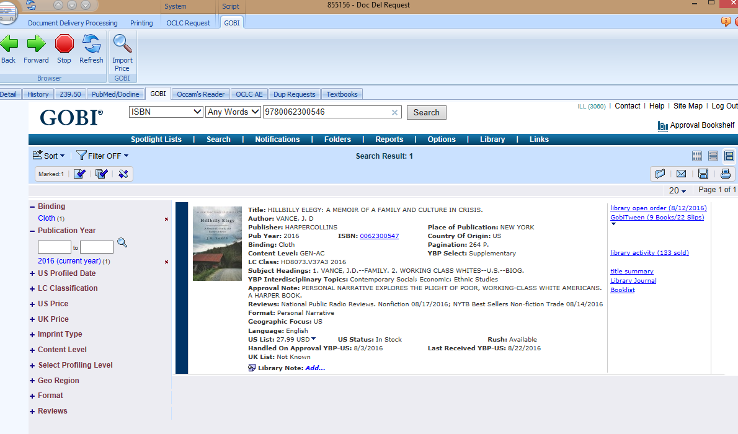

Slide 3
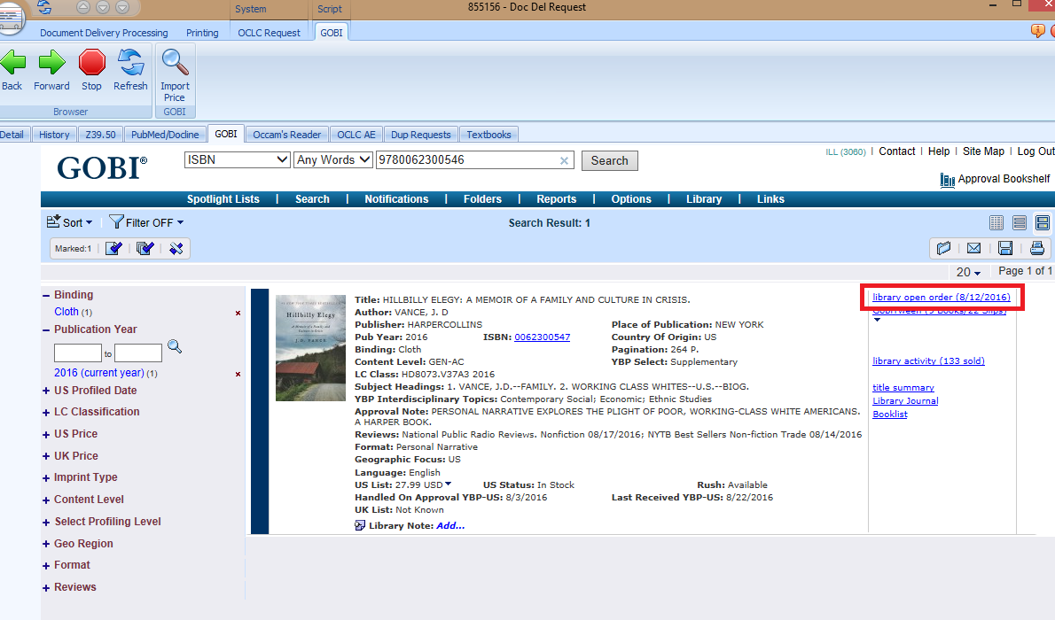

Slide 6
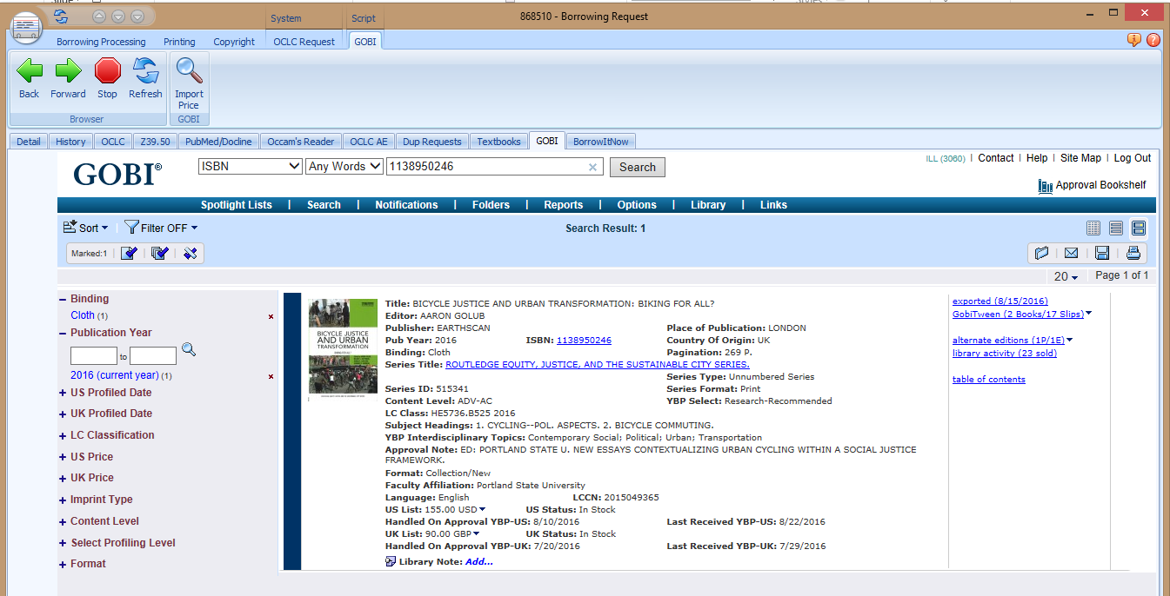

Slide 7
