Slide 1
Copyright and Faculty Education
James MacDonald, Digital Initiatives Librarian
Geoffrey R. Weller Library
University of Northern British Columbia
Notes:
The University of Northern British Columbia is a small research institution. With approximately 3500 undergraduate students and 500 graduate students. We were recently rated #1 in our class in Canada by McLeans magazine (small undergraduate institutions).
Copyright law and the copyright landscape in Canada has undergone some upheaval in Canada in the past 5 years. Many of you may be aware of these changes but I want to point out two major changes. The first was a major increase in fees charged by "Access Copyright." Access Copyright collected a per student fee from universities for a pseudo copyright clearance. Those fees were theoretically passed on to publishers and authors for the use of their work. In 2011, Access Copyright proposed a massive increase to its fees. The increase threatened already cash strapped universities with sudden annual bills in the 100s of thousands to millions of dollars depending on their size. It wasn't surprising, therefore, when the universities revolted and dropped Access Copyright in favour of clearing copyright on a case by case basis.
This was all to the good. Access Copyright created an environment that essentially allowed institutions to pay little attention to copyright on their campuses. The Access Copyright fiasco forced universities to examine their practices, licenses and educate their faculty and students. At UNBC we started a copyright clearance office out of the library. Today this position continues to operate at UNBC and we continue educating our community.

Slide 2
Patrice Hall
Library Assistant Copyright
Been with UNBC for 3 years
Gives Copyright in the Classroom information sessions
Offers copyright sessions for graduate students
Conducts Copyright Drop-in Clinics
Creates copyright FAQs for email distribution
Proactive consultation with faculty
Notes:
That office essentially consists of a single full-time staff member. Patrice Hall is excellent and really ought to be the one speaking today. But it's the start of the term and she is still attending to last minute clearances for course materials.
Patrice's thorough understanding of copyright and the academy makes her a very valuable asset. She also backs up our interlibrary loan officer. It's quite convenient that copyright clearance and ILL have opposite peak periods.
At UNBC we do not operate under a philosophy of force. Patrice's office is open to all faculty and students but reading lists, theses and other copyright related works are not required to pass through her hands. We operate under a model of guidance. Which puts the onus on Patrice to get out and educate the community. We have found that when people understand copyright and are aware of services they will generally use those services.
Patrice does a number of things to educate our faculty – which I'll speak about today:
Gives Copyright in the Classroom information sessions
Offers copyright sessions for graduate students
Conducts Copyright Drop-in Clinics
Creates copyright FAQs for email distribution
Proactively contacts new faculty and teaching faculty

Slide 3
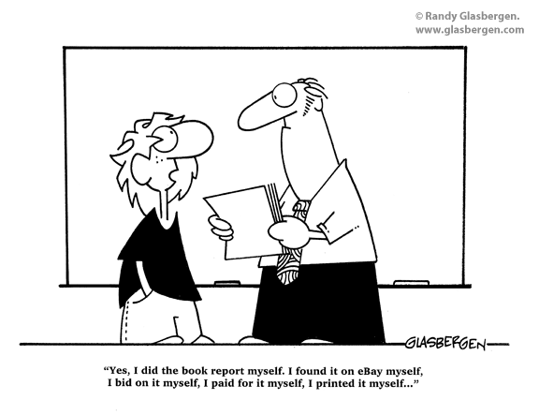
Copyright in the Classroom
Notes:
When the copyright office was first established we began holding "Copyright in the Classroom" sessions on a regular basis. These sessions are intended to give faculty a foundational understanding of copyright issues as they pertain to their teaching. The format is a traditional talking head lecture that last about an hour with opportunities for questions.
We offer these sessions less frequently today. At the start these were standing room only lectures. Now that these have been run for several years attendance has dropped off. We believe, however, this is a result of saturation – our faculty largely understand the issues. Or at least understand whom to contact about the issues.

Slide 4
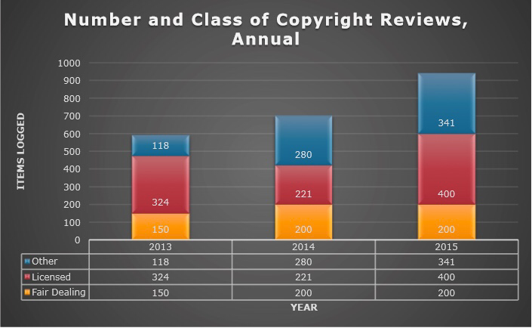
Notes:
This growing understanding is evidenced by the increasing number of copyright reviews each year. Because reading lists and course materials are not vetted on a mandatory basis it is encouraging to see continual growth in the use of the copyright office. The experience is not so painful that the office is avoided.
Identifying alternatives
Reviewing reading lists
Consulting

Slide 5
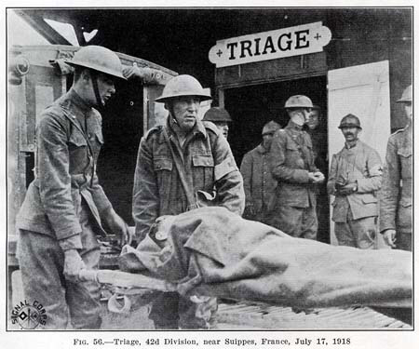
Copyright Drop-in Clinics
Notes:
Drop-in clinics are offered weekly throughout the term, except during exam periods, and generally have 1-2 participants with the occasional no-show. However, the invitation and marketing of the clinics are still a great way to get people thinking about copyright. Patrice generally sees a rise in questions from faculty shortly after the announcement goes out.
Drop in clinics are opportunities for solutions not speeches. Users come equipped with questions and Patrice works through those questions one on one with them. Users may bring their reading lists, working thesis or other project and Patrice reviews it with them.
Brochures are often handed out here and users are made aware of self-serve options such as the website, the UNBC Fair Dealing Guidelines, the 6 point Fair Dealing test, instructions for creating permalinks, etc.

Slide 6
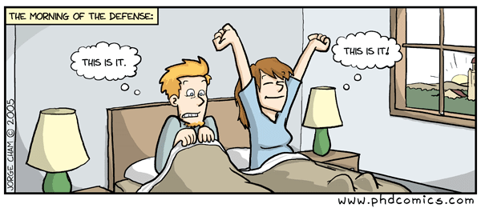
Graduate Student Copyright Education
Notes:
Graduate Student Copyright Education
These sessions are offered regularly and are tailored for graduate students. The last thing any one wants is a poor grad student freaking out because they have not obtained the proper copyright permissions and they are about to defend their thesis. Most graduate schools will not publish a thesis if students can't produce clearances for third party work.
Patrice advertises these sessions on the main UNBC events website and works with our Graduate Programs to get the word out.

Slide 7
Copyright FAQs
Sent to our college listservs
Frequency varies
These are great but reach out personally when you can
Notes:
General Email Education – Proactive
Because we know that we'll never catch everyone with our Drop-in clinics and sessions Patrice takes advantage of campus mailing lists. The trick here is to find the Goldilocks zone – not too many emails and not too few.
The FAQs generally answer timely questions or questions she has been seeing repeatedly. She always attaches UNBC's "Fair Dealing" guidelines to these emails.
Patrice notes however that:
"It is better to reach out personally to individuals when the opportunity presents itself."

Slide 8
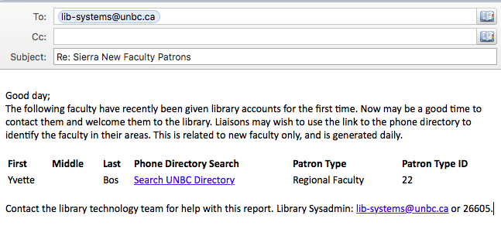
Faculty Alerts
New Faculty
Faculty teaching courses
Notes:
We have two interesting proactive helps for reaching out to faculty.
1st as new faculty are hired at UNBC Patrice gets an automated email informing her of their arrival. This allows Patrice to contact them personally to discuss the services of the copyright office. Your IT departments could easily set this up for you. We circumvent IT by simply running a nightly report against our library system. When a new faculty member receives a library account they are added to the list for the next day's email. Emails go out only when there are new faculty.
2nd Patrice gets a spreadsheet several weeks before the start of each term outlining each teaching faculty and the courses being taught. This allows her to create custom email messages with Word's mail merge aimed specifically at teaching faculty.
Hello professor X
I see that you are teaching CHEM 250 and Political Science 100 this semester. The copyright office is here to help with the preparation of your courses. Attached you'll find the library fair dealings guidelines. Services we offer: reading list reviews, etc etc.

Slide 9
Teach them correct principles and allow them to govern themselves.
Joseph Smith
Notes:
Successful Education in copyright requires:
Dedicated professional staff
Proactively working with the community
Leveraging technical systems (email, Library systems) to get the information you need
As a small institution we can't afford to institute mandatory reading list screenings or courseware vetting. We must rely on an educated faculty willing to comply with copyright principles.
Teaching correct principles and allowing the community to govern themselves

Slide 10
Copyright Law and ILL
Aaron Schwabach
aarons@tjsl.edu

Slide 11
What is protected by copyright?
17 USC § 102(a):
Copyright protection subsists, in accordance with this title, in original works of authorship fixed in any tangible medium of expression, now known or later developed, from which they can be perceived, reproduced, or otherwise communicated, either directly or with the aid of a machine or device. Works of authorship include the following categories:
(1) literary works;
(2) musical works, including any accompanying words;
(3) dramatic works, including any accompanying music;
(4) pantomimes and choreographic works;
(5) pictorial, graphic, and sculptural works;
(6) motion pictures and other audiovisual works;
(7) sound recordings; and
(8) architectural works.

Slide 12
So pretty much everything in the library? Not quite:
First of all, some works are never copyrighted.
17 USC § 105:
Copyright protection under this title is not available for any work of the United States Government, but the United States Government is not precluded from receiving and holding copyrights transferred to it by assignment, bequest, or otherwise.
What about state and foreign government works, and works of international organizations?

Slide 13
Then there are works that are no longer in copyright.
The copyright term has been subject to a lot of changes over the past few decades, so determining whether a work is still in copyright can get complicated.
Works formerly copyrighted are now in the public domain if:
First published in the US and published before 1923, OR
By authors who died before 1946 (or not known to have died later), OR
First published in the US and published between 1923 and 1963 and for which copyright was not renewed, OR
First published in the US before 1977 and published without a copyright notice
All works published after 1989 can be presumed to be copyrighted.
Most works published between 1978 and 1989 can be presumed to be copyrighted, although some exceptions apply.
For more detailed information: Peter B. Hirtle, Copyright Term and the Public Domain in the United States, Jan. 1, 2016, available at http://copyright.cornell.edu/resources/publicdomain.cfm

Slide 14
If the work is still in copyright, what can you do with it?
First of all, the right of first sale provided by 17 USC § 109 allows the original copy to be lent, sold, or given away to anyone you want.
No problems arise unless you want to copy part or all of the text.
Happily Congress has anticipated the needs of libraries and educational institutions with §§ 107 and 108.

Slide 15
17 USC § 108
(a) Except as otherwise provided in this title and notwithstanding the provisions of section 106, it is not an infringement of copyright for a library or archives, or any of its employees acting within the scope of their employment, to reproduce no more than one copy or phonorecord of a work, except as provided in subsections (b) and (c), or to distribute such copy or phonorecord, under the conditions specified by this section, if—
(1) the reproduction or distribution is made without any purpose of direct or indirect commercial advantage;
(2) the collections of the library or archives are (i) open to the public, or (ii) available not only to researchers affiliated with the library or archives or with the institution of which it is a part, but also to other persons doing research in a specialized field; and
(3) the reproduction or distribution of the work includes a notice of copyright that appears on the copy or phonorecord that is reproduced under the provisions of this section, or includes a legend stating that the work may be protected by copyright if no such notice can be found on the copy or phonorecord that is reproduced under the provisions of this section.

Slide 16
17 USC § 108 “except as provided in subsections (b) and (c)”
(b) The rights of reproduction and distribution under this section apply to three copies or phonorecords of an unpublished work duplicated solely for purposes of preservation and security or for deposit for research use in another library or archives of the type described by clause (2) of subsection (a), if—
(1) the copy or phonorecord reproduced is currently in the collections of the library or archives; and
(2) any such copy or phonorecord that is reproduced in digital format is not otherwise distributed in that format and is not made available to the public in that format outside the premises of the library or archives.

Slide 17
17 USC § 108 “except as provided in subsections (b) and (c)”
(c)The right of reproduction under this section applies to three copies or phonorecords of a published work duplicated solely for the purpose of replacement of a copy or phonorecord that is damaged, deteriorating, lost, or stolen, or if the existing format in which the work is stored has become obsolete, if—
(1) the library or archives has, after a reasonable effort, determined that an unused replacement cannot be obtained at a fair price; and
(2) any such copy or phonorecord that is reproduced in digital format is not made available to the public in that format outside the premises of the library or archives in lawful possession of such copy.
For purposes of this subsection, a format shall be considered obsolete if the machine or device necessary to render perceptible a work stored in that format is no longer manufactured or is no longer reasonably available in the commercial marketplace.

Slide 18
17 USC § 108(d): Copying part of a work for loan
(d) The rights of reproduction and distribution under this section apply to a copy, made from the collection of a library or archives where the user makes his or her request or from that of another library or archives, of no more than one article or other contribution to a copyrighted collection or periodical issue, or to a copy or phonorecord of a small part of any other copyrighted work, if—
(1) the copy or phonorecord becomes the property of the user, and the library or archives has had no notice that the copy or phonorecord would be used for any purpose other than private study, scholarship, or research; and
(2) the library or archives displays prominently, at the place where orders are accepted, and includes on its order form, a warning of copyright in accordance with requirements that the Register of Copyrights shall prescribe by regulation.

Slide 19
17 USC § 108(e): Copying all of a work for loan
(e) The rights of reproduction and distribution under this section apply to the entire work, or to a substantial part of it, made from the collection of a library or archives where the user makes his or her request or from that of another library or archives, if the library or archives has first determined, on the basis of a reasonable investigation, that a copy or phonorecord of the copyrighted work cannot be obtained at a fair price, if—
(1) the copy or phonorecord becomes the property of the user, and the library or archives has had no notice that the copy or phonorecord would be used for any purpose other than private study, scholarship, or research; and
(2) the library or archives displays prominently, at the place where orders are accepted, and includes on its order form, a warning of copyright in accordance with requirements that the Register of Copyrights shall prescribe by regulation.

Slide 20
17 USC § 108(g)
(g) The rights of reproduction and distribution under this section extend to the isolated and unrelated reproduction or distribution of a single copy or phonorecord of the same material on separate occasions, but do not extend to cases where the library or archives, or its employee—
(1) is aware or has substantial reason to believe that it is engaging in the related or concerted reproduction or distribution of multiple copies or phonorecords of the same material, whether made on one occasion or over a period of time, and whether intended for aggregate use by one or more individuals or for separate use by the individual members of a group; or
(2) engages in the systematic reproduction or distribution of single or multiple copies or phonorecords of material described in subsection (d):

Slide 21
17 USC § 108(g) continued
Provided, That nothing in this clause prevents a library or archives from participating in interlibrary arrangements that do not have, as their purpose or effect, that the library or archives receiving such copies or phonorecords for distribution does so in such aggregate quantities as to substitute for a subscription to or purchase of such work.
So what does this mean?
In addition to the statute, there are the National Commission on New Technological Uses of Copyrighted Works ("CONTU") Guidelines

Slide 22
17 USC § 108(g) continued
National Commission on New Technological Uses of Copyrighted Works ("CONTU") Guidelines rule of five:
Re 108(g)(2):
1. “substitute for a subscription to or purchase of such work =
Requests within a single year from a single requester for six or more copies of an article or articles published in a single periodical within the past five years
Re 108(d):
Requests within a single year from a single requester for a total of six or more copies or phonorecords of or from any given work (including a collective work) during the entire period when such material shall be protected by copyright.
Neither limit applies when requester has source in its own library, or has ordered it.

Slide 23
CONTU Guidelines additional requirements
Adhering to the rule of five necessitates some record-keeping. The burden of this is on the requester:
The requester must include with the request a certification that the request complies with the guidelines
The requester must maintain records of all its requests for copies to which the guidelines apply, along with records of the fulfillment of such requests, until the end of the third complete calendar year after the end of the calendar year in which the request was made.
Note that the CONTU Guidelines apply only to articles and partial works, not to entire books
The request recipient thus has no duty under the Guidelines with respect to copies of entire books
And the only duty of the recipient with regard to works covered by the Guidelines is to ensure that the necessary certification is included with the request.

Slide 24
17 USC § 108
(h)(1)For purposes of this section, during the last 20 years of any term of copyright of a published work, a library or archives, including a nonprofit educational institution that functions as such, may reproduce, distribute, display, or perform in facsimile or digital form a copy or phonorecord of such work, or portions thereof, for purposes of preservation, scholarship, or research, if such library or archives has first determined, on the basis of a reasonable investigation, that none of the conditions set forth in subparagraphs (A), (B), and (C) of paragraph (2) apply.
(2)No reproduction, distribution, display, or performance is authorized under this subsection if—
(A)the work is subject to normal commercial exploitation;
(B)a copy or phonorecord of the work can be obtained at a reasonable price; or
(C)the copyright owner or its agent provides notice pursuant to regulations promulgated by the Register of Copyrights that either of the conditions set forth in subparagraphs (A) and (B) applies.
(3)The exemption provided in this subsection does not apply to any subsequent uses by users other than such library or archives.

Slide 25
17 USC § 108
(i)
The rights of reproduction and distribution under this section do not apply to a musical work, a pictorial, graphic or sculptural work, or a motion picture or other audiovisual work other than an audiovisual work dealing with news, except that no such limitation shall apply with respect to rights granted by subsections (b), (c), and (h), or with respect to pictorial or graphic works published as illustrations, diagrams, or similar adjuncts to works of which copies are reproduced or distributed in accordance with subsections (d) and (e).

Slide 26
17 USC § 107
Notwithstanding the provisions of sections 106 and 106A, the fair use of a copyrighted work, including such use by reproduction in copies or phonorecords or by any other means specified by that section, for purposes such as criticism, comment, news reporting, teaching (including multiple copies for classroom use), scholarship, or research, is not an infringement of copyright. In determining whether the use made of a work in any particular case is a fair use the factors to be considered shall include—
(1) the purpose and character of the use, including whether such use is of a commercial nature or is for nonprofit educational purposes;
(2) the nature of the copyrighted work;
(3) the amount and substantiality of the portion used in relation to the copyrighted work as a whole; and
(4) the effect of the use upon the potential market for or value of the copyrighted work.
The fact that a work is unpublished shall not itself bar a finding of fair use if such finding is made upon consideration of all the above factors.

Slide 27
Copyright Law and ILL
Aaron Schwabach
aarons@tjsl.edu

Slide 28
Copyright & Fair Use: What It Means and How to Educate Users
Mari Cheney, J.D., M.L.I.S.

Slide 29
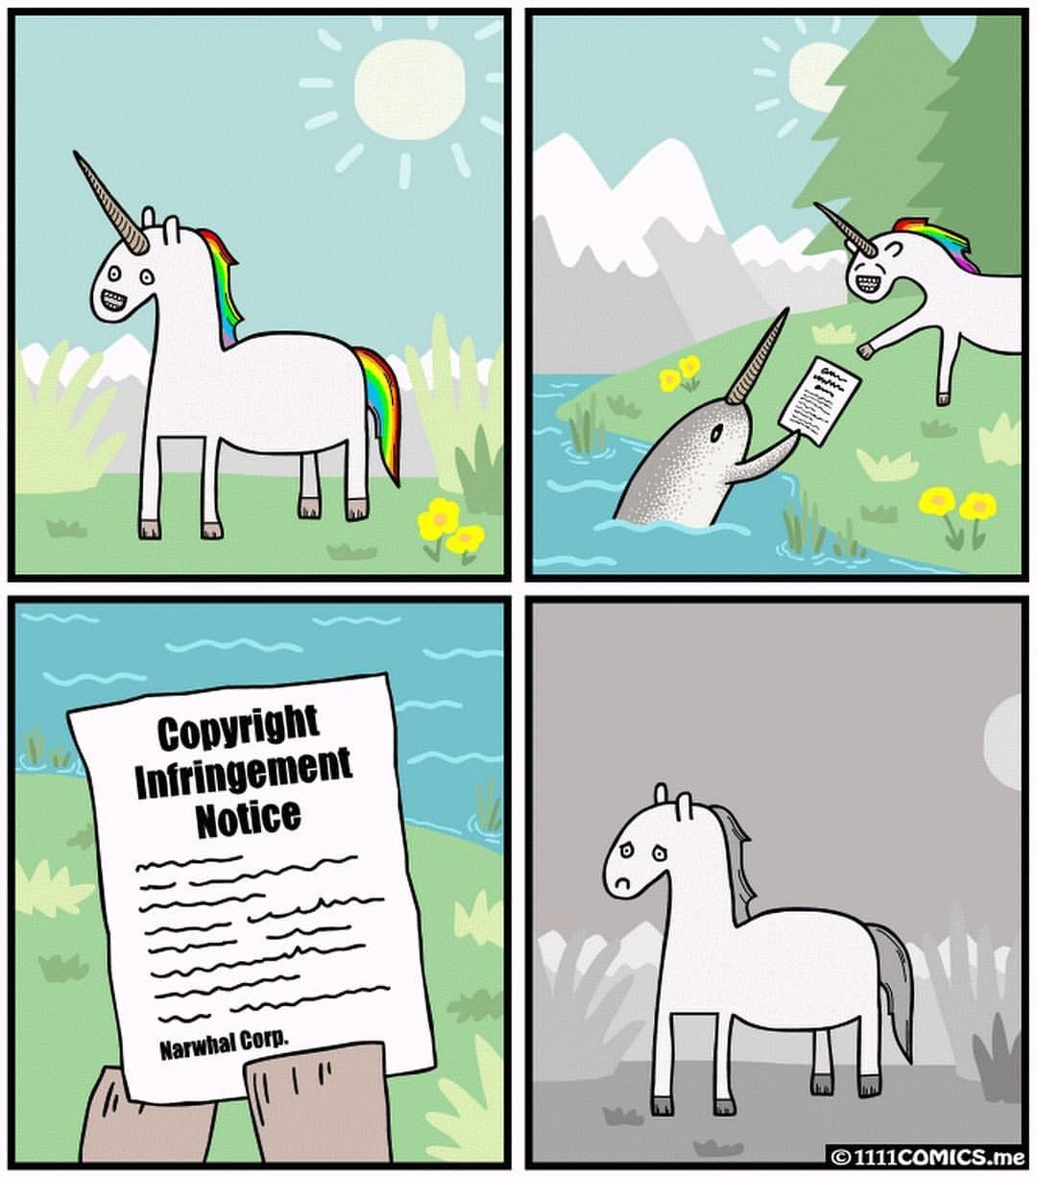

Slide 30
ILL & Digital Resources
Definitions
Common Difficulties
Contract Terms
ILL Clauses in Digital Resource Licenses
Managing ILL Compliance
Final Thoughts
Resources

Slide 31
Definitions
What are Digital Resources?
Journals
Books
Datasets
Databases
Audiovisual files

Slide 32
Definitions
An electronic (a.k.a. digital) resource that the library has purchased access to and negotiated the license for terms of use.
(vs. freely available on the web or purchased outright)

Slide 33
Common Difficulties
Copyrights & Contract Law
“When a license is signed, that license, not copyright law or fair use, governs what can and cannot be done with the purchased content.” (Weir, 54)

Slide 34
Common Difficulties
“Many libraries in the past have made the assumption that if these (ILL) rights are not explicitly forbidden, then it is okay to provide materials to other libraries via ILL...however, in reality, this is not the case.” (Weir, 59)
ILL is not always included in licenses and when it is, not necessary standard language

Slide 35
Common Difficulties
Temptation to use the digital version of book/article/etc.

Slide 36
Contract Terms
Does the license state exactly what can be loaned?
Number of downloads
Number of pages
Does the license state how the material can be sent - emailed, faxed, printed first, then mailed, etc.?
Does the license state that the publisher can change the terms without notice to the end user (library)?

Slide 37
Examples

Slide 38
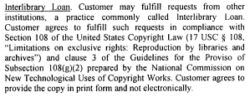
BLOOMBERG
BNA

Slide 39
ProQuest

Slide 40
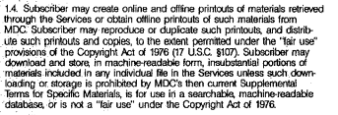
Lexis
Original Contract
New Terms

Slide 41
Westlaw
2. Westlaw License.
2.2 Law School Personnel. If you are law school personnel, we also grant you a limited, non-exclusive, nontransferable license to include data in your academic writings prepared during the course of your regular curriculum. Any further distribution is prohibited without our written permission. Data included in your writings must retain copyright notices.

Slide 42
EBSCOhost

Slide 43
“When signing a contract, assume that you are signing away all copyright exceptions including fair use, unless they are expressly stated in the contract that is signed…” (Weir, 55)

Slide 44
License Management

Slide 45
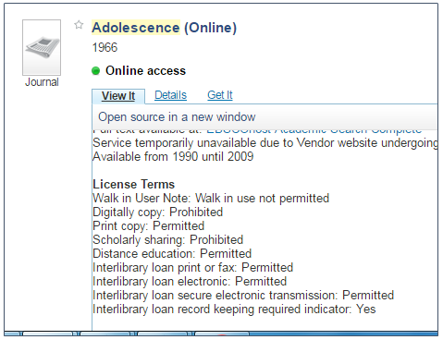
Commerical Products

Slide 46
In-house Database

Slide 47
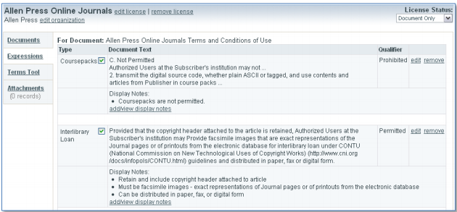
Open Source
http://coral-erm.org/

Slide 48
Final Thoughts
When in doubt, ask the publisher!

Slide 49
Resources
Becky Albitz, Licensing and Managing Electronic Resources (Chandos Publishing 2008)
Kyle K. Courtney, Copyright in the Digital Age, in Law Librarianship in the Digital Age 31 (Ellyssa Kroski ed., Scarecrow Press 2014)
Ryan O. Weir, Licensing Electronic Resources and Contract Negotiation, in LITA Guide: Managing Electronic Resources 53 (Ryan O. Weir, ed., ALA TechSource 2012)

