Slide 1
Creating an ILL Training Resource Site/Wiki with Users in Mind
Dana Von Berg
University of Arizona Libraries
September 8, 2016
Northwest ILL Conference
Portland, Oregon
Notes:
This template can be used as a starter file for presenting training materials in a group setting.
Sections
Right-click on a slide to add sections. Sections can help to organize your slides or facilitate collaboration between multiple authors.
Notes
Use the Notes section for delivery notes or to provide additional details for the audience. View these notes in Presentation View during your presentation.
Keep in mind the font size (important for accessibility, visibility, videotaping, and online production)
Coordinated colors
Pay particular attention to the graphs, charts, and text boxes.
Consider that attendees will print in black and white or grayscale. Run a test print to make sure your colors work when printed in pure black and white and grayscale.
Graphics, tables, and graphs
Keep it simple: If possible, use consistent, non-distracting styles and colors.
Label all graphs and tables.

Slide 2
Presentation goals
Provide an overview of ILL Borrowing training process at UA Libraries.
Share information on how we created our new training site.
Explain the chosen structure and how information is categorized for various users.
Share feedback received from user groups.

Slide 3
Presentation Outline
ILL Borrowing Statistics from UA Libraries
Training Process at UA Libraries
Orientation
Documentation
Hands on Experience
Post Training Assessment
III. New Training Site
Background
Screenshots
IV. Section I: “AIS Searching Resources”
Description of Sub-Headings
View of “Basic Training Documents” Sub-Heading
View of “Borrowing Searching---Instructions and Resources” Sub-Heading
Sub-Section “Articles and Book Chapters—Instructions”
Sub-Section “Articles and Book Chapters---Resources”
D. Feedback from AIS searching staff on “AIS Searching Resources” section
V. Section II: “DDA Staff Resources”
Description of Sub Headings.
Description of Sub Heading “DDA Borrowing Staff”
Description of Sub-Section “Daily Borrowing Staff Tasks”
Description of Sub-Section “Borrowing Management Tasks”
Feedback from DDA Borrowing Staff on the “DDA Staff Resources” section
VI. Section III: OC (Office Coordinator) Instructions
Description of Sub-Headings
Description of Sub-Heading “Fines and Charges”
Description of Sub-Heading “Receiving Articles”
Description of Sub-Heading “Other OC Instructions and Templates”
Feedback from staff on “OC (Office Coordinator) Instructions section
Conclusion

Slide 4
ILL Borrowing Searching Statistics (Data based on July 1-Dec. 31, 2015)
Number of Staff: 12
Total number of scheduled searching hrs. per week 46
Avg. Weekly Hours Searched (per staff member): 4
Avg. Monthly Volume of Incoming Requests: 4,000
Number and percentage of requests searched by Access Svcs. Staff: 63%
Turn around time in days (Article Requests): 2.05
Turn around time in days (Loan Requests): 8.75
Turn around time in days (Doc Del Articles): 1.46
NOTE: Turnaround Time is from request submission to receipt.
Notes:
Give a brief overview of the presentation. Describe the major focus of the presentation and why it is important.
Introduce each of the major topics.
To provide a road map for the audience, you can repeat this Overview slide throughout the presentation, highlighting the particular topic you will discuss next.

Slide 5
Training Process at UA Libraries--Orientation
ILL Overview
Processes
Request Types
Consortial Agreements
Next Step: Online tutorials
Notes:
Give a brief overview of the presentation. Describe the major focus of the presentation and why it is important.
Introduce each of the major topics.
To provide a road map for the audience, you can repeat this Overview slide throughout the presentation, highlighting the particular topic you will discuss next.

Slide 6
Training Process at UA Libraries -- Documentation
Basic Training Documents
Loans
Articles
Document Delivery
Checklist
Flowcharts
Request Lifecycle

Slide 7
Training Process at UA Libraries – Hands On Experience
Practice sessions
One to One Training
Separate training queues created
Loans then Articles
Checklist of request types and examples are followed
Fake requests created for items not covered
Generally 1.5 hours in length 3 times per week
Training usually takes 4-6 weeks, meeting 1-3 times per week depending on schedules

Slide 8
Post Training Assessment
Time frame
Self-Assessment
Training Assessment
* Copies of the self-assessment and training assessments included in the Appendices.

Slide 9
New Training Site--Background
Switched from SharePoint (SP) 2010 to 2013.
Using the Wiki Page Library instead of an Enterprise Wiki
Provides us with more flexibility in organizing and grouping content.
Front page cleaner, less busy
Intuitive Headings
Written how people speak
Brief and to the point (avoid excessive scrolling)
Including intuitive keywords for faster searching
Side navigation matches landing page
Links added in more than one location
Front page content kept to a minimum
Grouped into 3 main sections
Contains sub-sections that link to many resources

Slide 10
OLD SharePoint 2010 site:

Slide 11
NEW SharePoint 2013 site:

Slide 12
Section I: AIS Searching Resources – Descriptions of Sub-Headings
AIS staff only need to view the first column—all they need is there
Searching Expectations – explains what DDA expects from them and explains how we evaluate their performance.
Basic Training Documents – This sections contains links to PDF files of our basic training documentation which includes searching incoming loan, article & book chapter requests as well as the flowcharts used when beginning ILL searching.
Borrowing Searching—Instructions and Resources – Biggest section with instructions for handling unusual requests along with resources for handling harder requests.
Cancelling Requests – Contains useful information on cancelling requests as well as links to our list of cancellation messages.

Slide 13
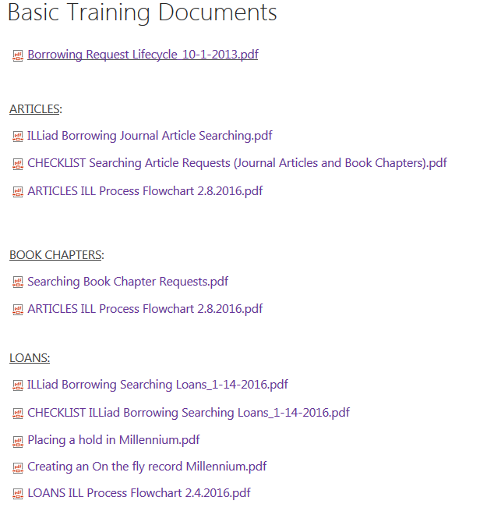
Section I: AIS Searching Resources – View of “Basic Training Documents” Sub-Heading

Slide 14
Section I: AIS Searching Resources – View of “Borrowing Searching---Instructions and Resources” Sub-Heading

Slide 15
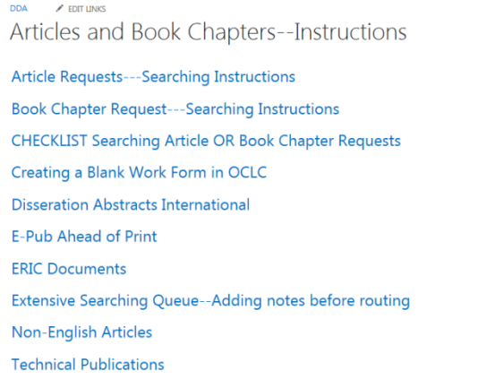
Section I: AIS Searching Resources →Borrowing Searching---Instructions and Resources→View of Subsections “Article and Books Chapters—Instructions & Resources

Slide 16
Feedback from Searching Staff on “AIS Searchers” section :
4 recent trainees & 1 staff who searches high volume of requests surveyed
Asked to locate the following (survey also listed in Appendix)
Instructions for submitting RUSH requests
How to process a request for an AIAA paper
How to process requests for new publications
Processing an “E-Pub ahead of print” request
Processing requests for ERIC documents
Ratings scale:
1 = I was not able to find what I needed.
2= I found this through a keyword search using the “Search” box.
3= I found this via the headings in the “AIS Searching Resources” section

Slide 17
Results from AIS Searcher Survey:
1 searcher found it easiest to use the search box for all the questions but found all the needed pages.
The remaining four searchers surveyed found roughly half the pages with the search box and half with the headings.
Only 1 searcher was unable to find the page in Question #3 on processing requests for new publications. She had found a different page she thought was the correct one, via the search box.
Findability score breakdown from all 5 searchers surveyed:
Instructions for submitting RUSH requests 3,3,3,2,2
How to process a request for an AIAA paper 3,3,3,2,2
How to process requests for new publications 3,3,2,2,1
Processing an “E-Pub ahead of print” request 3,3,2,2,2
Processing requests for ERIC documents 3,3,3,2,2
1 = not able to find
2 = found through a keyword search
3 = found via the headings in the “AIS Searching Resources” section

Slide 18
Results from AIS Searcher Survey (continued):
Comments & Feedback (from the searchers who provided some):
“The search function works VERY well! Sometimes I am confused about what larger topic something might be listed under but the search always bring back what I need.”
“This was easy to use. Thanks.”
“This was easy since I am familiar with the DDA wiki. I knew what I was looking for. I use the “search this site” box when I am in a hurry. I think that most people will need to use the search this site to get into the correct page.“
“I had a hard time finding an answer to question 3, even with the “search this site” tool. I’m not sure if I found the right page. Overall, I think the wiki is really useful and helpful. Having the wiki made me feel much more confident starting out a new ILL processor. It’s a great tool to reference as you process requests, especially since there are many different types of requests that require specific processes.”

Slide 19
Next Steps for “AIS Searching Resources” Section:
Added a link to the “Technical Publications” page (the answer to question 2) and the link to the “E-pub Ahead of Print” page (the answer to question 4) to both of the “Articles and Book Chapters” subsection which are the instructions and resources pages. This way the searcher can open either section and find the needed page without having to think about whether it’s an article or resource.
Consider eliminating the distinction of “instructions” and “resources” so all items could appear in one list on one page, depending on how lengthy that would be.
Provide new searchers with this survey, after training is complete, to see how well they can find the needed pages.
Check-in more regularly with new and frequent searchers on how the wiki is working for them and seek suggestions they have for improvement.

Slide 20
Section II: DDA Staff Resources—Description of Sub-Headings
Second section – Borrowing staff resources.
DDA Borrowing Staff sub-section contains resources borrowing staff use for daily tasks, management tasks and various other resources used for difficult borrowing searching.
Borrowing Receives Instructions contains instructions for processing borrowing receives, a handy reference for printing new ILL books straps.
Lending Resources are placed here as a refresher for borrowing staff, section also contains information on service levels.
Production Area Management contains instructions borrowing staff might need to reference.
SharePoint 2013 Instructions contains instructions for adding pages, links and headings to the SharePoint 2013 site.

Slide 21
Section II: DDA Staff Resources—Description of Sub-Heading “DDA Borrowing Staff”
Daily Borrowing Staff Tasks – Contains instructions and resources for various tasks conducted daily or very frequently. Examples include 30 day old OCLC requests, Overdues, International orders, recall, renewals, etc.
Borrowing Management Tasks – Contains info. pertinent to borrowing managers such as IDS workflow information, updating OCLC custom holdings and purchasing IFLA vouchers.
Borrowing Polices – Policy info. on ordering theses, cancelling requests.
Technical Resources – Info. on ordering technical reports and locating them in our collection and online.
Worldshare – Link to Worldshare and instructions.
International Resources – Info. organized by country with instructions for ordering from libraries and searching various resources for foreign publications.

Slide 22
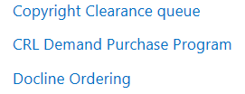
Section II: DDA Staff Resources →DDA Borrowing Staff section: Daily Borrowing Staff Tasks
Section contains instructions and policies around tasks that are either done on a daily basis or very frequently by all borrowing staff, not just the borrowing managers.
Tasks are labeled according to their queue or process and when applicable include information on the type of task such as ordering or processing, depending on our staff lingo.
Striving for intuitive labeling so content can be located quickly.
Tasks such as 30 day old OCLC requests, copyright clearance, and renewals are done daily while others are done rather frequently but not always daily, e.g. CRL demand purchasing, borrowing overdues, recalls.

Slide 23
Section II: DDA Staff Resources →DDA Borrowing Staff section: Borrowing Management Tasks
IDS Project Workflow Toolkit — Contains basic information about the IDS project and links to their tool kit.
Monitoring Special Queues – Instructions and policies around borrowing queues with specific issues that need to be dealt with by borrowing managers.
OCLC Custom Holdings Groups – List of our OCLC Custom Holdings Groups readily available for viewing.
Purchasing IFLA Vouchers from OCLC – Instructions for purchasing IFLA vouchers from OCLC so we can fill borrowing requests for items from foreign, non-OCLC libraries.
Updating SHRS Participant Information – Instructions for adding and removing libraries from our SHRS consortia in OCLC custom holdings in ILLIAD.

Slide 24
Feedback from Borrowing Staff on the “DDA Staff Resources” section:
Feedback received from my colleagues who handle difficult borrowing and management tasks:
“I think it is well organized and easy to find things. It is easy to navigate through the site using either menu. The heading names are intuitive as is the organization. “
“The front page is so clean looking and you can quickly assess the alphabetical order---which is reassuring that I won’t be spending too much time figuring out the organization. I like that you can search by tasks alphabetically AND using the search queue. I like that within the explanation of tasks links serve as cross-section—For example, you can link on Demand Purchase Program within ETHOS”

Slide 25
Section III: OC (Office Coordinator)—Description of Sub-Headings
Third Section – OC Office Coordinator Instructions:
Many of our section headings such as “FedEx instructions”, “Fines and Charges”, “Proxy Cards” and “Resends” are self explanatory but here is an explanation of some that might be less intuitive:
AHSL Instructions – Instructions related to sending and receiving ILL items from our Health Sciences Library.
E-Mail Templates – Contains the text of various e-mail messages we routinely send to customers.
Pay Document Delivery and UAiR – Instructions for processing paid document delivery requests for items whose citations are found online through our University of Arizona Institutional Repository (UAiR).
Video Streaming OC Instructions – Contains instructions and tips for customer service staff that aid them in answering questions around our video streaming service.

Slide 26
Section III: OC (Office Coordinator)—Description of Sub-Heading “Fines and Charges”
This sub-section contains instructions for adding and reducing customer fines.
Headings in this sub-section were labeled as we refer to them which is basically in terms of their respective functions.

Slide 27
Section III: OC (Office Coordinator)—Description of Sub-Heading “Receiving Articles”
Contains instructions for receiving various types of articles from vendors with different delivery methods.
Our lingo and the function of the task has been incorporated into the sub-headings.

Slide 28
Section III: OC (Office Coordinator)—Description of Sub-Heading “Other OC Instructions and Templates”
Sub-section contains instructions and resources that didn’t quite fit into one of our key categories on the front page.
Separated out by instructions, resources and templates, based on content and function.
These items can be located through our search box due to the naming of each heading staying true to our in-house language and the function.

Slide 29
Feedback from resource sharing staff on “Office Coordinator Instructions” section:
Feedback received from ILL staff in my department who handle customer tasks (which we call Office Coordinator or OC):
“The front page is so clean/ This area especially benefits from the search box---OC has so many nuances and the search box really helps me cut to the chase. I like the Q/A aspects of some of the sections (see Proxy Card OC information). But when appropriate there is text Receiving Articles that need to be scanned. Some of us are visual and some of us want to read instructions and the pages in this area seems to consider the different ways we process information and I really appreciate that.”
“The right decision has been made to focus on content.”
“It is easy to use, headings are clear and contains good, helpful information. I find it is easy to find the information I need- so easy access, and very detailed step by step instructions. I use it all the time with no problem.”

Slide 30
Next steps for sections used by DDA staff: “DDA Staff Resources” and “Office Coordinator Instructions”
Discuss findability issues at our working group meeting and work together to make certain pages easier to locate.
Seek immediate feedback from new staff undergoing training.
Check in more regularly with DDA staff on how the site is working for them and seek ongoing suggestions for improvement.

Slide 31
Conclusion & Summary
Overall, staff find the headings to be intuitive.
Landing page with headings is preferred to the side-bar navigation of the 2010 site.
Search box picks up keywords from page content and headings, contributing to quick findability.
Continuously seeking feedback from all staff on better labeling, organization and layout will help maintain a clearer, more usable structure.
Continually a work in progress as new searchers are trained and new information is added that needs to be accommodated to fit into the structure.

Slide 32
QUESTIONS?
Contact information:
Dana Von Berg
Library Information Associate Senior
Delivery, Description & Acquisitions
University of Arizona Libraries
1510 E. University Blvd.
Tucson, AZ 85721-0055
Phone: 520-621-8753
E-mail: vonbergd@email.arizona.edu

Slide 33
Appendix 1: Trainee Self Assessment Form

Slide 34
Appendix 2: Assessment of ILL Training and Trainer

Slide 35
Appendix 3: Survey to assess “AIS Searching Resources” section

Slide 36
Appendix 4: Article & Book Chapter Process Flowchart

Slide 37
Appendix 5: Borrowing Loan Process Flowchart

