Slide 1
Keeping the Baby AND the Bathwater
Supplementing Traditional ILL With an On-Demand Document Delivery Service

Slide 2
About Miami University
Selective admissions
Undergraduate emphasis, some grad programs
16,000 undergrads / 2,700 grads
New distance education / travel programs

Slide 3
Pre-Existing Document Delivery
900 Returnables / 1,900 Non-Returnables / Yr
10,500 Returnables thru consortia
Avg. turnaround: 2.67 days (non-returnables)

Slide 4
Pre-existing Concerns
Increase in expectations about speed
Decrease in interest in print
Flat budget = fewer journal titles locally

Slide 5
Why GetItNow
Integration w/software
Selection of publishers
Quick turnaround time
No reciprocation in delivery time

Slide 6
Initial Questions
Scope of service: Just faculty / grad?
Mediated / Unmediated?
Delivery mechanism?

Slide 7
Ground Rules for Trial Launch
Open to ALL affiliated patrons
Budget: $27k
Max # of requests per day

Slide 8
Timeline
Started discussing article Pay-Per-View in late 2013.
Looked at various vendors, including Read Cube.
Selected Copyright Clearance Center (CCC) based on ability to work with link resolver & ILLIAD, also a good number of publishers included.
Began as a pilot, ballparked $27,000 initial funding as a worst case scenario based on one year of ILL requests at $70 per article.
Considered starting as a mediated service, Summer 2014.
Decided we needed to go unmediated so patrons could access articles on nights and weekends (the whole point of “Get It Now”).
Went unmediated Fall 2014.

Slide 9
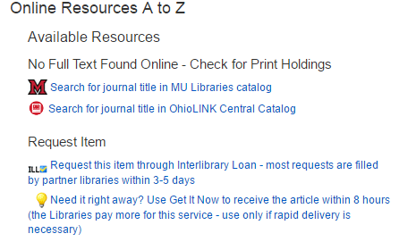
Deploying GetItNow

Slide 11
Requests by Discipline

Slide 12
Publishers
Taylor & Francis (43%)
WolterKluwers (12%)
Elsevier, Informa, Nature, Sage, Springer (4% each)
Emerald, Oxford (3% each)
Karger, Future Media (2% each)
Others (15%)

Slide 13
Requests by User Type

Slide 14
Occasional Issues
Requests duplicating library holdings
Requests > 8 hours

Slide 15
Impact on ILL Non-Returnables
2013/4: 1,819 requests
2015/16: 1,915 requests
16,000 undergrads / 2,700 grads

Slide 16
Questions
Rob Withers Head of Access Services witherre@miamioh.edu
Jennifer Bazeley Coordinator of Serials bazelejw@miamioh.edu
Kevin Messner Head of Branch Libraries messnekr@miamioh.edu
Susan Hurst Business Librarian hurstsj@miamioh.edu

