Slide 1
Triage! Get It Now as a Document Delivery Service Option
Mary-Kate Dopkins

Slide 2
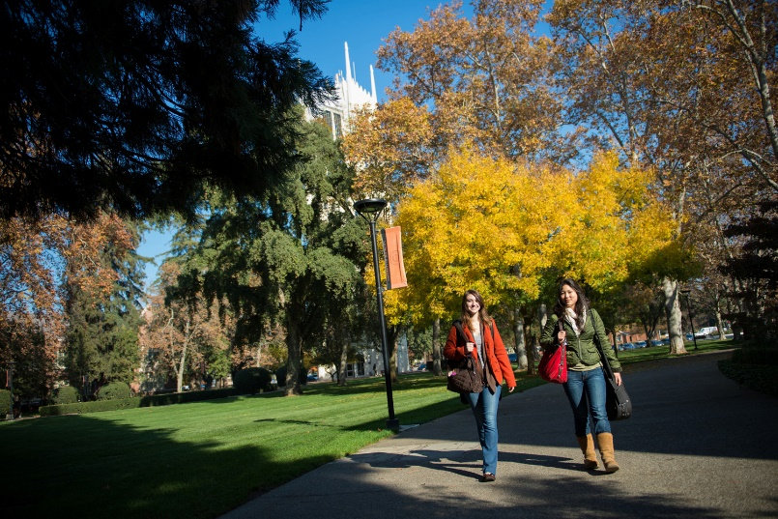
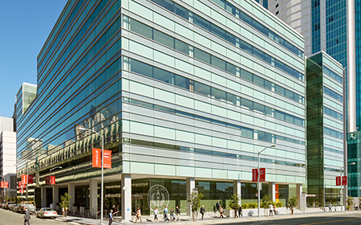
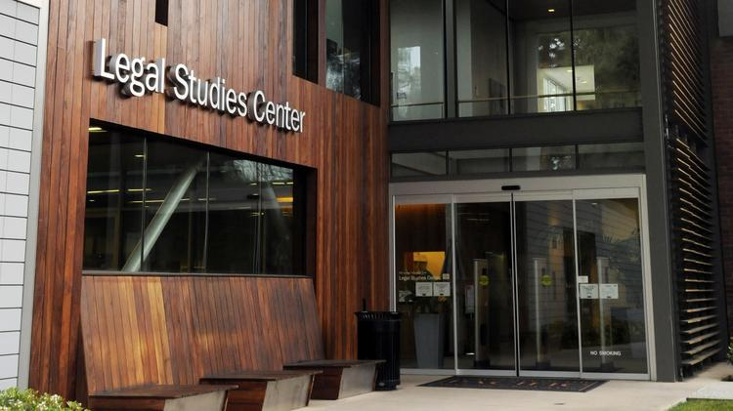
3 Campus, 1 University
Why explore a document delivery service?
Stockton, San Francisco, & Sacramento campuses
Limited physical library access for some programs
Enhancement of digital libraries
Centralize services

Slide 3
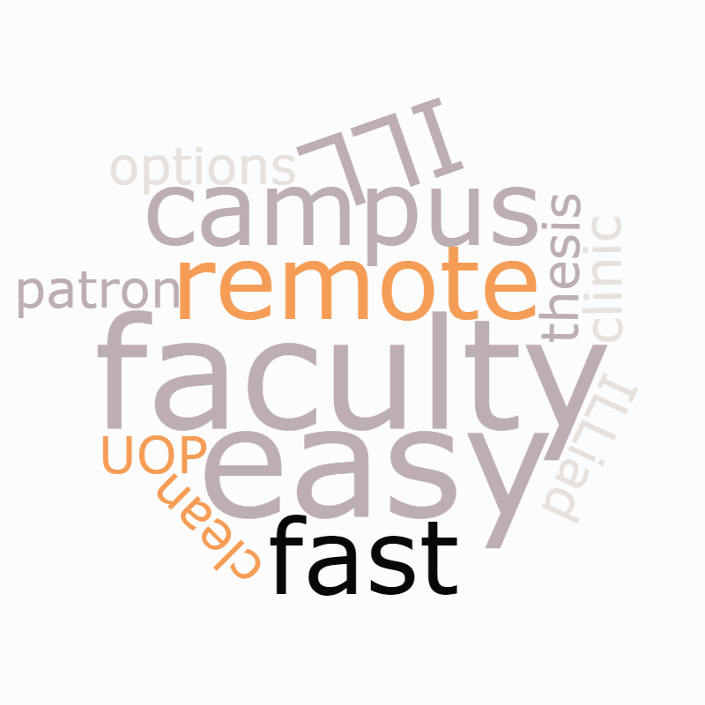

Slide 4
Service Drivers Dental Clinics

Slide 5
Service Drivers Faculty Relations

Slide 6
ILLiad with Get It Now

Slide 7
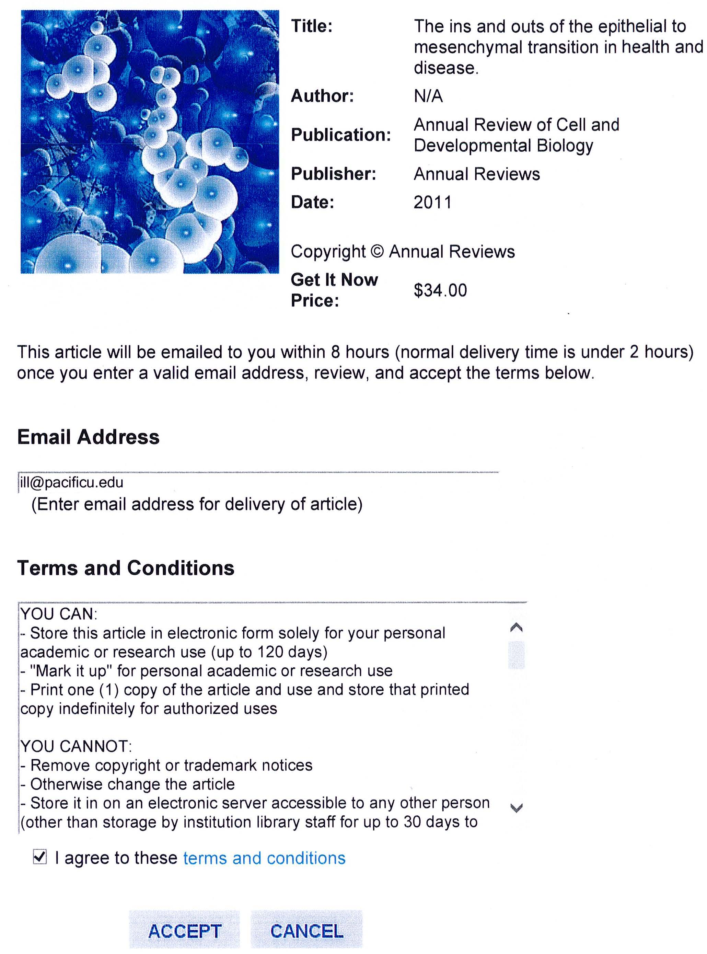
Easy to use
24/7, 365 days/year
Rapid turnaround

Slide 8
Concerns
Fewer articles than anticipated

Slide 9
Concerns
Low volume use means costs will not have a chance to average out

Slide 10
Thank You

