Slide 1
OCCAM’S READER
2016 Update

Slide 2
Nationwide Launch
Over 50 universities are using Occam’s Reader since the national launch in January 2016
Large and small institutions benefit from Occam’s Reader participation
400 total requests through August 2016
Of these, 165 requests were successfully filled

Slide 3
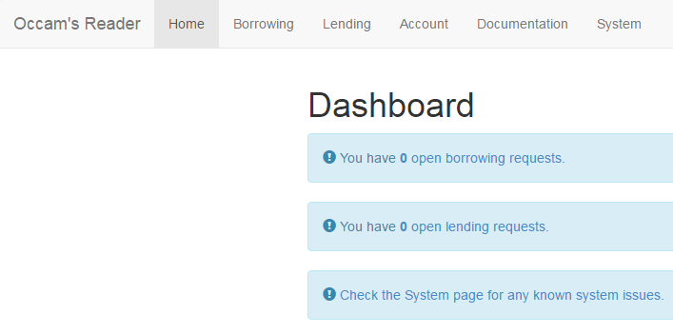
End-to-end web-based requesting
Also includes ILLiad addon to push information from ILLiad into OR

Slide 4
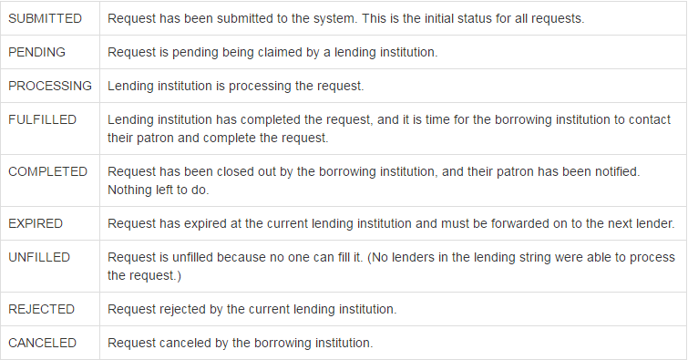
Anatomy of a Request

Slide 5
How We Address eBook Discovery
Currently:
Users indicate favorable lending contracts by publisher
(Soon to be phased out)
WorldCat searching based on eBook holdings reported to WorldCat
Works with either the ISBN or the OCLC Number

Slide 6
How We Address eBook Discovery
Coming soon:
Publisher-supplied eBook holdings
User-uploaded, searchable eBook holdings

Slide 7
Demonstration of New Viewer
OccamsReader.org
The new viewer is a ground-up rebuild from the first versions of Occam’s Reader. It is a mobile-first responsive design with touch controls, so it looks great on phones and tablets.

Slide 8
Pricing

Slide 9
Future Developments
Data sets
By the end of the calendar year, all Occam’s Reader participants will be able to borrow and to lend research data sets using Occam’s Reader.
3D objects
We received a grant, from the Texas State Library and Archives Commission, to develop a pilot system in conjunction with the University of Houston. The ILL process will be handled by the Occam’s Reader system. After grant-funded proof of concept, this functionality will be available to all Occam’s Reader members.

Slide 10
Thank You
Ryan Litsey & Kenny Ketner
Libraries.Occams.Reader@ttu.edu
OccamsReader.org

