Slide 1
Making the case for Lending Assessment
Or, why do they keep putting my symbol in their lending string?
Liz Sterthaus
Interlibrary Loan Librarian
Embry-Riddle Aeronautical University
Daytona Beach, FL
Elizabeth.Sterthaus@erau.edu

Slide 2
New Student Union to be completed in 2017

Slide 3
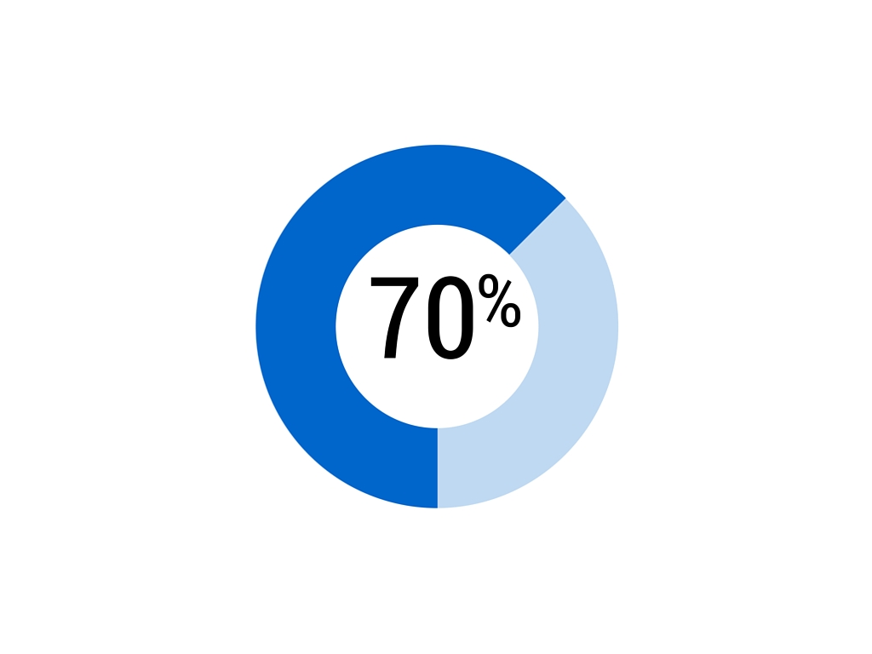
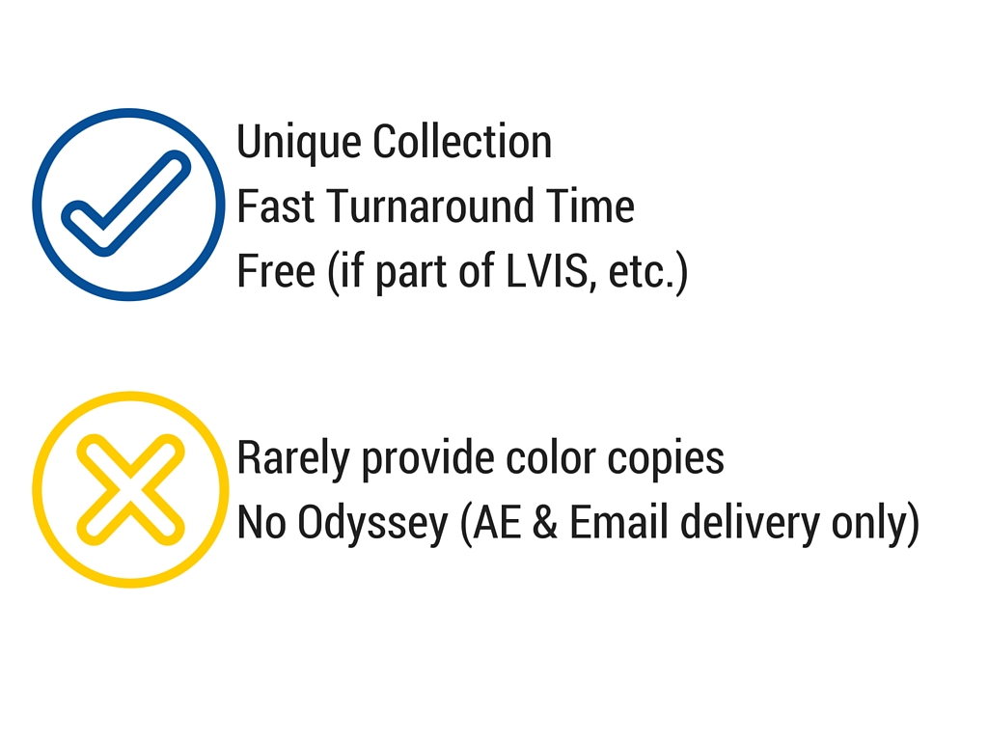
Why bother with Lending Assessment?

Slide 4
List of Reasons used on the Survey
FER has a unique collection.
FER’s turnaround time is fast.
FER is a part of a free lending and/or reciprocal borrowing group (e.g. LVIS, FLIN, etc.).
FER provides clear, scanned copies.
FER delivers copies using my preferred delivery methods.
I make my choices randomly in order to distribute my requests to a variety of lending libraries.
No reason.
Other

Slide 5
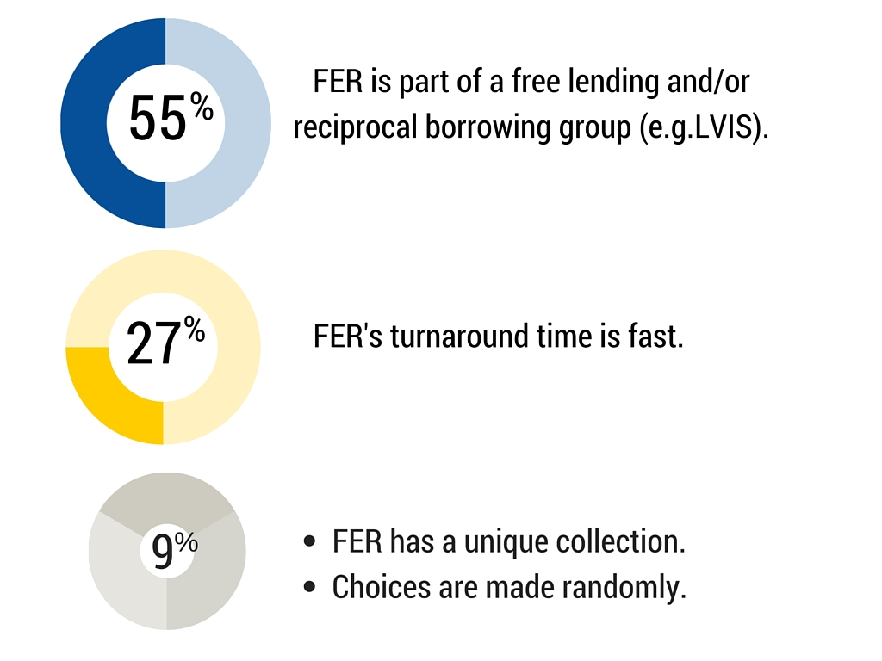
Primary Reasons

Slide 6
What I discovered
Free copies are the primary reason why libraries put us first in the lending string.
Unique collection was only selected once as a primary reason.
No negative or positive feedback concerning the condition of our scanned copies or preferred delivery methods.
90% of the respondents indicated that they make a conscious choice when considering possible lenders.

Slide 8
Possible ideas for future Lending Assessment
For Hunt Library ILL:
Send out a similar survey to Florida libraries only.
See if I can determine why some libraries do not use us more often.
In general:
If lending statistics are decreasing, it may be worth it to explore the reasons why.
How do libraries feel about OCLC’s new 2-day response time?

Slide 9
Thank You!
Liz Sterthaus
Interlibrary Loan Librarian
Embry-Riddle Aeronautical University
Elizabeth.Sterthaus@erau.edu
386-323-8774

