Slide 1
Finding a Win-Win in Service Delivery Through Examining ILL Cancellations
Susan E. Beck New Mexico State University

Slide 2
Background: Our university
28 PhD programs 58 Masters programs
1,062 Faculty 14,852 Enrollment

Slide 3
Background: InterLibrary Loan – Request It! Service

Slide 4
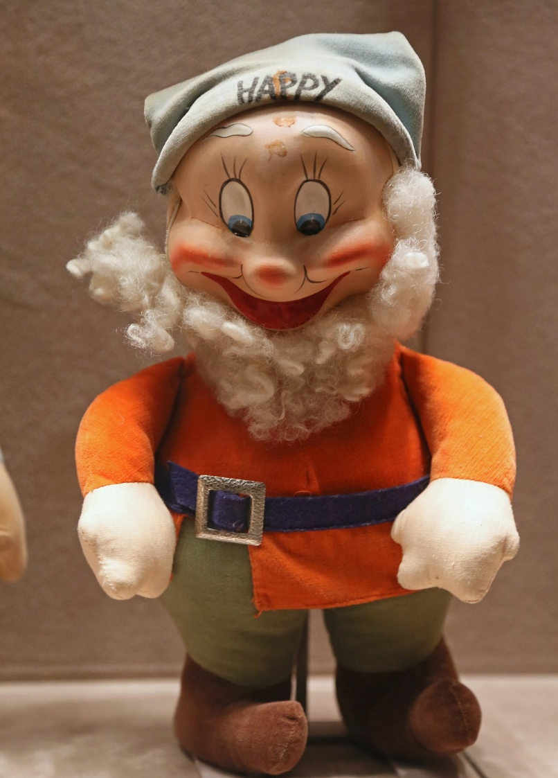
Reference InterLibrary Loan
https://www.flickr.com/photos/17599044@N08/4231823500/in/dateposted/
https://www.flickr.com/photos/jcapaldi/8705845276/in/album-72157633397945022/

Slide 5
Our original cancellation message
We gave step-by-step instructions & thought we were super helpful…

Slide 6
We changed the automated message to include step by step instructions, where to click, what to type…
-----Original Message----- From: NMSU Library Information Delivery Services [mailto:ill@lib.nmsu.edu] Sent: Monday, March 11, 2015 11:48 AM To: susabeck@lib.nmsu.edu Subject: Automated NMSU Library ILL Notification Dear Susan Beck, A request you have placed: (test) American antiquity 1 1 2010 Title: mathematica equations Author: smith TN: 466094 has been cancelled by the interlibrary loan staff for the following reason: Available in the NMSU Electronic Journals Go to http://yw2pn3mr9l.search.serialssolutions.com/ Type in the journal title and click Search. If you have a question about this cancelled item, please contact the interlibrary loan office at ill@lib.nmsu.edu or 575-646-4737 with the Transaction Number 466094. Thank you for using ILLiad.
But it wasn’t enough. People want their stuff NOW.

Slide 7
Reaction from Reference?
https://www.flickr.com/photos/17599044@N08/4231823500/in/dateposted/

Slide 8
Let’s have a meeting!
How about an “Inside ILL” training for Reference?

Slide 9
Let’s take a look at Ref Analytics data
What’s REALLY going on?

Slide 10
Ref Analytics Data: Questions
Why was my article request on ILL cancelled?
ill said that we had the article i requested and i cant find it
I need help finding an article that ILL said we have
I tried to ILL this article but I'm told it's in stacks. What does that mean?
ILL sent me a message saying that we have thes articles, can you help me find them?
looking for articles from socindex - ILL office cancelled my requests
My ill request got canceled.
My ILL was cancelled but I cannot access the articles.
grad student needs help finding articles canceled by ILL
Student has question about message from ILL that articles she requested are in library e-journals

Slide 11
Ref Analytics Data (con’t)
Student has question about message from ILL that articles she requested are in library e-journals
help finding articles in human capital theory and why ILL requests were cancelled...
Rejected ILL request because we have the journal
I requested a journal article thru ILL & I haven't been notified the status.
Graduate Student requested two articles via Illiad. They were cancelled because they were in Branson East Storage
ILL cancelled my request; says we have it electronically but I can't find it
help resubmitting early view articles to ILL (and why were they cancelled?)
student submitted an ILL request. Recieved message that it was in bound journals
Got email from ILL but can't find article
Student got response from ILL that we have the journal she requested
help deciphering ILL email
Explanation of ILL emails
ILL articles were cancled because we have them here but I can't find them

Slide 12
More Data from Ref Analytics
Total Reference Questions, 2013-2015 | 9,495
Questions Related to ILL | 191 | 2% | Of all reference questions
Questions Related to ILL Cancellations | 25 | 13% | Of all reference questions related to ILL

Slide 13
Let’s look at Illiad WebReports
First pass

Slide 14
Illiad WebReports: More granularity
Second pass

Slide 15
Let’s interview students!
“What’s your first response to this e-mail?”

Slide 16
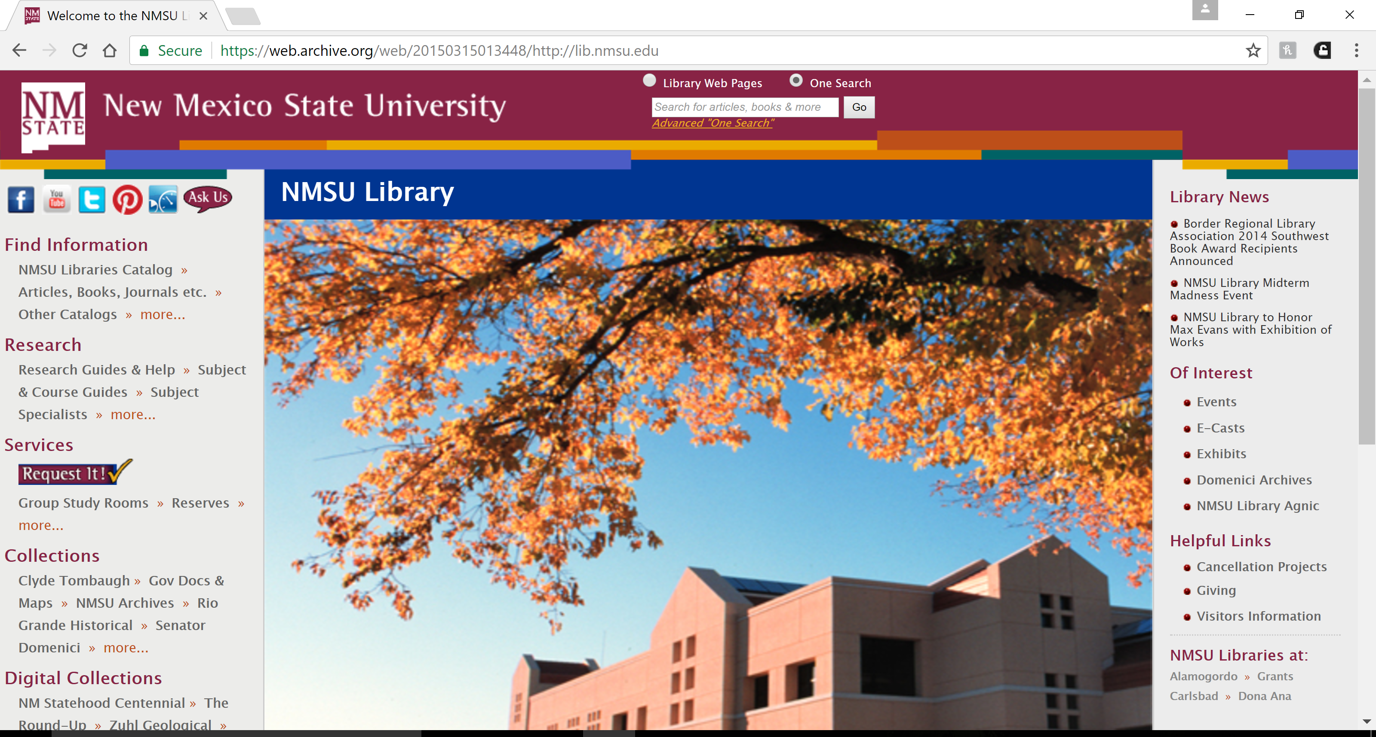
Insufficient & Inefficient Tools
March 15, 2015

Slide 17
Our ILL Stats were telling another story
Meanwhile…

Slide 19
We route cancelled requests for NMSU E-Journals through Doc Del?
So what if…

Slide 20
It’s time to assess
Two years later

Slide 21
Ref Analytics, 2015-2017
Question
My ILL request was cancelled can you help?
my request has been cancelled, but I still need to look for the thesis.
Response
Verified we don't have the article, referred to ILL for more details.
If the lending library won't release the dissertation, NMSU library can't buy the dissertation. The borrowing policy is determined by the lending library, so we must abide by their policies. I did however find an article from the same author, I think it's a summary of their dissertation.

Slide 22
More data from Ref Analytics
Total Reference Transactions, 2015-2017 | 8,232
Questions Related to ILL | 309 | 4% | of all Reference Questions
Questions Related to ILL Cancellations | 2 | 1% | of all Questions Related to ILL

Slide 23
Updates from Illiad WebReports, 2015-2017
Cancellations decreased by 10%!

Slide 24
Illiad WebReports, 2015-2017
More granularity

Slide 25
Improved Web Presence
July 2017

Slide 27
Reflections
React vs. Assess
Step back
Triangulate data
Maintain healthy skepticism
Gather feedback 360
Occam’s razor

Slide 28
Advice for studying a problem
Find a topic→What, When
Formulate questions→What, Why
Define population→Who, When
Select design & measurement→How
Gather evidence→How
Interpret evidence→Why
Tell about what you did and found out

Slide 29
Keep in mind that…
No study is perfect
All data is dirty is some way or another; research is what you do with that dirty data
Measurement involves making choices

Slide 30
Questions?
Comments?

