Slide 1
Leading Through Times of Change
Northwest Interlibrary Loan and
Resource Sharing Conference
September 13, 2018
Trevor A. Dawes
@tadawes

Slide 2
Rutgers Announcement
Source: http://comminfo.rutgers.edu/mlis-program-news/scai-announces-expanded-lis-curriculum-options-and-opportunities.html

Slide 3
Rutgers Announcement
Source: http://comminfo.rutgers.edu/mlis-program-news/scai-announces-expanded-lis-curriculum-options-and-opportunities.html

Slide 4
Challenges to Libraries
Defining Customer Service Metrics
Impact of Technology
Statistics – What to Measure
Patron Privacy
Brown, Charles H. and Humphrey Bousfield. Circulation Work in College and University Libraries. Chicago: American Library Association,1933.

Slide 5
Other Challenges
Accountability and Assessment
Library Spaces
Staff Skills Development
Equity, Diversity and Inclusion and Social Justice
Declining Budgets

Slide 6
Understanding Library and Higher Ed Trends
EDUCAUSE (including Horizon Report)
ACRL Environmental Scan
Ithaka S+R
Pew Research Foundation
OCLC
ALA

Slide 7
ARL New Roles for New Times

Slide 8
ARL New Roles for New Times

Slide 9
ARL New Roles for New Times

Slide 11
New Roles for Librarians

Slide 12
Some new positions at Washington University in STL
Some new positions at the University of Delaware
Copyright and Digital Access Librarian
Digital Archivist
Head of Publishing Production Services
Scholarly Publishing Director
Digital Infrastructure Librarian
Film Preservationist
AUL for Scholarly Publishing and Research
Director of Strategic Initiatives
Digital Content Specialist
Digital Publishing and Copyright Librarian
Organizational Learning Coordinator
Digital Applications Interface Specialist

Slide 13
First Modern Organi-zational Chart? http://www.slate.com/blogs/the_vault/2014/02/05/the_first_modern_organizational_chart_is_a_thing_of_beauty.html

Slide 14
Skills Needed by Library Workers
Project Management
Instructional Design / Instructional Technology
Digital Information Management
Data Analytics / Data Visualization
Technological / Programming
Assessment
Communications and Marketing
Others….

Slide 15
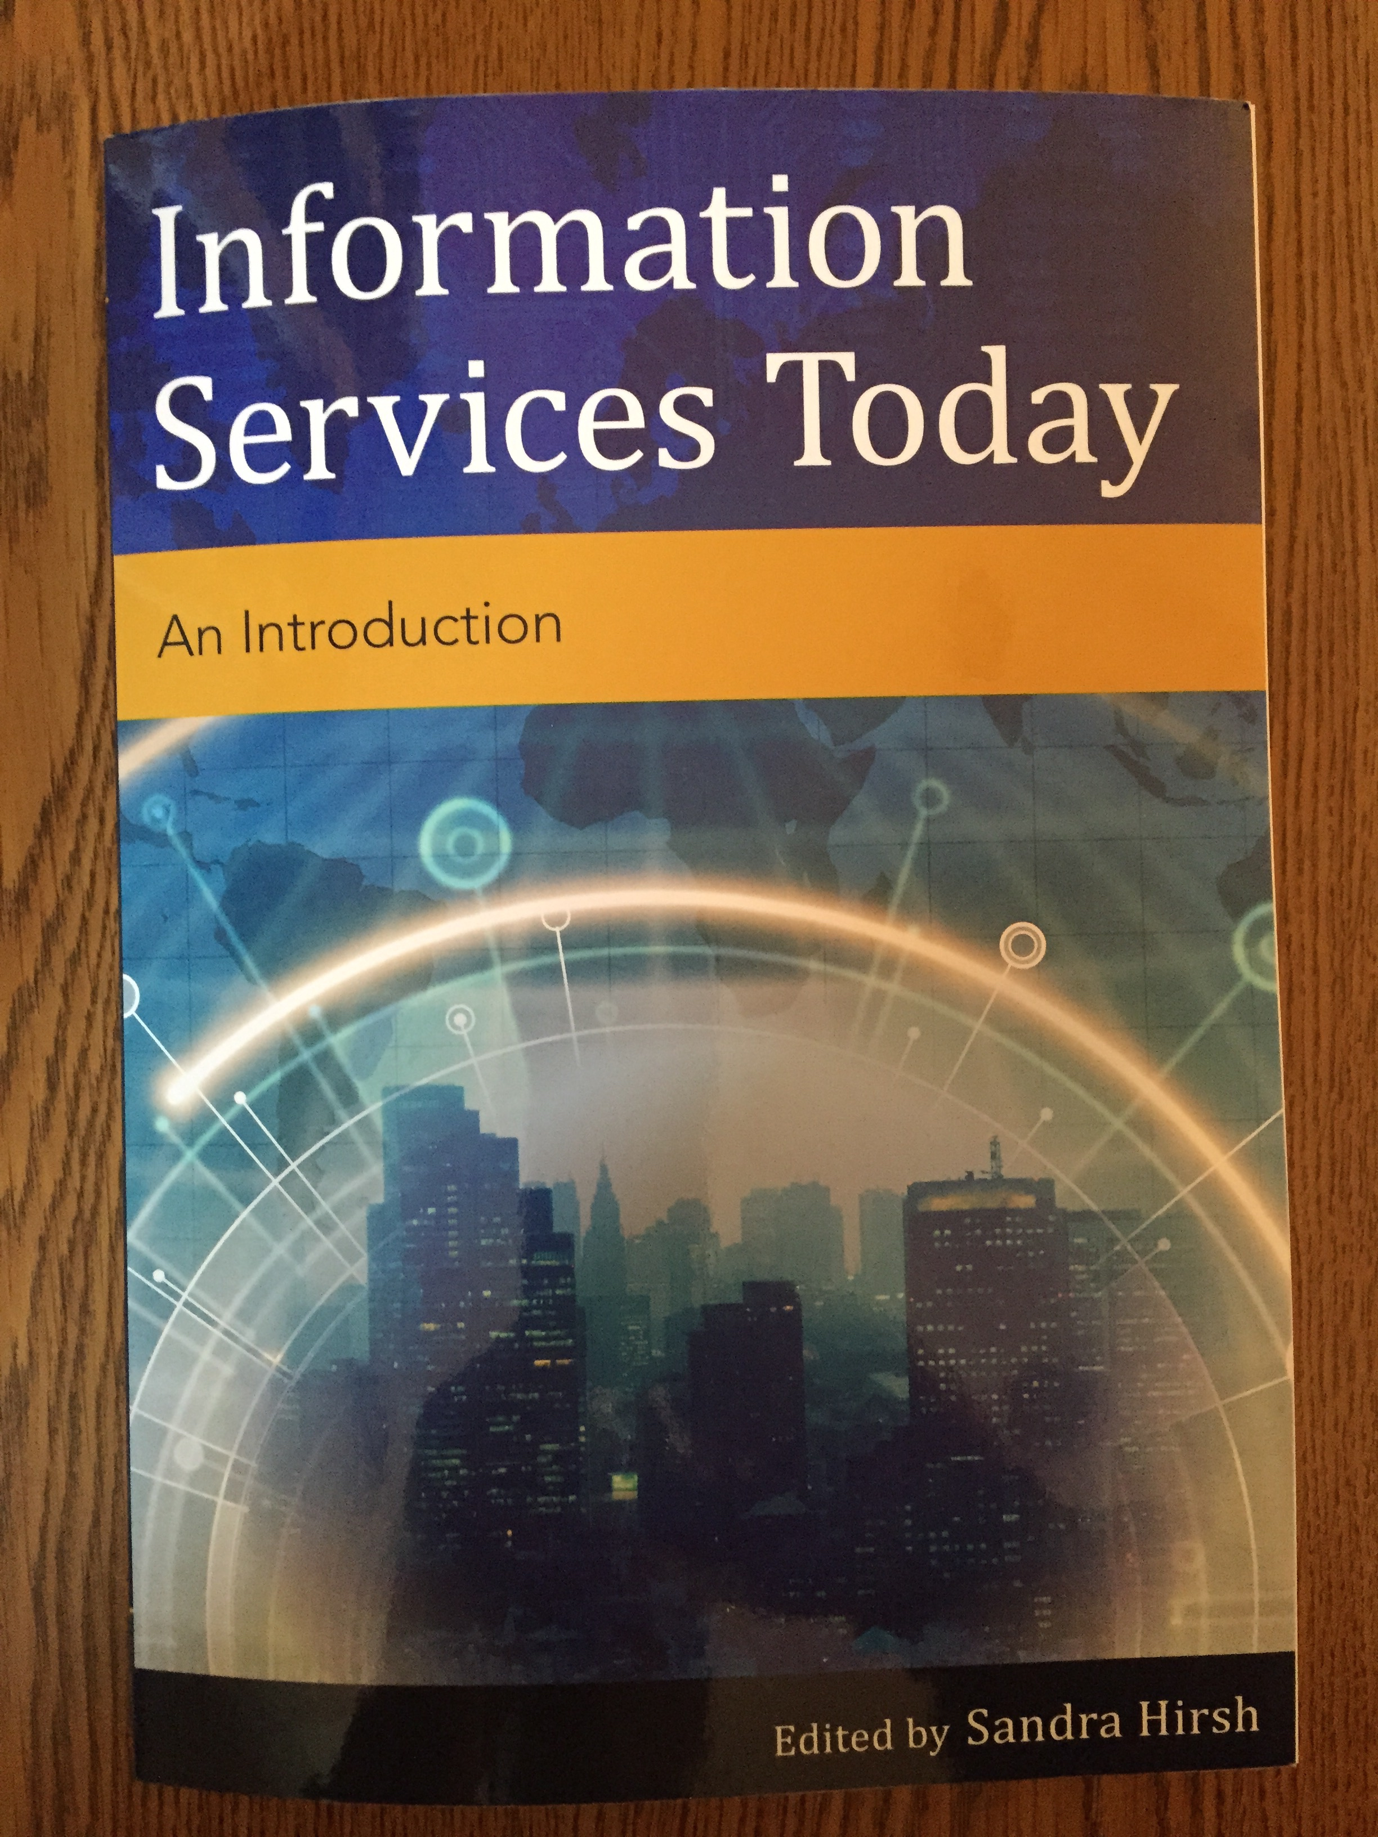
Libraries and Information Services Today

Slide 16
Changing Organizational Culture
Image Source: https://goo.gl/images/keXJxy

Slide 18
Understanding EDI
Image Source: http://www.lawsocietygazette.ca/news/understanding-the-new-equality-diversity-and-inclusion-edi-obligations-are-you-ready/

Slide 20
Image Source: https://goo.gl/images/5M7JmV

Slide 21
Questions / Discussion

