Slide 1
S.H.A.P.E.S.
Sharing &
Helping
Academics
Prepare for Educational
Success

Slide 2
New Resources, Same tradition of sharing
As the needs of our users expands we need to begin considering new types of resource sharing to meet new types of learning
Data sets
3D objects

Slide 3
The First system for the ILL of 3D objects
The system is composed of two components:
The online database of objects
The ability to request objects

Slide 4
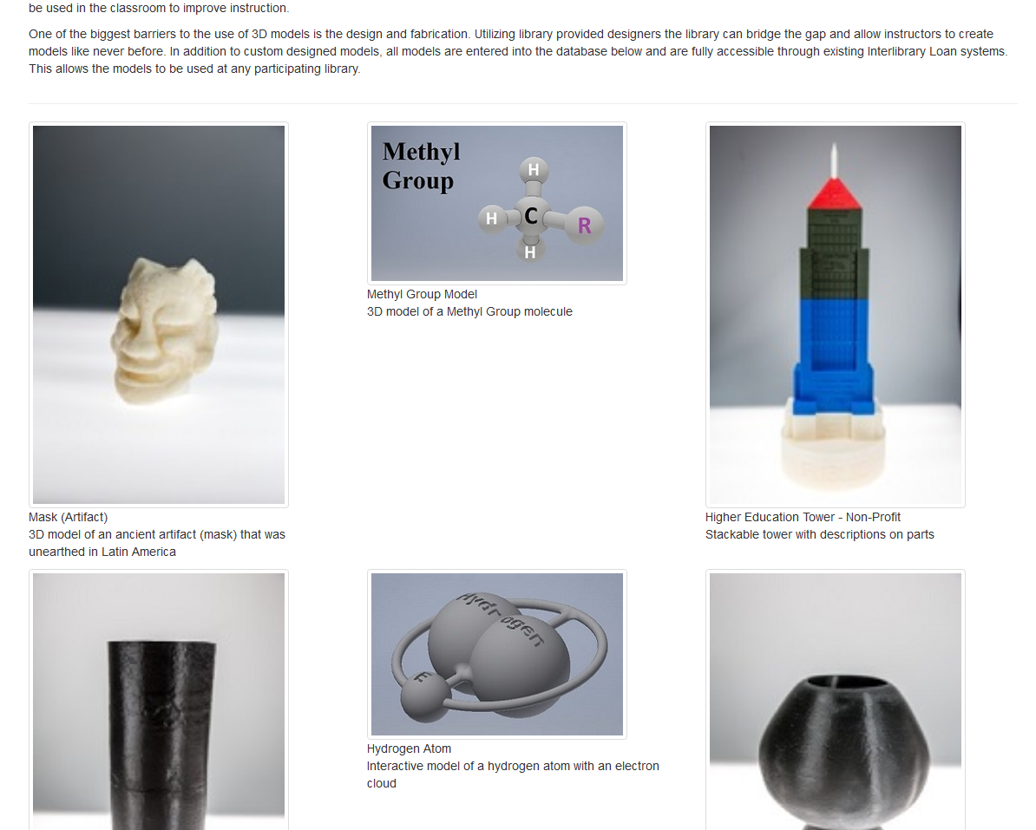
The Database of Objects
The website displays all of the objects that have been submitted by participating universities
Original object files are maintained at the submitting institution
It is publicly accessible for users to decide what objects they want

Slide 5
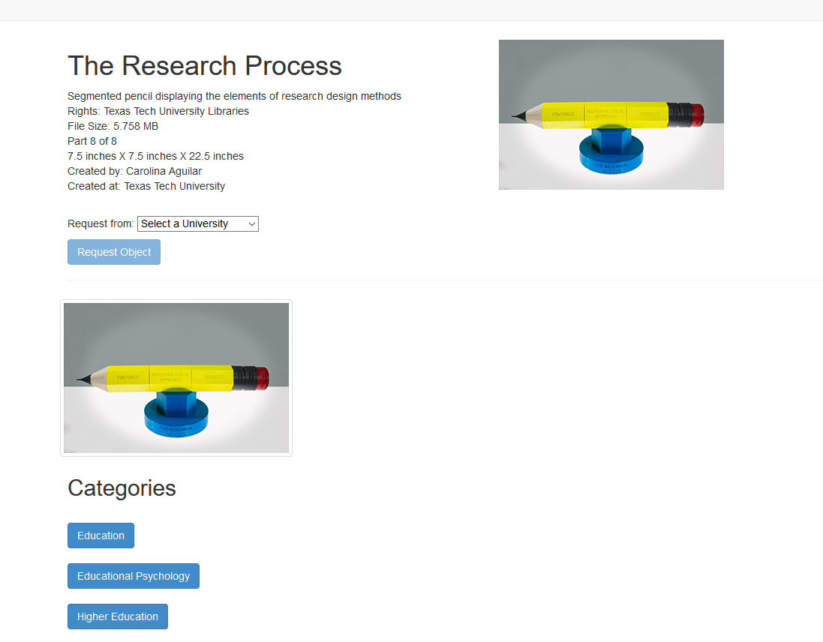
The Database of Objects
When a user selects an objects they are taken to the request screen
The request screen uses Open URL to populate an ILLiad request page

Slide 6
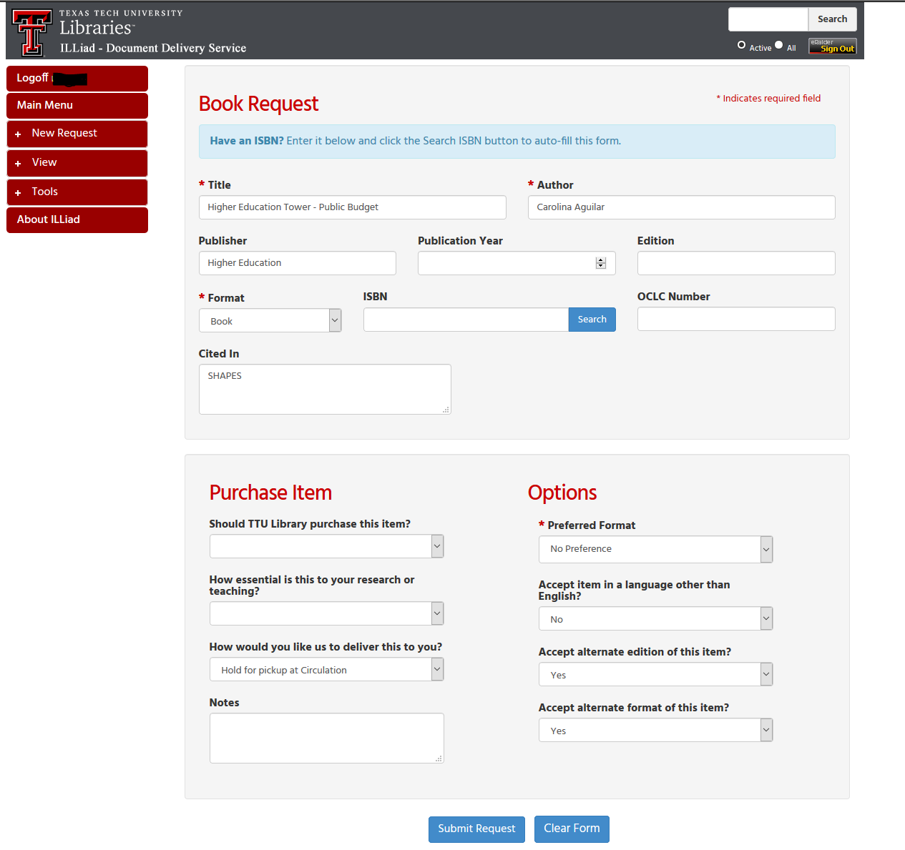
The ability to Request Objects
Each request is then processed in the local ILLiad pages and includes the notes field for SHAPES

Slide 7
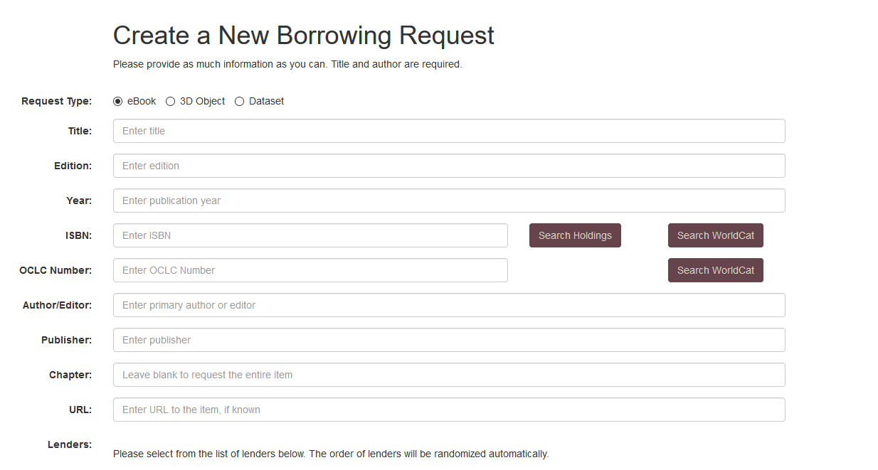
The ability to Request Objects
Requests are then passed from ILLiad into the Occam’s Reader system
Once in Occam’s Reader the lending library is identified
The reason we use Occam’s Reader is because of the integration with existing library ILL workflows and the files related to the object

Slide 8
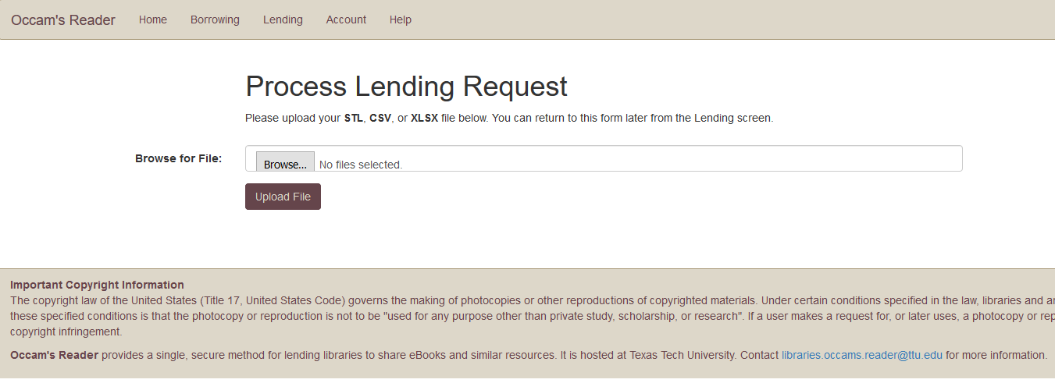
The ability to Request Objects
The lending library uploads the local .stl file into Occam’s Reader

Slide 9
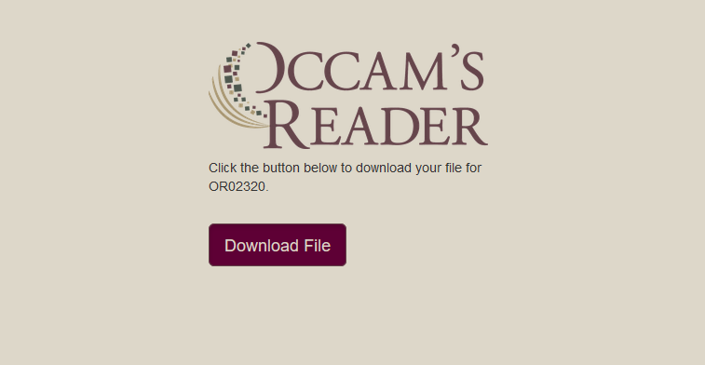
The ability to Request Objects
The file is then downloaded by the borrower and sent for fabrication
Once the object is fabricated by the library the file is deleted and the object is given to the patrons

Slide 10
Does it work?
The system was developed to help faculty, by giving them another resource type to improve classroom instruction
A study was conducted using the transactional model of communication
The study showed a 20% increase in student knowledge retention immediately after interacting with the 3D object.

Slide 11
Questions?
The SHAPES program was developed through a grant from the Texas State Library and Archives Commission
Ryan Litsey
Weston Mauldin

