Slide 1
Managing and Supporting Student Staff
Reflections of a First-Time Supervisor
presented By Miriam Wnuk (CityU of Seattle Library)
Northwest Interlibrary Loan and Resource Sharing Conference
September 13-14, 2018

Slide 2
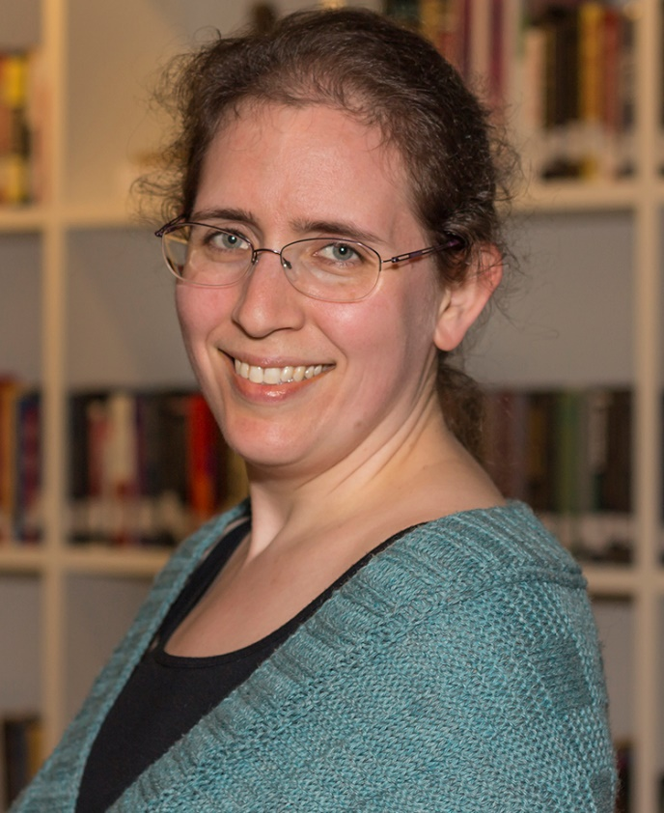
Miriam Wnuk
MLIS, MEd
Library Technician II
Interlibrary Loan
Circulation
Copy Cataloging
Supervisor
Department Liaison
Other Duties as Assigned

Slide 3
City University of Seattle
Private, not-for-profit school
Located in the Belltown neighborhood in Seattle, Washington
Walking distance from Pike Street Market and Space Needle
Nicknamed CityU
Established 1973 (City College)
Affiliation National University System (National University – California, John F. Kennedy University – Pleasant Hill, CA)

Slide 4
About CityU
Local and International campuses
Mexico, Vietnam, China, Slovakia, Czech Republic, Switzerland
Library serves all North American students (76%)
Washington (64%)
Seattle, WA
Everett, WA
Renton, WA
Vancouver, WA
JBLM, WA
Canada (12%)
Victoria, BC
Vancouver, BC
Edmonton, AB
Calgary, AB
Student Population
Headcount: 6,755
Full-Time: 21%
¾ Time: 13%
½ Time or less: 66%
Type
Undergraduate: 45%
Graduate: 39%
Doctorate: 4%
Non-degree Seeking: 12%
US International Students: 629 (9%)
From 11 countries
Veterans & Military Students: 468 (7%)
Average Age (USA/Canada): 35 (56% Female, 44% male)
Degrees Programs
Business & Management
Project Management
Professional Leadership
Computer and Information Systems
Teaching & Education
Health and Human Services
Instruction Delivery Methods
In Person: 32%
Online: 31%
Hybrid: 16%
Performance Based: 8%
Internships & Practica: 13%

Slide 5
Student Staff (Library Assistants)
Duties
First Line Customer Service
Technology Assistance
Interlibrary Loan back-up
Other duties as assigned
Linh Hoang (Vietnam, 11 months), Maheesa Maheen (India, 2+ years), Rohan Ali (Pakistan, 2+ months)

Slide 6
Hiring & Training
Hiring
Training
Interview with an open mind
Criteria?
Is there a skill the department needs?
Don’t rush
Interview questions, if created by library staff, should allow for creative answers.
Ask current student staff for feedback on questions. Involve them in the hiring process.
Train new hires in the important things
FERPA, dress code, duty expectations
Senior Library Assistant?
Give someone with experience an chance to lead
If your staff is large enough, make a game out of shelving for the new assistant.
Tip: If allowed, let a senior L.A. be involved in all parts of the hiring process, starting with resume review.
Notes:
Interview with an open mind – not all students have library or even work experience, but they may have an interest. If I hadn’t kept an open mind my first time hiring I would have ignored all undergraduate applicants since the job announcement stated “graduate students preferred.”
Don’t Rush them – this might be their first job interview EVER!
Interview questions – use questions that could use examples from work and life, again…not all applicants have work experience.
Training – Upon hiring walk a new student employee through the confidential laws and the expectations of how they are to act while working. Introduce them around the library, but if you have the opportunity let another experienced student staff member train them on the daily tasks. This gives the senior student staff person the opportunity to help the new person succeed and gives them a chance to bond on the job. In my library student staff rarely work at the same time, so this is great time for them to create a community feeling.
Involving a Senior Student Library Assistant with the hiring and training process is a great experience as a supervisor and allows that student to add a line on their resume when they graduate.

Slide 7
Scheduling
Balance needs with wants
Needs
Classes
School commitments (clubs, committees)
Pre-existing volunteer work (think of like a 2nd job)
Wants
Late starts/early dismissals
Vacations
New volunteer work
Ask for a desired schedule and class/school commitment times
Make no promises
Discuss a schedule with them before making it final, give them OWNERSHIP
There may be a reason they didn’t want to put a request in writing…
You are not a DICTATOR
Be flexible (holidays, birthdays, weddings)
Late buses happen
Exercise: Give a few students the parameters you work with to create the schedule and let them try it.
Notes:
Scheduling – we all hate it, but it has to be done
Nobody envies the person who has to make the schedule, but we’re not dictator’s. By giving library assistants ownership of the schedule before it’s final they are more likely to feel heard and more likely to be on time. They agreed to this schedule. Counsel students about tardiness when it’s a daily occurrence and reasonable schedule modifications have not solved the problem.

Slide 8
Talking & Listening
Work/School/Life Balance
Are there pressures you can give advice on?
Be none-judgmental
Give advice where you can, recommend professional assistance if you can’t
Work Quality Issues
Is something within the library making it hard for them to do their job?
Example: Access to cold food storage and security issues
Tip: Have an open door policy and mean it.
Notes:
For some students you may be the only adult that isn’t pressuring them to do well in class or perhaps they were assaulted on or off campus. Perhaps the sibling they live with is making it hard for them to do their class work. Your library assistant may need you to by a sympathetic ear. Sometimes you can give advice or recommend they seek professional assistance. But they will only come to you if they have learned you are trustworthy and willing to listen.

Slide 9
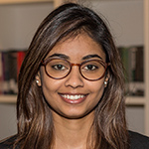
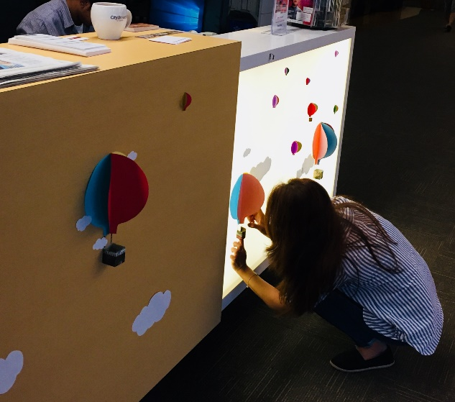
What is your super power?
Maheesa Maheen
Super power
Entropy wrangler
Library use
Keeps large, possibly chaotic, projects in order
Linh Hoang
Super Power
Visual Designer
Library use
Creates book displays and seasonal decorations
Tip: Students may not know their actual super power, assign them varied tasks before assigning them a specialty.
Notes:
In interviews, I’ve begun to ask the question: What is your superpower? In fact, I can thank my Senior Library Assistant for rewording a question to this description….and it’s odd to label a slide this, but it’s an important part of how you manage library assistants, student staff, or pages. What about this person makes them amazing and how can they use this power in the library?
How can you, the supervisor, take advantage of their super power? I have two examples…
Rohan, who you saw earlier, is still very new in the library, and I haven’t found his super power….yet.

Slide 10
Be their CHEERLEADER!!
School
Support the work they do in the school, not just the library
Example: ENACTUS competition, IT clubs
Graduation
Be there! Offer them words of encouragement.
Life
Volunteer work
If they were hired with regular volunteer hours elsewhere, think of it as a class for scheduling purposes.
Wedding plans
Get library staff in on a wedding party or gift, offer to work their schedule around activities
Job hunt post-graduation
They are your library assistants until they graduate, help them find their future!
Reminder: You may be the only positive adult role model your student staff member interacts with regularly.

Slide 11
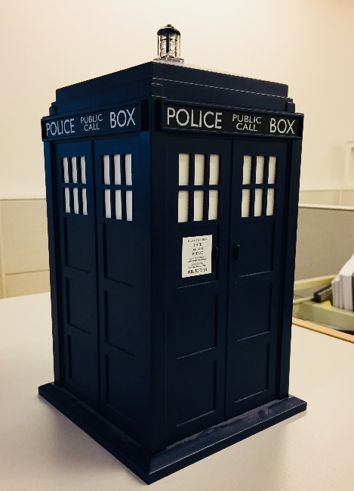
Show Appreciation
Midterms / Finals
“Cookie Jar”
Provide treats to help them study long hours.
A mix of candy, snacks, and Cup O’noodles. Think of it as things they can share and a meal to eat.
Tailor to seasons and not always food
Summer finals: hand sanitizer, Fall: Lip balm, Winter: hand lotion, Summer: sunscreen
Keep a “pantry” for when they forget breakfast or need a snack
These are often healthier items, think granola bars & pretzels…but the occasional cookie might sneak in.
This should be open to anybody who stops by… a co-worker, another student, or a homeless person looking for shelter resources.
Tip: I’m a foodie, but a hand-written card or a few spoken words can go a long way.

Slide 12
Bringing it all together…
Hire students who fit your culture and give a senior L.A. a chance to lead in training.
Schedule – Create it with the staff and give them “buy-in”
Communicate – Talk and listen to your staff about their life and work needs.
Find their super power! – Use the talent of your staff
Be a cheerleader! – Support your staff in their activities outside the library, be their mentor.
Show appreciation – They are doing a lot of work to free you and other library staff up. Money not required, but treats appreciated.

Slide 13
CU3/WAUODT
Q & A
Contact information:
Miriam Wnuk
mwnuk@cityu.edu
ill@cityu.edu
Free Lender – no charge library
LVIS
Special collection – Complete ERIC ED fiche collection
Business cards available

